Slide 1
Text Classification and Naïve Bayes
The Task of Text Classification

Slide 2
Is this spam?

Slide 3
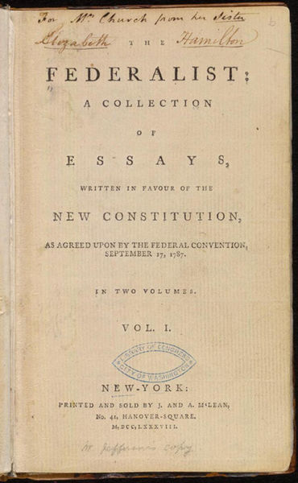
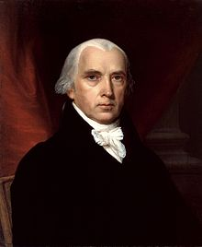
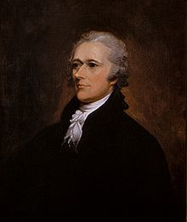
Who wrote which Federalist papers?
1787-8: anonymous essays try to convince New York to ratify (officially valid) U.S Constitution: Jay, Madison, Hamilton.
Authorship of 12 of the letters in dispute
1963: solved by Mosteller and Wallace using Bayesian methods
James Madison
Alexander Hamilton

Slide 4
Male or female author?
By 1925 present-day Vietnam was divided into three parts under French colonial rule. The southern region embracing Saigon and the Mekong delta was the colony of Cochin-China; the central area with its imperial capital at Hue was the protectorate of Annam…
Clara never failed to be astonished by the extraordinary felicity of her own name. She found it hard to trust herself to the mercy of fate, which had managed over the years to convert her greatest shame into one of her greatest assets…
S. Argamon, M. Koppel, J. Fine, A. R. Shimoni, 2003. “Gender, Genre, and Writing Style in Formal Written Texts,” Text, volume 23, number 3, pp. 321–346
Notes:
#1: Saigon. Grey, Anthony (Male, British Journalist)
#2: Jerusalem the Golden. Drabble, Margaret (Female, Novelist)
From shlomo argamon

Slide 5


Positive or negative movie review?
unbelievably disappointing
Full of zany (unconventional humor) characters and richly applied satire (exaggeration), and some great plot twists
this is the greatest screwball (crazy) comedy ever filmed
It was pathetic. The worst part about it was the boxing scenes.

Slide 6
What is the subject of this article?
MEDLINE Article
MeSH (Thesaurus) Subject Category Hierarchy
Antogonists and Inhibitors
Blood Supply
Chemistry
Drug Therapy
Embryology
Epidemiology
…
?

Slide 7
Text Classification
Assigning subject categories, topics, or genres
Spam detection
Authorship identification
Age/gender identification
Language Identification
Sentiment analysis
…

Slide 8
Text Classification: definition
Input:
a document d
a fixed set of classes C = {c₁, c₂,…, c_{J}}
Output: a predicted class c ∈ C

Slide 9
Classification Methods: Hand-coded rules
Rules based on combinations of words or other features
spam: black-list-address OR (“dollars” AND“have been selected”)
Accuracy can be high
If rules carefully refined by expert
But building and maintaining these rules is expensive

Slide 10
Classification Methods: Supervised Machine Learning
Input:
a document d
a fixed set of classes C = {c₁, c₂,…, c_{J}}
A training set of m hand-labeled documents (d₁,c₁),....,(d_{m},c_{m})
Output:
a learned classifier γ:d → c

Slide 11
Classification Methods: Supervised Machine Learning
Any kind of classifier
Naïve Bayes
Logistic regression
Support-vector machines
k-Nearest Neighbors
…

Slide 12
Text Classification and Naïve Bayes
Naïve Bayes (I)

Slide 13
Naïve Bayes Intuition
Simple (“naïve”) classification method based on Bayes rule
Relies on very simple representation of document
Bag of words

Slide 14
The Bag of Words Representation

Slide 15
The bag of words representation
seen | 2
sweet | 1
whimsical | 1
recommend | 1
happy | 1
... | ...
γ(
)=c

Slide 16
Text Classification and Naïve Bayes
Formalizing the Naïve Bayes Classifier

Slide 17

Bayes’ Rule Applied to Documents and Classes
For a document d and a class c

Slide 18
Naïve Bayes Classifier (I)
MAP is “maximum a posteriori” = most likely class
Bayes Rule
Dropping the denominator: This is possible because we will be computing P(d|c)P(c)/P(d) for each possible class. But P(d) doesn’t change for each class;

Slide 19
Naïve Bayes Classifier (II)
Document d represented as features x1..xn

Slide 20
Naïve Bayes Classifier (IV)
O(|X|^{n}•|C|) parameters
How often does this class occur?
Could only be estimated if a very, very large number of training examples was available.
We can just count the relative frequencies in a corpus

Slide 21
Multinomial (more than two parts) Naïve Bayes Independence Assumptions
Bag of Words assumption: Assume position doesn’t matter
Conditional Independence: Assume the feature probabilities P(x_{i}|c_{j}) are independent given the class c.

Slide 22
Multinomial (polynomial) Naïve Bayes Classifier

Slide 23
Applying Multinomial Naive Bayes Classifiers to Text Classification
positions ← all word positions in test document

Slide 24
Text Classification and Naïve Bayes
Naïve Bayes: Learning

Slide 25
Learning the Multinomial Naïve Bayes Model
Sec.13.3
First attempt: maximum likelihood estimates
simply use the frequencies in the data
Number of documents lies in class c_{j,} divided by total number of documents.
Count of word w_{i} in class c_{j} divided by count of all words in class c_{j}

Slide 26
Parameter estimation
fraction of times word w_{i} appears
among all words in documents of topic/class c_{j}
Create mega-document for topic/class j by concatenating all docs in this topic
Use frequency of w in mega-document

Slide 27
Problem with Maximum Likelihood
Sec.13.3
What if we have seen no training documents with the word fantastic and classified in the topic positive (thumbs-up)?
Zero probabilities cannot be conditioned away, no matter the other evidence!

Slide 28
Laplace (add-1) smoothing for Naïve Bayes

Slide 29
Multinomial Naïve Bayes: Learning
From training corpus, extract Vocabulary
Calculate P(c_{j}) terms
For each c_{j} in C do
docs_{j} ← all docs with class =c_{j}
Calculate P(w_{k} | c_{j}) terms
Text_{j} ← single doc containing all docs_{j}
For each word w_{k} in Vocabulary
n_{k} ← # of occurrences of w_{k} in Text_{j}

Slide 30
Text Classification and Naïve Bayes
Multinomial Naïve Bayes: A Worked Example

Slide 31
 | Doc | Words | Class
Training | 1 | Chinese Beijing Chinese | c
 | 2 | Chinese Chinese Shanghai | c
 | 3 | Chinese Macao | c
 | 4 | Tokyo Japan Chinese | j
Test | 5 | Chinese Chinese Chinese Tokyo Japan | ?
Priors:
P(c)=
P(j)=
3
4
1
Choosing a class:
P(c|d5)
P(j|d5)
4
3/4 * (3/7)³ * 1/14 * 1/14
≈ 0.0003
Conditional Probabilities:
P(Chinese|c) =
P(Tokyo|c) =
P(Japan|c) =
P(Chinese|j) =
P(Tokyo|j) =
P(Japan|j) =
(5+1) / (8+6) = 6/14 = 3/7
(0+1) / (8+6) = 1/14
1/4 * (2/9)³ * 2/9 * 2/9
≈ 0.0001
(0+1) / (8+6) = 1/14
(1+1) / (3+6) = 2/9
(1+1) / (3+6) = 2/9
(1+1) / (3+6) = 2/9

Slide 32
Naïve Bayes in Spam Filtering
SpamAssassin Features:
Mentions online Pharmacy for human demanding needs.
Mentions millions of (dollar) ((dollar) NN,NNN,NNN.NN)
Phrase: impress ... girl
From: starts with many numbers
Subject is all capitals
HTML has a low ratio of text to image area
One hundred percent guaranteed
Claims you can be removed from the list
'Prestigious Non-Accredited Universities'
https://spamassassin.apache.org/old/tests_3_3_x.html

Slide 33
Summary: Naive Bayes is Not So Naive
Very Fast, low storage requirements
Robust to Irrelevant Features
Irrelevant Features cancel each other without affecting results
Very good in domains with many equally important features
Decision Trees suffer from fragmentation in such cases – especially if little data
Optimal if the independence assumptions hold: If assumed independence is correct, then it is the Bayes Optimal Classifier for problem
A good dependable baseline for text classification
But we will see other classifiers that give better accuracy

Slide 34
Text Classification and Naïve Bayes
Optimizing NB Classifier for Sentiment Classification

Slide 35
Optimizing Sentiment Analysis
Some small changes are generally employed that improve performance as compared to standard NB text classification.
Binary multinomial naive Bayes or binary NB:
Same except for each document we remove all duplicate words before concatenating them into the single big document.
Worked without add-1 smoothing to make the differences clearer.
Dealing with Negation:
Prepend the prefix NOT to every word after a token of logical negation (n’t, not, no, never) until the next punctuation mark .
Insufficient labeled training data:
Sentiment lexicons: lists of words that are pre- annotated with positive or negative sentiment.

Slide 36
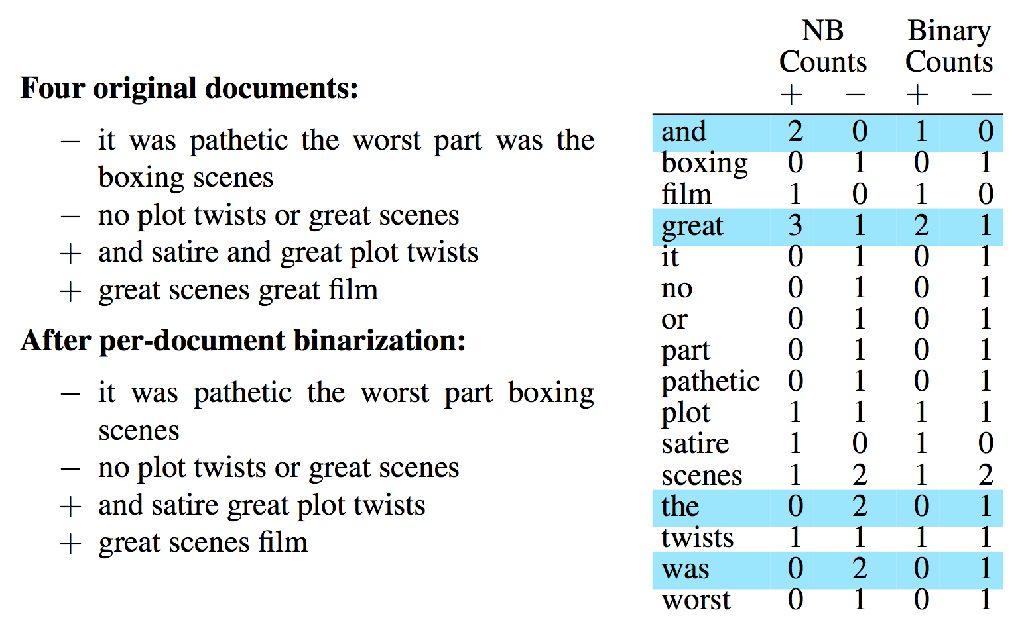
Binary multinomial NB or binary NB.

Slide 37
Dealing with Negation:
For example the phrase: didn’t like this movie , but I
Becomes: didn’t NOT_like NOT_this NOT_movie , but I
Newly formed ‘words’ like NOT_like, NOT_recommend will thus occur more often in negative document and act as cues for negative sentiment, while words like NOT_bored, NOT_dismiss will acquire positive associations.
Notes:
Logical negation (n’t, not, etc.) is not often with words like NOT_bored, NOT_dismiss and hence these words remains less in count as compared to NOT_like, NOT_recommend, etc.

Slide 38
Insufficient labeled training data:
Sentiment lexicon is used when labeled training data is deficient.
Four popular lexicons are the General Inquirer (Stone et al., 1966), LIWC (Pennebaker et al., 2007), the opinion lexicon of Hu and Liu (2004a) and the MPQA Subjectivity Lexicon (Wilson et al., 2005).
Some samples of positive and negative words from the MPQA lexicon include:
+ : admirable, beautiful, confident, dazzling, ecstatic, favor, glee, great
-: awful, bad, bias, catastrophe, cheat, deny, envious, foul, harsh, hate
Add a feature like ‘this word occurs in the positive/negative lexicon’ that is counted whenever a word from that lexicon occurs and treat all instances of words in the lexicon as counts for that one/second feature.
When training data is sparse or not representative of the test set, using dense lexicon features may generalize better.

Slide 39
Text Classification and Naïve Bayes
Naïve Bayes: Relationship to Language Modeling

Slide 40
Naïve Bayes and Language Modeling
Naïve bayes classifiers can use any sort of feature
URL, email address, dictionaries, network features, etc.
But if, as in the previous slides
We use only word features
we use all of the words in the text (not a subset)
Then
Naïve bayes has an important similarity to language modeling.

Slide 41
Each class = a unigram language model
Sec.13.2.1
Assigning each word: P(word | c)
Assigning each sentence: P(s|c)=Π P(word|c)
Class pos
0.1 I
0.1 love
0.01 this
0.05 fun
0.1 film
…
P(”I love this fun film”|+) = 0.1x 0.1x 0.01x 0.05x 0.1 = 0.0000005
Note that this is just the likelihood part of the naive Bayes model; once we multiply in the prior, a full naive Bayes model might well make a different classification decision.

Slide 42
Naïve Bayes as a Language Model
Sec.13.2.1
Which class assigns the higher probability to s?
Model pos
Model neg
0.2 I
0.001 love
0.01 this
0.005 fun
0.1 film
0.1 I
0.1 love
0.01 this
0.05 fun
0.1 film
I
love
this
fun
film
0.1
0.1
0.01
0.05
0.1
0.2
0.001
0.01
0.005
0.1
P(s|pos) > P(s|neg)

Slide 43
Text Classification and Naïve Bayes
Precision, Recall, and the F measure

Slide 44
Evaluation Example
In spam detection, our goal is to label every email as being in the spam category (“positive”) or not in the spam category (“negative”).
We also need to know whether the email is actually spam or not, i.e. the human-defined labels for each document (Gold Labels) that we are trying to match.
We start by building a contingency table like the one shown next.

Slide 45
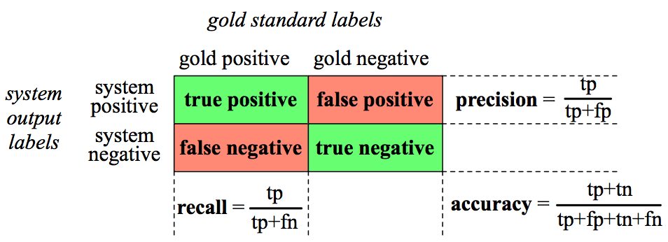
Contingency Table
For example, true positives are documents that are indeed spam (indicated by human-created gold labels) and our system said they were spam.
False negatives are documents that are indeed spam but our system labeled as non-spam.
Notes:
precision, recall, f-measure [many have seen before]
there are two sets: CORRECT entities and SELECTED entities
2x2 contingency table, four possible outcomes
for precision & recall, you're ignoring bottom corner (where you get O right)
precision: what proportion of your guesses are correct?
note that correctness means (a) correct boundaries, and (b) correct label
recall: what proportion of true entities did you get right?
ASK STUDENTS HERE ABOUT WHY NOT TO USE ACCURACY
[note that there is typically a trade-off between precision and recall!]
[to get high precision, be very reluctant to make guesses – but then you may have poor recall]
[to get high recall, be very promiscuous in making guesses – but then you may have poor precision]

Slide 46
Accuracy, Precision and Recall
Accuracy: what percentage of all the observations (for the spam examples that means all emails) our system labeled correctly.
Accuracy doesn’t work well when the classes are unbalanced.
For example: In one million tweets, only 100 are discussing their love (or hatred) for our pie, while the other 999,900 are tweets about something completely unrelated.
Imagine a simple classifier stupidly classified every tweet as “not about pie”. This classifier would have 999,900 true negatives and only 100 false negatives for an accuracy of 999,900/1,000,000 or 99.99%!
Accuracy is not a good metric when the goal is to discover something that is rare, or at least not completely balanced in frequency.
Notes:
Precision P = tp/(tp + fp)
Recall R = tp/(tp + fn)
Mention precision recall tradeoff.
precision, recall, f-measure [many have seen before]
there are two sets: CORRECT entities and SELECTED entities
2x2 contingency table, four possible outcomes
for precision & recall, you're ignoring bottom corner (where you get O right)
precision: what proportion of your guesses are correct?
note that correctness means (a) correct boundaries, and (b) correct label
recall: what proportion of true entities did you get right?
ASK STUDENTS HERE ABOUT WHY NOT TO USE ACCURACY
[note that there is typically a trade-off between precision and recall!]
[to get high precision, be very reluctant to make guesses – but then you may have poor recall]
[to get high recall, be very promiscuous in making guesses – but then you may have poor precision]

Slide 47


Accuracy, Precision and Recall
What percent of positive predictions (system based) were correct?
Precision measures the percentage of the items that the system detected (i.e., the system labeled as positive) that are in fact positive (i.e., are positive according to the human gold labels). Precision is defined as
What percent of the positive cases (given positive cases) did you catch
Recall measures the percentage of items actually present in the input (given) that were correctly identified by the system.
Notes:
Precision P = tp/(tp + fp)
Recall R = tp/(tp + fn)
Mention precision recall tradeoff.
precision, recall, f-measure [many have seen before]
there are two sets: CORRECT entities and SELECTED entities
2x2 contingency table, four possible outcomes
for precision & recall, you're ignoring bottom corner (where you get O right)
precision: what proportion of your guesses are correct?
note that correctness means (a) correct boundaries, and (b) correct label
recall: what proportion of true entities did you get right?
ASK STUDENTS HERE ABOUT WHY NOT TO USE ACCURACY
[note that there is typically a trade-off between precision and recall!]
[to get high precision, be very reluctant to make guesses – but then you may have poor recall]
[to get high recall, be very promiscuous in making guesses – but then you may have poor precision]

Slide 48
Accuracy, Precision and Recall
Precision and recall helps in solving the problem with the useless “not about pie” classifier.
This classifier, despite having a fabulous accuracy of 99.99%, has a terrible recall of 0 (since there are no true positives, and 100 false negatives, the recall is 0/100).
Precision at finding relevant tweets is equally problematic.
Precision and recall, unlike accuracy, emphasize true positives: finding the things that we are supposed to be looking for.
Notes:
Precision P = tp/(tp + fp)
Recall R = tp/(tp + fn)
Mention precision recall tradeoff.
precision, recall, f-measure [many have seen before]
there are two sets: CORRECT entities and SELECTED entities
2x2 contingency table, four possible outcomes
for precision & recall, you're ignoring bottom corner (where you get O right)
precision: what proportion of your guesses are correct?
note that correctness means (a) correct boundaries, and (b) correct label
recall: what proportion of true entities did you get right?
ASK STUDENTS HERE ABOUT WHY NOT TO USE ACCURACY
[note that there is typically a trade-off between precision and recall!]
[to get high precision, be very reluctant to make guesses – but then you may have poor recall]
[to get high recall, be very promiscuous in making guesses – but then you may have poor precision]

Slide 49


A combined measure: F
A combined measure that assesses the P and R tradeoff is F-measure (van Rijsbergen, 1975) :
β parameter weights the recall and precision. Values of β > 1 favor recall, while values of β < 1 favor precision. When β = 1, precision and recall are equally balanced; This is the most frequently used metric, and is called F_{β}=1 or just F₁ .

Slide 50
Text Classification and Naïve Bayes
Text Classification: Evaluation

Slide 51
More Than Two Classes: Sets of binary classifiers
Sec.14.5
There are two kinds of multi-class classification tasks.
Any-of or multi-label classification: a document can belong to 0, 1, or >1 classes.
For each class c_{i}∈C
Build a classifier γ_{ci} to distinguish c_{i} from all other classes c’ ∈C
Given test doc d,
Evaluate it for membership in each class c_{i} using each γ_{ci}
d belongs to any class for which γ_{ci} returns true.

Slide 52
More Than Two Classes: Sets of binary classifiers
Sec.14.5
One-of or multinomial classification: Classes are mutually exclusive, each document in exactly one class.
For each class c_{i}∈C
Build a classifier γ_{ci} to distinguish c_{i} from all other classes c’ ∈C
Given test doc d,
Evaluate it for membership in each class c_{i} using each γ_{ci}
d belongs to the one class with maximum score

Slide 53
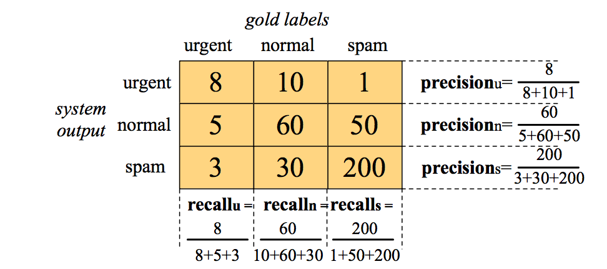
Evaluation
Sec.14.5
How to compute a distinct precision and recall value for each class?
For example confusion matrix for a hypothetical 3 way one-of email categorization decision (urgent, normal, spam).

Slide 54
Evaluation
Sec.14.5
Derive a single metric that tells us how well the system is doing, we can combine these values in two ways.
In macroaveraging, we compute the performance for each class, and then average over classes.
In microaveraging, we collect the decisions for all classes into a single contingency table, and then compute precision and recall from that table.

Slide 55
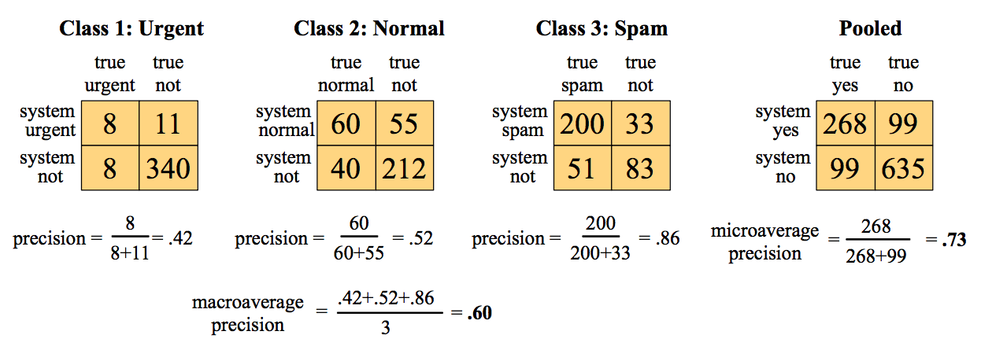
Evaluation
Sec.14.5
A microaverage is dominated by the more frequent class (in this case spam), since the counts are pooled.
The macroaverage better reflects the statistics of the smaller classes, and so is more appropriate when performance on all the classes is equally important.

Slide 56
Development Test Sets and Cross-validation
Having a fixed training set, devset, and test set creates problem: the test set (or devset) might not be large enough to be representative.
Better to use all data for training and test by cross-validation:
Randomly choose a training and test set division of data, train classifier, and then compute the error rate on the test set.
Repeat step 1 with a different randomly selected training and test sets.
Do this process 10 times and average these 10 runs to get an average error rate. This is called 10-fold cross-validation.

Slide 57
Development Test Sets and Cross-validation
Cross-validation has a problem of all data usage for testing means known test data which should be blind.
Looking at the corpus is often important for designing the system to suggest possible features or to see what’s going on.
Create a fixed training set and test set, then do 10-fold cross-validation inside the training set, but compute error rate the normal way in the test set, as shown in Fig next.

Slide 58
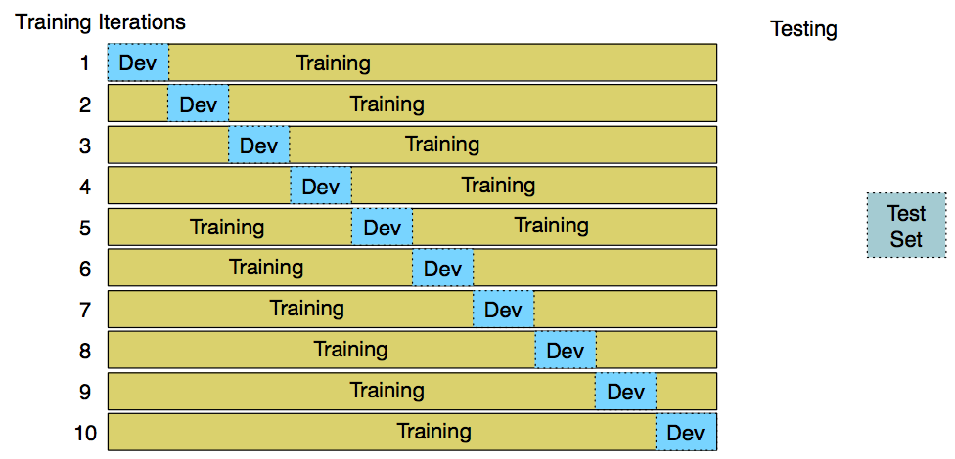
Development Test Sets and Cross-validation

Slide 59
Text Classification and Naïve Bayes
Text Classification: Statistical Significance Testing

Slide 60
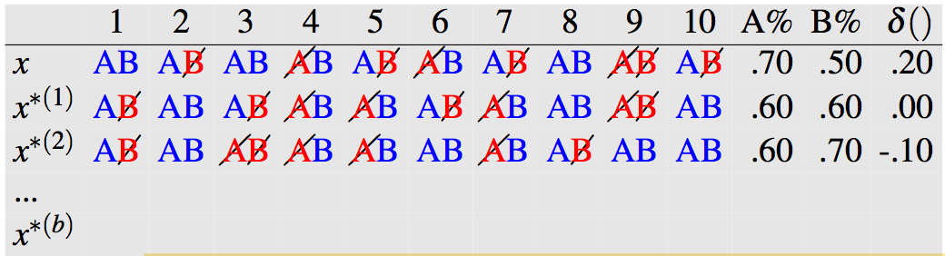
Statistical Significance Testing
Sec. 15.3.1
Often we want to compare our new version of the system to the unaugmented version. Or we want to compare our algorithm to a previously published one to know which is better.
In NLP, we can answer it through bootstrap test (Efron and Tibshirani, 1993) or a similar test, approximate randomization (Noreen, 1989).
Let’s say we have a test set x of n observations x = x1,x2,..,xn on which A’s performance is better than B by δ(x).

Slide 61
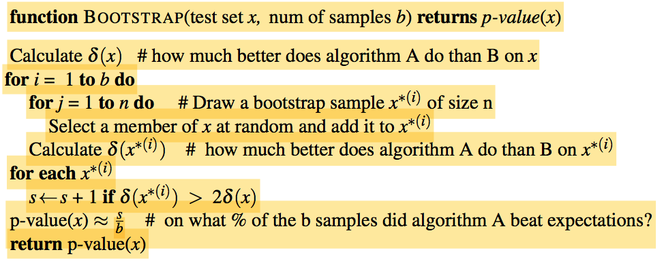
Statistical Significance Testing
Sec. 15.3.1
If we assume for simplicity that our metric is accuracy, A has an accuracy of .70 and B of .50, so δ(x) is .20.

Slide 62
Text Classification and Naïve Bayes
Text Classification: Practical Issues

Slide 63
Practical Issues
Sec. 15.3.1
What should I do?
Manually written rules (need careful crafting).
Very little data (use Naïve Bayes or semi supervised training methods).
A reasonable amount of data or huge data (SVM, Regularized Logistic Regression, Naïve Bayes)
Accuracy as a function of data size
Real-world systems generally combine Automatic classification and Manual review of uncertain/difficult/"new” cases
Underflow Prevention: log space
Etc.

Slide 64
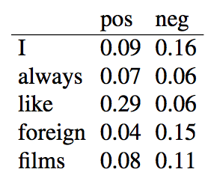
Homework #04 Use Python for all parts
(a): Assume the following likelihoods for each word being part of a positive or negative movie review, and equal prior probabilities for each class.
What class will Naive bayes assign to the sentence “I always like foreign films.”?

Slide 65
Homework #04 Use Python for all parts
(b): Given the following short movie reviews, each labeled with a genre, either comedy or action:
fun, couple, love, love comedy
fast, furious, shoot action
couple, fly, fast, fun, fun comedy
furious, shoot, shoot, fun action
fly, fast, shoot, love action
and a new document D: fast, couple, shoot, fly
compute the most likely class for D. Assume a naive Bayes classifier and use add-1 smoothing for the likelihoods.

Slide 66
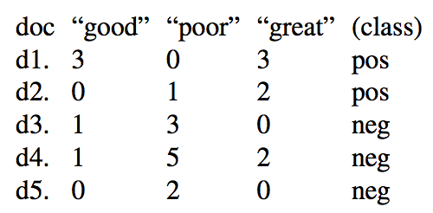
Homework #04 Use Python for all parts
(c): Train two models, multinominal naive Bayes and binarized naive Bayes, both with add-1 smoothing, on the following document counts for key sentiment words, with positive or negative class assigned as noted.
Use both naive Bayes models to assign a class (pos or neg) to this sentence: A good, good plot and great characters, but poor acting.
Do the two models agree or disagree?

