Slide 1
Minimum Edit Distance
Definition of Minimum Edit Distance

Slide 2
How similar are two strings?
Spell correction
  The user typed “graffe”
  Which is closest?
    graf
    graft
    grail
    giraffe
Computational Biology
  Align two sequences of nucleotides
  Resulting alignment:
AGGCTATCACCTGACCTCCAGGCCGATGCCC
TAGCTATCACGACCGCGGTCGATTTGCCCGAC
-AGGCTATCACCTGACCTCCAGGCCGA--TGCCC---
TAG-CTATCAC--GACCGC--GGTCGATTTGCCCGAC
Also for Machine Translation, Information Extraction, Speech Recognition

Slide 3
Edit Distance
The minimum edit distance between two strings
Is the minimum number of editing operations
  Insertion
  Deletion
  Substitution
Needed to transform one string into the other

Slide 4
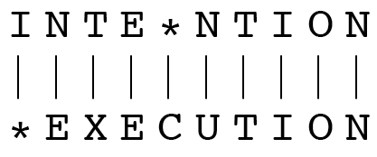
Minimum Edit Distance
Two strings and their alignment:

Slide 5
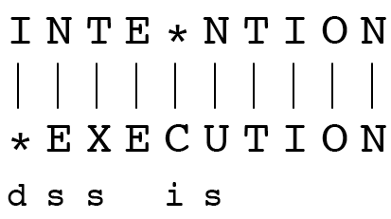
Minimum Edit Distance
If each operation has cost of 1
  Distance between these is 5
If substitutions cost 2 (Levenshtein)
  Distance between them is 8

Slide 6
Alignment in Computational Biology
Given a sequence of bases
An alignment:
Given two sequences, align each letter to a letter or gap
AGGCTATCACCTGACCTCCAGGCCGATGCCC
TAGCTATCACGACCGCGGTCGATTTGCCCGAC
-AGGCTATCACCTGACCTCCAGGCCGA--TGCCC---
TAG-CTATCAC--GACCGC--GGTCGATTTGCCCGAC

Slide 7
Other uses of Edit Distance in NLP
Evaluating Machine Translation and speech recognition
R Spokesman confirms senior government adviser was shot
H Spokesman said the senior adviser was shot dead
S I D I
Named Entity Extraction and Entity Co-reference
  IBM Inc. announced today
  IBM profits
  Stanford President John Hennessy announced yesterday
  for Stanford University President John Hennessy

Slide 8
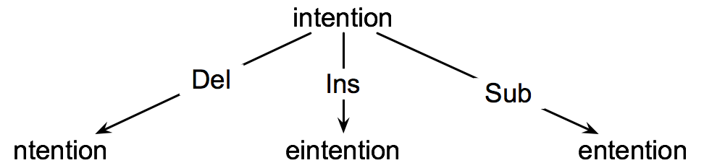
How to find the Min Edit Distance?
Searching for a path (sequence of edits) from the start string to the final string:
  Initial state: the word we’re transforming
  Operators: insert, delete, substitute
  Goal state: the word we’re trying to get to
  Path cost: what we want to minimize: the number of edits

Slide 9
Minimum Edit as Search
But the space of all edit sequences is huge! (many possibilities)
  We can’t afford to navigate naïvely (lack of wisdom)
  Lots of distinct paths wind up at the same state.
    We don’t have to keep track of all of them
    Just the shortest path to each of those revisited states.

Slide 10
Defining Min Edit Distance
For two strings
  X of length n
  Y of length m
We define D(i,j)
  the edit distance between X[1..i] and Y[1..j]
    i.e., the first i characters of X and the first j characters of Y
  The edit distance between X and Y is thus D(n,m)

Slide 11
Minimum Edit Distance
Computing Minimum Edit Distance

Slide 12
Dynamic Programming for
Minimum Edit Distance
Dynamic programming: A tabular computation of D(n,m)
Solving problems by combining solutions to subproblems.
Bottom-up
  We compute D(i,j) for small i,j
  And compute larger D(i,j) based on previously computed smaller values
  i.e., compute D(i,j) for all i (0 < i < n) and j (0 < j < m)

Slide 13
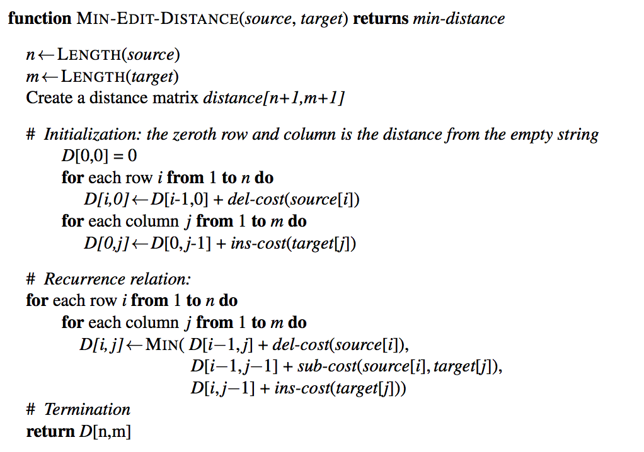
Defining Min Edit Distance (Levenshtein)

Slide 14
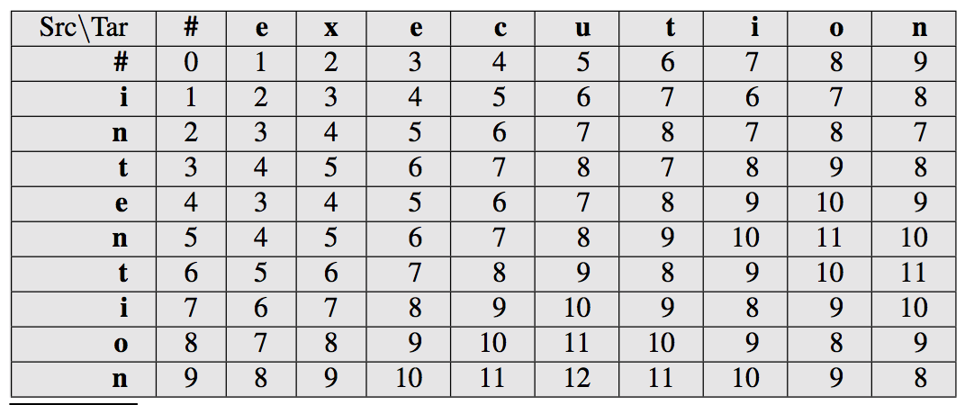
The Edit Distance Table

Slide 15
Minimum Edit Distance
Backtrace for Computing Alignments

Slide 16
Computing alignments
Edit distance isn’t sufficient
  We often need to align each character of the two strings to each other
We do this by keeping a “backtrace”
Every time we enter a cell, remember where we came from
When we reach the end,
  Trace back the path towards the upper right corner to read off the alignment

Slide 17
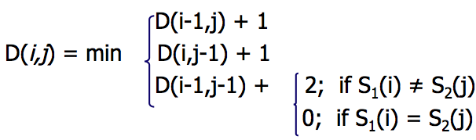
Edit Distance
N | 9
O | 8
I | 7
T | 6
N | 5
E | 4
T | 3
N | 2
I | 1
# | 0 | 1 | 2 | 3 | 4 | 5 | 6 | 7 | 8 | 9
 | # | E | X | E | C | U | T | I | O | N

Slide 18
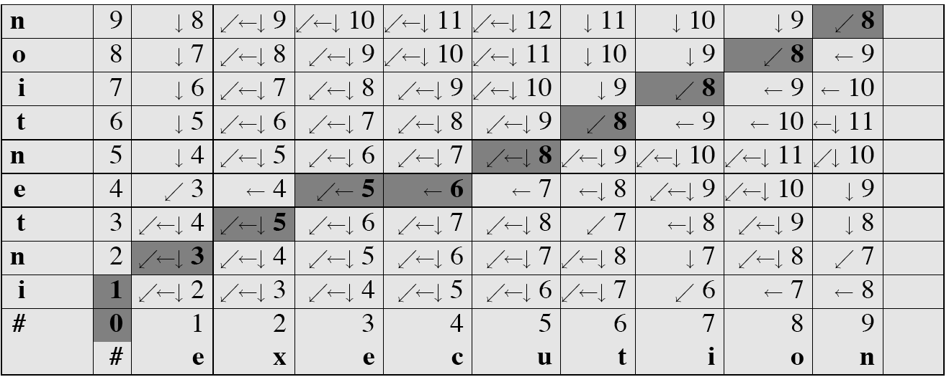
MinEdit with Backtrace

Slide 19
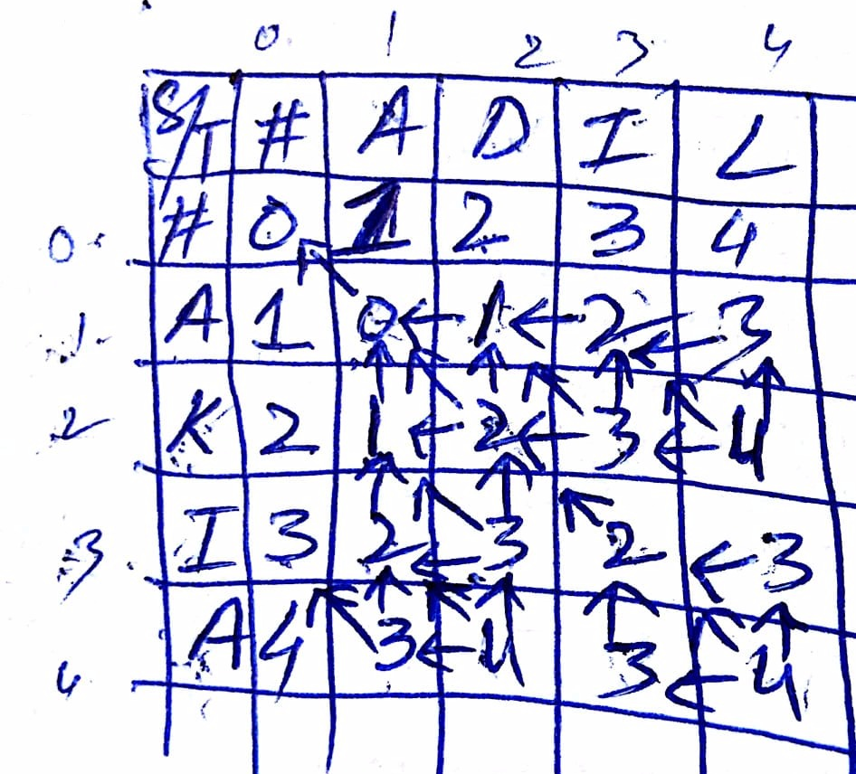
MinEdit with Backtrace

Slide 20
Adding Backtrace to Minimum Edit Distance
Recurrence Relation:
  For each i = 1…M
  For each j = 1…N
  D(i-1,j) + 1
  D(i,j)= min D(i,j-1) + 1
  D(i-1,j-1) + 2; if X(i) ≠ Y(j)
  0; if X(i) = Y(j)
  LEFT
  ptr(i,j)= DOWN
  DIAG
deletion
insertion
substitution
insertion
deletion
substitution

Slide 21
The Distance Matrix
Every non-decreasing path
from (0,0) to (M, N)
corresponds to
an alignment
of the two sequences
x₀ …………………… x_{N}
An optimal alignment is composed of optimal subalignments
y₀ ……………………………… y_{M}

Slide 22
Result of Backtrace
Two strings and their alignment:

Slide 23
Performance
Time:
  O(nm)
Space:
  O(nm)
Backtrace
  O(n+m)

Slide 24
Minimum Edit Distance
Weighted Minimum Edit Distance

Slide 25
Weighted Edit Distance
Why would we add weights to the computation?
  Spell Correction: some letters are more likely to be mistyped than others
  Biology: certain kinds of deletions or insertions are more likely than others

Slide 26
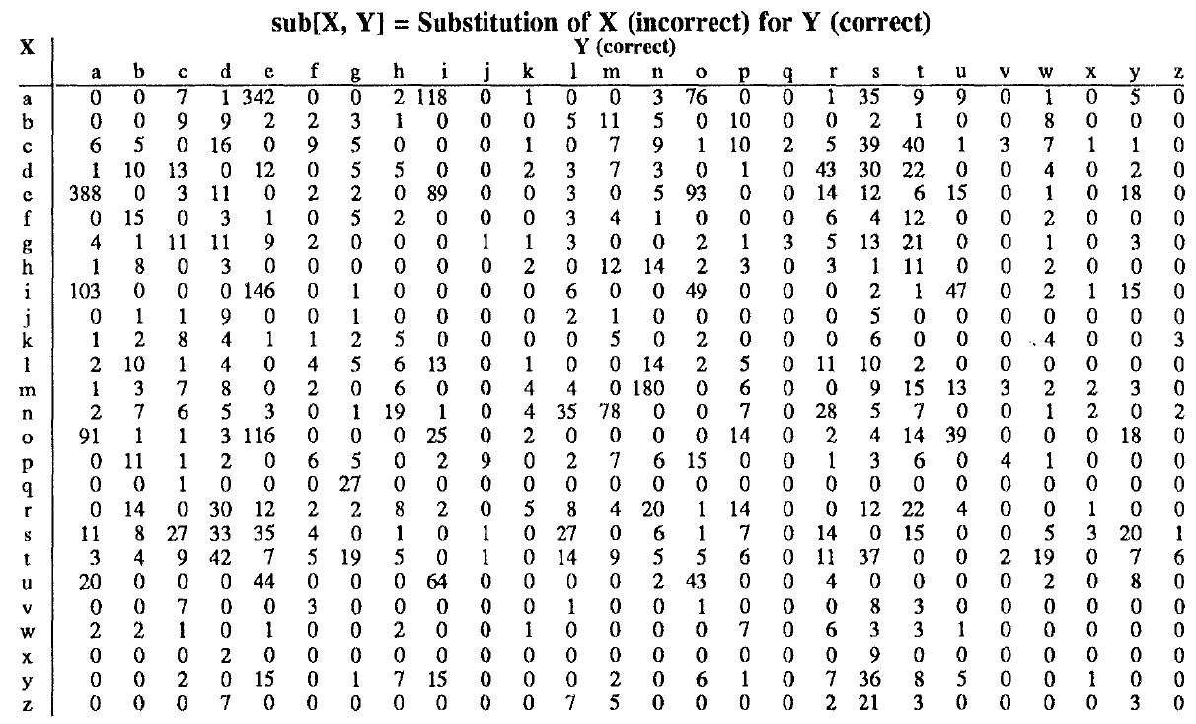
Confusion matrix for spelling errors

Slide 27
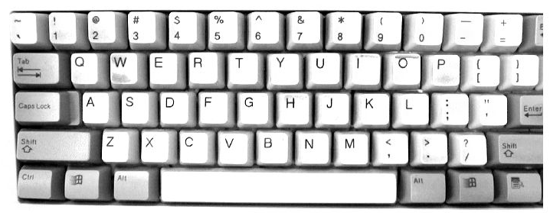

Slide 28
Weighted Min Edit Distance
Initialization:
  D(0,0) = 0
  D(i,0) = D(i-1,0) + del[x(i)]; 1 < i ≤ N
  D(0,j) = D(0,j-1) + ins[y(j)]; 1 < j ≤ M
Recurrence Relation:
  D(i-1,j) + del[x(i)]
  D(i,j)= min D(i,j-1) + ins[y(j)]
  D(i-1,j-1) + sub[x(i),y(j)]
Termination:
  D(N,M) is distance

Slide 29
Where did the name, dynamic programming, come from?
…The 1950s were not good years for mathematical research. [the] Secretary of Defense …had a pathological fear and hatred of the word, research…
I decided therefore to use the word, “programming”.
I wanted to get across the idea that this was dynamic, this was multistage… I thought, let’s … take a word that has an absolutely precise meaning, namely dynamic… it’s impossible to use the word, dynamic, in a pejorative sense. Try thinking of some combination that will possibly give it a pejorative meaning. It’s impossible.
Thus, I thought dynamic programming was a good name. It was something not even a Congressman could object to.”
Richard Bellman, “Eye of the Hurricane: an autobiography” 1984.

Slide 30
Minimum Edit Distance
Minimum Edit Distance in Computational Biology

Slide 31
Sequence Alignment
AGGCTATCACCTGACCTCCAGGCCGATGCCC
TAGCTATCACGACCGCGGTCGATTTGCCCGAC
-AGGCTATCACCTGACCTCCAGGCCGA--TGCCC---
TAG-CTATCAC--GACCGC--GGTCGATTTGCCCGAC

Slide 32
Why sequence alignment?
Comparing genes or regions from different species
  to find important regions
  determine function
  uncover evolutionary forces
Assembling fragments to sequence DNA
Compare individuals to looking for mutations

Slide 33
Alignments in two fields
In Natural Language Processing
  We generally talk about distance (minimized)
    And weights
In Computational Biology
  We generally talk about similarity (maximized)
    And scores

Slide 34
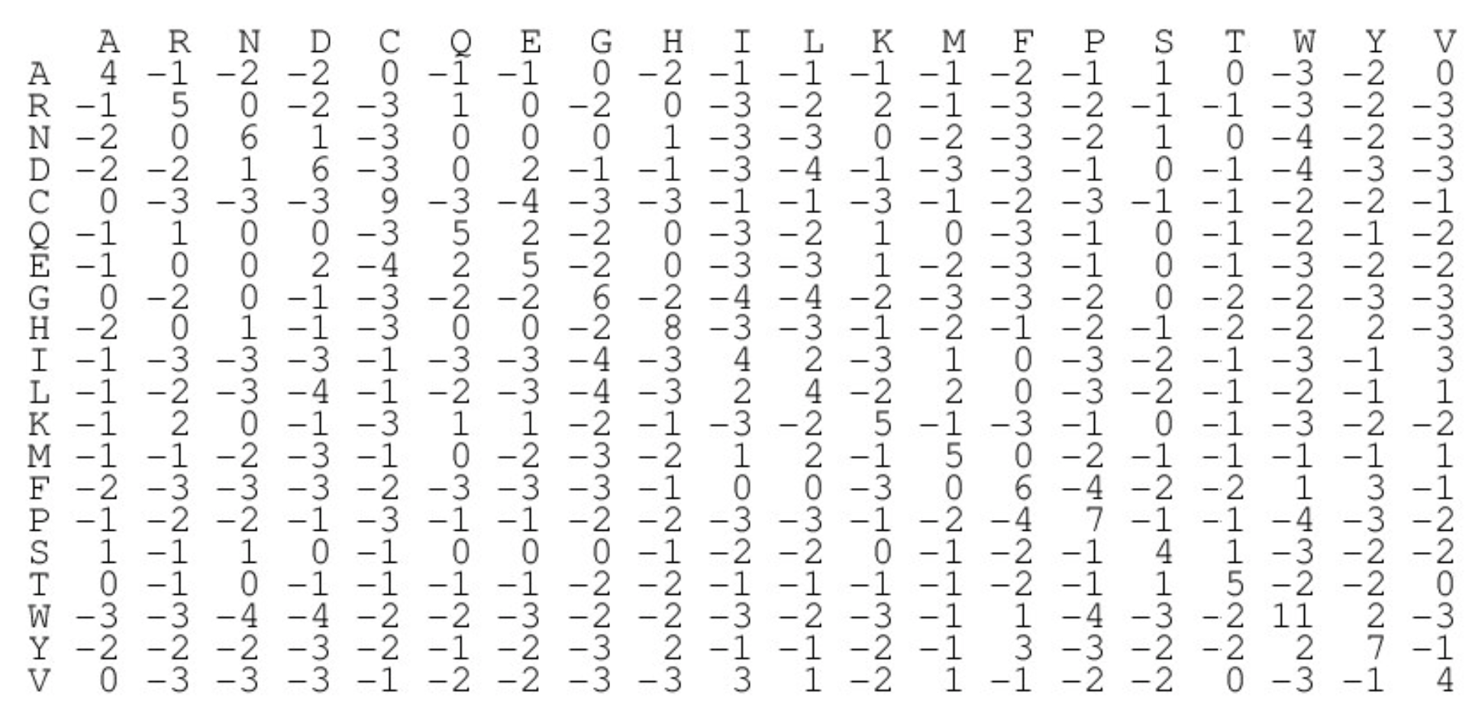
BLOSUM62 substitution matrix
Henikoff S, Henikoff JG. Amino acid substitution matrices from protein blocks. Proc Natl Acad Sci U S A. 1992;89(22):10915-9.
To understand it in detail, see the video: https://www.youtube.com/watch?v=ZUjAKgVrir4

Slide 35
The alignment score with BLOSUM62
Consider two alternative alignments of ANRGDFS and ANREFS with the gap opening penalty of 10:
  ANRGDFS
  ANR-EFS score: 4+6+5−10+2+6+4 = 17
  ANRGDFS
  ANRE-FS score: 4+6+5−2−10+6+4 = 13
The scoring scheme provides us with the quantitative measure of how good is some alignment relative to alternative alignments. However the scoring scheme does not tell us how to find the best alignment.

Slide 36
The Needleman-Wunsch Algorithm
A smart way to reduce the massive number of possibilities that need to be considered, yet still guarantees that the best solution will be found (Saul Needleman and Christian Wunsch, 1970).
The basic idea is to build up the best alignment by using optimal alignments of smaller subsequences.
The Needleman-Wunsch algorithm is an example of dynamic programming, a discipline invented by Richard Bellman (an American mathematician) in 1953!

Slide 37
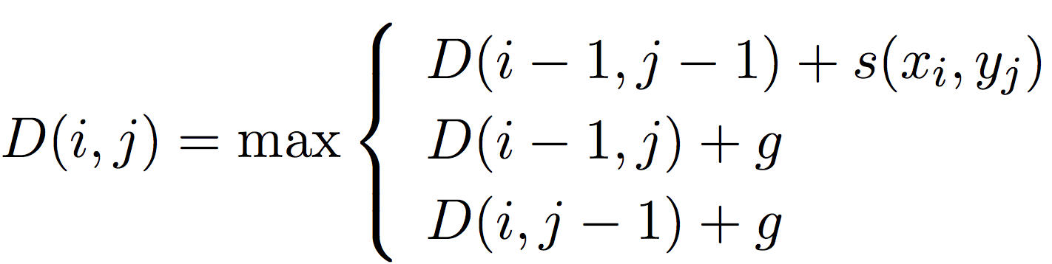
The Needleman-Wunsch Algorithm
A matrix D(i, j) indexed by residues of each sequence is built recursively, such that
Subject to a boundary conditions. s(i, j) is the substitution score for residues i and j, and g is the gap penalty.

Slide 38
The Needleman-Wunsch Algorithm
We consider all possible pairs of residue from two sequences (this gives rise to a 2D matrix representation).
We will have two matrices: the score matrix and traceback matrix.
The Needleman-Wunsch algorithm consists of three steps:
  Initialization of the score matrix
  Calculation of scores and filling the traceback matrix
  Deducing the alignment from the traceback matrix

Slide 39
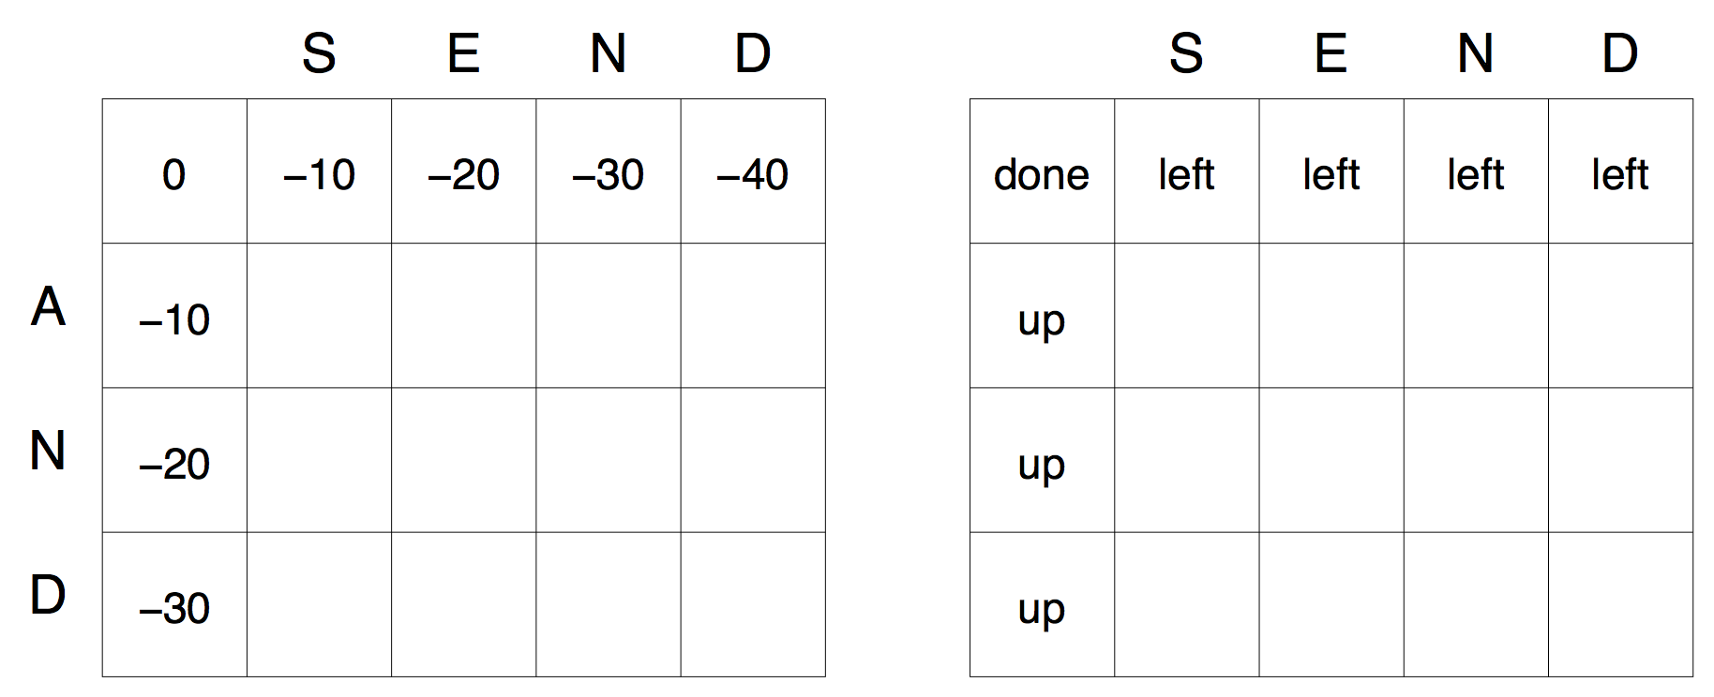
The Needleman-Wunsch Algorithm
The first row and the first column of the score and traceback matrices are filled during the initialization.

Slide 40
The Needleman-Wunsch Algorithm
The calculation for the cell C (2, 2):
    q_{diag} = C(1,1)+S(S,A) =0+1=1
    q_{up} = C(1,2)+g=−10+(−10) =−20
    q_{left} = C(2,1)+g=−10+(−10) =−20
Where C(1, 1), C(1, 2), and C(2, 1) are read from the score matrix, and S(S, A) is the score for the S ↔ A taken from the BLOSUM62 matrix.

Slide 41
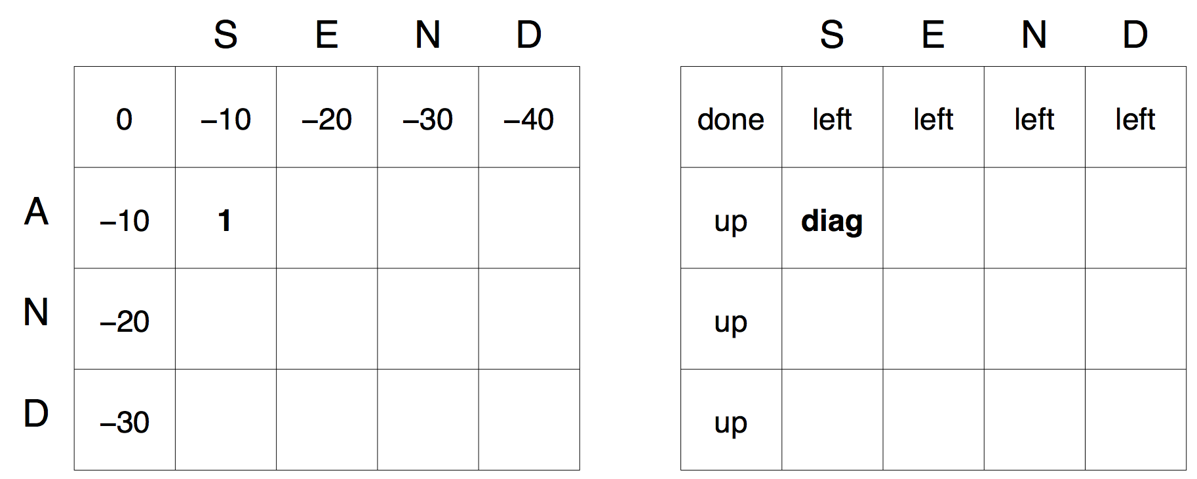
The Needleman-Wunsch Algorithm
For the score matrix C(2, 2) = q_{diag} which is 1. The corresponding cell of the traceback matrix is ”diag”:

Slide 42
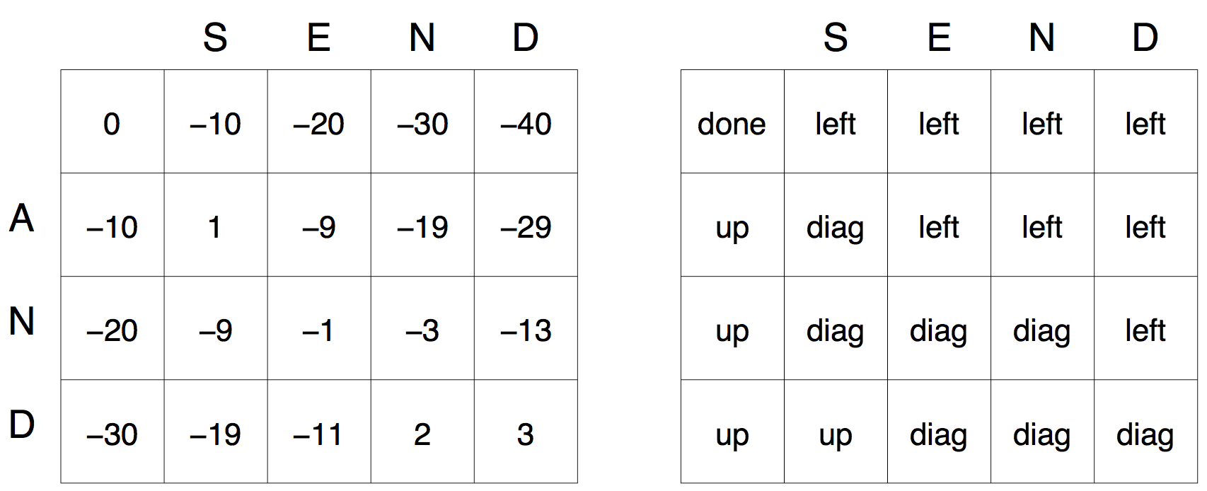
The Needleman-Wunsch Algorithm
The calculation for the cell C (2, 3):
    q_{diag} = C(1,2)+S(E,A) =−10+−1=−11
    q_{up} = C(1,3)+g =−20+(−10)=−30
    q_{left} = C(2,2)+g =1+(−10)=−9

Slide 43
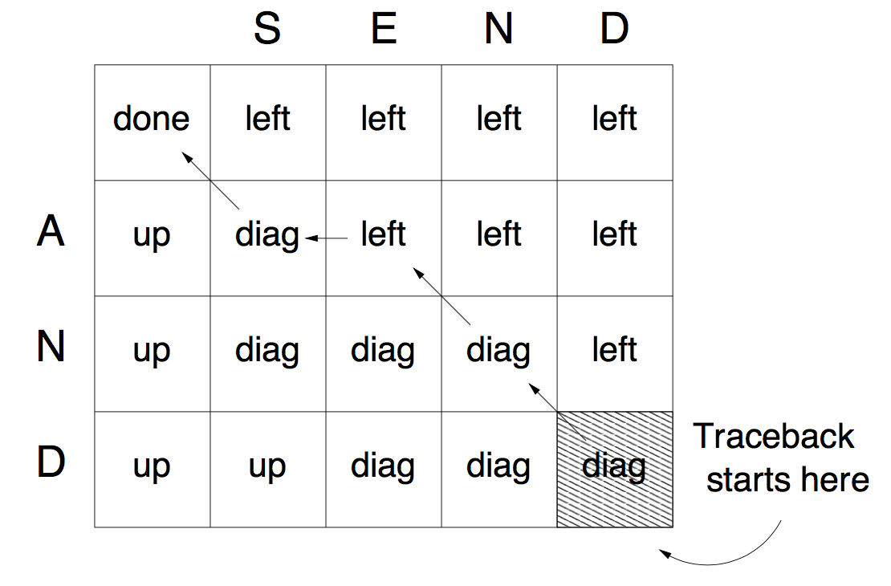
The Needleman-Wunsch Algorithm
The traceback performed on the completed traceback matrix:

Slide 44
The Needleman-Wunsch Algorithm
The alignment is deduced from the values of cells along the traceback path, by taking into account the values of the cell in the traceback matrix:
  diag – the letters from two sequences are aligned
  left – a gap is introduced in the left sequence
  up – a gap is introduced in the top sequence
Sequences are aligned backwards.

Slide 45
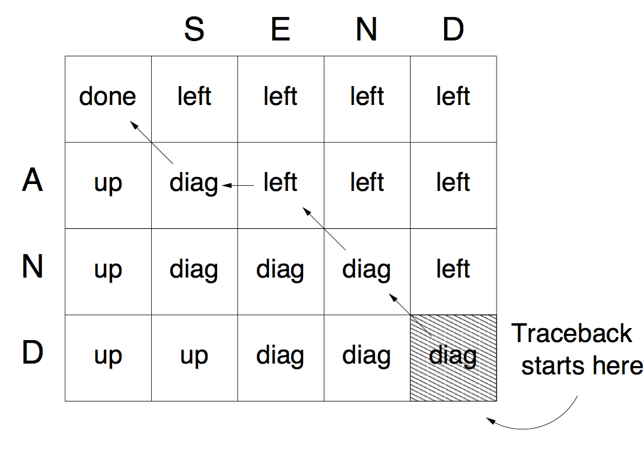
The Needleman-Wunsch Algorithm
The fourth cell from the traceback path is also ”diag” implying that the corresponding letters are aligned. We consider the letter A again, this time it is aligned with S:
      SEND
      A-ND

Slide 46
Smith Waterman Algorithm
Smith, Temple F. & Waterman, Michael S. (1981). "Identification of Common Molecular Subsequences" (PDF). Journal of Molecular Biology. 147: 195–197.
For alignment problems. Read it by yourself
Can be seen at the following lecture slides:
    http://docencia.ac.upc.edu/master/AMPP/slides/ampp_sw_presentation.pdf

Slide 47
Homework #2
Augment the minimum edit distance algorithm in Python to output an alignment; you will need to store pointers and add a stage to compute the backtrace.
Implement the Needleman-Wunsch and Smith-Waterman algorithm in Python: Check the code at https://github.com/alevchuk/pairwise-alignment-in-python

Slide 48
Sources To Be Tested
Currently a wide variety of code for tokenization and normalization is available, such as the Stanford Tokenizer ( https://nlp.stanford.edu/software/tokenizer.shtml ).
Specialized tokenizers for Twitter Or for sentiment (http://sentiment.christopherpotts.net/tokenizing.html ).
NLTK is an essential tool that offers both useful Python libraries ( http://www.nltk.org ) and many algorithms including text normalization and corpus interfaces.

Slide 49
Articles To Be Read
Specialized tokenizers for Twitter:
  (O’Connor, B., Krieger, M., and Ahn, D. (2010). Tweetmo- tif: Exploratory search and topic summarization for twitter. In ICWSM. )
For a Survey of Text Processing:
  (Palmer, D. (2012). Text preprocessing. In Indurkhya, N. and Damerau, F. J. (Eds.), Handbook of Natural Language Processing, pp. 9–30. CRC Press. )
Max-match algorithm we describe is commonly used as a segmentation baseline in languages like Chinese, higher accuracy algorithms like the Stanford CRF segmenter, are based on sequence models:
  (Chang, P.-C., Galley, M., and Manning, C. D. (2008). Opti- mizing Chinese word segmentation for machine translation performance. In Proceedings of ACL Statistical MT Work- shop, pp. 224–232. )
  (Tseng, H., Chang, P.-C., Andrew, G., Jurafsky, D., and Man- ning, C. D. (2005a). Conditional random field word seg- menter. In Proceedings of the Fourth SIGHAN Workshop on Chinese Language Processing. )

