Slide 1
Grading
Final Term: 40 %
Term Paper: 30%
Assignments and Quizzes: 30%

Slide 2
Basic Text Processing
Regular Expressions

Slide 3
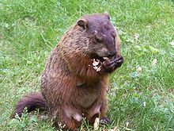
Regular expressions
A formal language for specifying text strings
How can we search for any of these?
  woodchuck
  woodchucks
  Woodchuck
  Woodchucks

Slide 4
Regular Expressions: Disjunctions
Letters inside square brackets []
Ranges [A-Z]
Pattern | Matches
[wW]oodchuck | Woodchuck, woodchuck
[1234567890] | Any digit
Pattern | Matches
[A-Z] | An upper case letter | Drenched Blossoms
[a-z] | A lower case letter | my beans were impatient
[0-9] | A single digit | Chapter 1: Down the Rabbit Hole

Slide 5
Regular Expressions: Negation in Disjunction
Negations [^Ss]
  Carat means negation only when first in []
Pattern | Matches
[^A-Z] | Not an upper case letter | Oyfn pripetchik
[^Ss] | Neither ‘S’ nor ‘s’ | I have no exquisite reason”
a^b | The pattern a carat b | Look up a^b now

Slide 6
Regular Expressions: More Disjunction
Woodchucks is another name for groundhog!
The pipe | for disjunction
Pattern | Matches
groundhog|woodchuck
yours|mine | yours mine
a|b|c | = [abc]
[gG]roundhog|[Ww]oodchuck

Slide 7
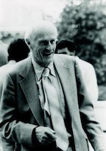
Regular Expressions: ? * + .
Pattern | Matches
colou?r | Optional previous char | color colour
oo*h! | 0 or more of previous char | oh! ooh! oooh! ooooh!
o+h! | 1 or more of previous char | oh! ooh! oooh! ooooh!
baa+ |  | baa baaa baaaa baaaaa
beg.n |  | begin begun begun beg3n
Stephen C Kleene
Kleene *, Kleene +

Slide 8
Regular Expressions: Anchors ^ $
Pattern | Matches
^[A-Z] | Palo Alto
^[^A-Za-z] | 1 “Hello”
\.$ | The end.
.$ | The end? The end!

Slide 9
Example
Find me all instances of the word “the” in a text.
  the
    Misses capitalized examples
  [tT]he
    Incorrectly returns other or theology
  [^a-zA-Z][tT]he[^a-zA-Z]

Slide 10
Errors
The process we just went through was based on fixing two kinds of errors
  Matching strings that we should not have matched (there, then, other)
    False positives (Type I)
  Not matching things that we should have matched (The)
    False negatives (Type II)

Slide 11
Errors cont.
In NLP we are always dealing with these kinds of errors.
Reducing the error rate for an application often involves two antagonistic (active opposition or hostility) efforts:
  Increasing accuracy or precision (minimizing false positives)
  Increasing coverage or recall (minimizing false negatives).
Notes:
Calculating precision and recall is actually quite easy. Imagine there are 100 positive cases among 10,000 cases. You want to predict which ones are positive, and you pick 200 to have a better chance of catching many of the 100 positive cases. You record the IDs of your predictions, and when you get the actual results you sum up how many times you were right or wrong. There are four ways of being right or wrong:
TN / True Negative: case was negative and predicted negative
TP / True Positive: case was positive and predicted positive
FN / False Negative: case was positive but predicted negative
FP / False Positive: case was negative but predicted positive
Makes sense so far? Now you count how many of the 10,000 cases fall in each bucket, say:
Predicted Negative Predicted Positive
Negative Cases TN: 9,760 FP: 140
Positive Cases FN: 40 TP: 60
Now, your boss asks you three questions:
What percent of your predictions were correct?
You answer: the "accuracy" was (9,760+60) out of 10,000 = 98.2%
What percent of the positive cases did you catch?
You answer: the "recall" was 60 out of 100 = 60%
What percent of positive predictions were correct?
You answer: the "precision" was 60 out of 200 = 30%

Slide 12
Errors cont.
Calculating precision and recall is actually quite easy. Imagine there are 100 positive cases among 10,000 cases. You want to predict which ones are positive, and you pick 200 to have a better chance of catching many of the 100 positive cases. You record the IDs of your predictions, and when you get the actual results you sum up how many times you were right or wrong. There are four ways of being right or wrong:
TN / True Negative: case was negative and predicted negative
TP / True Positive: case was positive and predicted positive
FN / False Negative: case was positive but predicted negative
FP / False Positive: case was negative but predicted positive
Makes sense so far? Now you count how many of the 10,000 cases fall in each bucket, say:

Slide 13
Errors cont.
Predicted Negative Predicted Positive
Negative Cases TN: 9,760 FP: 140
Positive Cases FN: 40 TP: 60
Now, your boss asks you three questions:
What percent of your predictions were correct?
You answer: the "accuracy" was (9,760+60) out of 10,000 = 98.2%
What percent of the positive cases did you catch?
You answer: the "recall" was 60 out of 100 = 60%
What percent of positive predictions were correct?
You answer: the "precision" was 60 out of 200 = 30%

Slide 14
Summary
Regular expressions play a surprisingly large role
  Sophisticated sequences of regular expressions are often the first model for any text processing text
For many hard tasks, we use machine learning classifiers
  But regular expressions are used as features in the classifiers
  Can be very useful in capturing generalizations

Slide 15
Basic Text Processing
Word tokenization

Slide 16
Text Normalization
Every NLP task needs to do text normalization:
  Segmenting/tokenizing words in running text
  Normalizing word formats
  Segmenting sentences in running text

Slide 17
How many words?
I do uh main- mainly business data processing
  Fragments, filled pauses
Seuss’s cat in the hat is different from other cats!
  Lemma: same stem, part of speech, rough word sense
    cat and cats = same lemma
  Wordform: the full inflected surface form
    cat and cats = different wordforms

Slide 18
How many words?
they lay back on the San Francisco grass and looked at the stars and their
Type: an element of the vocabulary.
Token: an instance of that type in running text.
How many?
  15 tokens (or 14)
  13 types (or 12) (or 11?)

Slide 19
How many words?
N = number of tokens
V = vocabulary = set of types
  |V| is the size of the vocabulary
 | Tokens = N | Types = |V|
Switchboard phone conversations | 2.4 million | 20 thousand
Shakespeare | 884,000 | 31 thousand
Google N-grams | 1 trillion | 13 million

Slide 20
Simple Tokenization in UNIX
(Inspired by Ken Church’s UNIX for Poets.)
Given a text file, output the word tokens and their frequencies
tr -sc ’A-Za-z’ ’\n’ < shakes.txt
| sort
| uniq –c
1945 A
72 AARON
19 ABBESS
5 ABBOT
... ...
Change all non-alpha to newlines
Sort in alphabetical order
Merge and count each type
25 Aaron
6 Abate
1 Abates
5 Abbess
6 Abbey
3 Abbot
.... …

Slide 21
The first step: tokenizing
tr -sc ’A-Za-z’ ’\n’ < shakes.txt | head
//head only shows first 10 lines from the file
THE
SONNETS
by
William
Shakespeare
From
fairest
creatures
We
...

Slide 22
The second step: sorting
tr -sc ’A-Za-z’ ’\n’ < shakes.txt | sort | head
A
A
A
A
A
A
A
A
A
...

Slide 23
More counting
Merging upper and lower case
tr ‘A-Z’ ‘a-z’ < shakes.txt | tr –sc ‘A-Za-z’ ‘\n’ | sort | uniq –c
Sorting the counts
tr ‘A-Z’ ‘a-z’ < shakes.txt | tr –sc ‘A-Za-z’ ‘\n’ | sort | uniq –c | sort –n –r
23243 the
22225 i
18618 and
16339 to
15687 of
12780 a
12163 you
10839 my
10005 in
8954 d
What happened here?

Slide 24
Issues in Tokenization
Finland’s capital → Finland Finlands Finland’s ?
what’re, I’m, isn’t → What are, I am, is not
Hewlett-Packard → Hewlett Packard ?
state-of-the-art → state of the art ?
Lowercase → lower-case lowercase lower case ?
San Francisco → one token or two?
m.p.h., PhD. → ??

Slide 25
Tokenization: language issues
French
  L'ensemble → one token or two?
    L ? L’ ? Le ?
    Want l’ensemble to match with un ensemble
German noun compounds are not segmented
  Lebensversicherungsgesellschaftsangestellter
  ‘life insurance company employee’
  German information retrieval needs compound splitter

Slide 26
Tokenization: language issues
Chinese and Japanese no spaces between words:
  莎拉波娃现在居住在美国东南部的佛罗里达。
  莎拉波娃 现在 居住 在 美国 东南部 的 佛罗里达
  Sharapova now lives in US southeastern Florida
Further complicated in Japanese, with multiple alphabets intermingled
  Dates/amounts in multiple formats
  フォーチュン500社は情報不足のため時間あた$500K(約6,000万円)
Katakana
Hiragana
Kanji
Romaji
End-user can express query entirely in hiragana!

Slide 27
Word Tokenization in Chinese
Also called Word Segmentation
Chinese words are composed of characters
  Characters are generally 1 syllable and 1 morpheme.
  Average word is 2.4 characters long.
Standard baseline segmentation algorithm:
  Maximum Matching (also called Greedy)

Slide 28
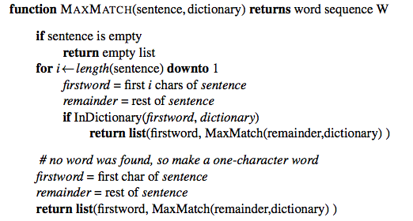
Maximum Matching
Word Segmentation Algorithm
Notes:
Dictionary = ['danny', 'condo', 'a', 'the','to','has', 'been', 'unable', 'go', 'at']
Sentence= “atcondogo”
Run the algorithm and we will get "at condo go"

Slide 29
Max-match segmentation illustration
Thecatinthehat
Thetabledownthere
Doesn’t generally work in English!
But works astonishingly well in Chinese
  莎拉波娃现在居住在美国东南部的佛罗里达。
  莎拉波娃 现在 居住 在 美国 东南部 的 佛罗里达
Modern probabilistic segmentation algorithms even better
  the cat in the hat
  the table down there
  theta bled own there

Slide 30
Basic Text Processing
Word Normalization and Stemming

Slide 31
Normalization
Need to “normalize” terms
  Information Retrieval: indexed text & query terms must have same form.
    We want to match U.S.A. and USA
We implicitly define equivalence classes of terms
  e.g., deleting periods in a term
Alternative: asymmetric expansion:
  Enter: window Search: window, windows
  Enter: windows Search: Windows, windows, window
  Enter: Windows Search: Windows
Potentially more powerful, but less efficient

Slide 32
Case folding
Applications like IR: reduce all letters to lower case
  Since users tend to use lower case
  Possible exception: upper case in mid-sentence?
    e.g., General Motors
    Fed vs. fed
    SAIL vs. sail
For sentiment analysis, MT, Information extraction
  Case is helpful (US versus us is important)

Slide 33
Lemmatization
Reduce inflections or variant forms to base form
  am, are, is → be
  car, cars, car's, cars' → car
the boy's cars are different colors → the boy car be different color
Lemmatization: have to find correct dictionary headword form
Machine translation
  Spanish quiero (‘I want’), quieres (‘you want’) same lemma as querer ‘want’
  A common unit among words from dictionary is called lemma. For example, given the words amusement, amusing, and amused, the lemma for each and all would be amuse.

Slide 34
Morphology
Morphemes:
  The small meaningful units that make up words
  Stems: The core meaning-bearing units
    A common unit among words without dictionary is called stem. In the example of amusing, amusement, and amused above, the stem would be amus.
  Affixes: Bits and pieces that adhere (join) to stems
    Often with grammatical functions
  Nonperishable is comprised of three morphemes: non-<prefix>, perish <base morpheme>, and –able <suffix>. Both non- and -able are examples of an affix

Slide 35
Stemming
Reduce terms to their stems in information retrieval
Stemming is crude (not refined) chopping of affixes
  language dependent
  e.g., automate(s), automatic, automation all reduced to automat.
for example compressed
and compression are both
accepted as equivalent to
compress.

Slide 36
Porter’s algorithm
The most common English stemmer
Step 1a
  sses → ss caresses → caress
  ies → i ponies → poni
  ss → ss caress → caress
  s → ø cats → cat
Step 1b
  (*v*)ing → ø walking → walk
  sing → sing
  (*v*)ed → ø plastered → plaster
  …
Step 2 (for long stems)
  ational→ ate relational→ relate
  izer→ ize digitizer → digitize
  ator→ ate operator → operate
  …
Step 3 (for longer stems)
  al → ø revival → reviv
  able → ø adjustable → adjust
  ate → ø activate → activ
  …

Slide 37
Viewing morphology in a corpus
Why only strip –ing if there is a vowel?
  (*v*)ing → ø walking → walk
  sing → sing

Slide 38
Viewing morphology in a corpus
Why only strip –ing if there is a vowel?
  (*v*)ing → ø walking → walk
  sing → sing
tr -sc 'A-Za-z' '\n' < shakes.txt | grep ’ing$' | sort | uniq -c | sort –nr
tr -sc 'A-Za-z' '\n' < shakes.txt | grep '[aeiou].*ing$' | sort | uniq -c | sort –nr
1312 King
548 being
541 nothing
388 king
375 bring
358 thing
307 ring
152 something
145 coming
130 morning
548 being
541 nothing
152 something
145 coming
130 morning
122 having
120 living
117 loving
116 Being
102 going

Slide 39
Dealing with complex morphology is sometimes necessary
Some languages require complex morpheme segmentation
  Turkish
  Uygarlastiramadiklarimizdanmissinizcasina
  `(behaving) as if you are among those whom we could not civilize’
  Uygar `civilized’ + las `become’
    + tir `cause’ + ama `not able’
    + dik `past’ + lar ‘plural’
    + imiz ‘p1pl’ + dan ‘abl’
    + mis ‘past’ + siniz ‘2pl’ + casina ‘as if’

Slide 40
Basic Text Processing
Sentence Segmentation and Decision Trees

Slide 41
Sentence Segmentation
!, ? are relatively unambiguous
Period “.” is quite ambiguous
  Sentence boundary
  Abbreviations like Inc. or Dr.
  Numbers like .02% or 4.3
Build a binary classifier
  Looks at a “.”
  Decides EndOfSentence/NotEndOfSentence
  Classifiers: hand-written rules, regular expressions, or machine-learning

Slide 42
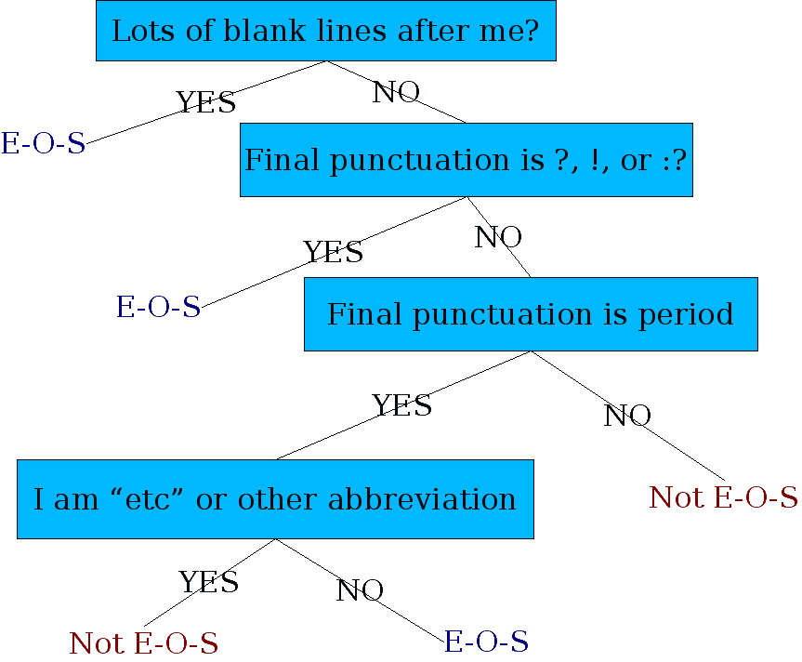
Determining if a word is end-of-sentence: a Decision Tree

Slide 43
More sophisticated decision tree features
Case of word with “.”: Upper, Lower, Cap, Number
Case of word after “.”: Upper, Lower, Cap, Number
Numeric features
  Length of word with “.”
  Probability(word with “.” occurs at end-of-s)
  Probability(word after “.” occurs at beginning-of-s)

Slide 44
Implementing Decision Trees
A decision tree is just an if-then-else statement
The interesting research is choosing the features
Setting up the structure is often too hard to do by hand
  Hand-building only possible for very simple features, domains
    For numeric features, it’s too hard to pick each threshold
  Instead, structure usually learned by machine learning from a training corpus

Slide 45
Decision Trees and other classifiers
We can think of the questions in a decision tree
As features that could be exploited by any kind of classifier
  Logistic regression
  SVM
  Neural Nets
  etc.

Slide 46
Homework #1
We have studied text processing with regular expressions in Unix/Linux environment. Apply the same concept in Python available through RE, or Regex on the shakes.txt file available on the internet or can be downloaded from the course page.

