Slide 1
Introduction
CS-5840: Natural Language Processing
Instructor: Qaiser Abbas
Source: Dr. Wei Xu, Ohio State University

Slide 2
Course Webpage
http://www.clsp.org/qabbas/nlp.html
Applications of NLP are everywhere because people communicate most everything in language: web search, advertisement, emails, customer service, language translation, radiology reports, etc. Upon completing, you will be able to recognize NLP tasks in your day-to-day work, propose approaches, and judge what techniques are likely to work well.

Slide 3
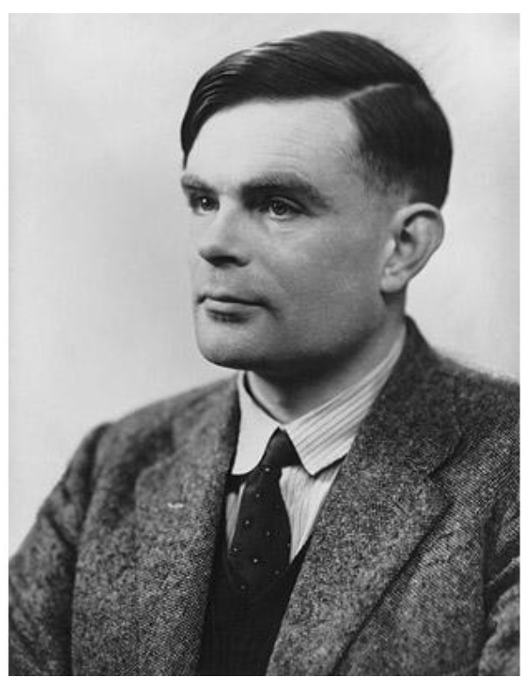
Language, Thought and Artificial Intelligence
Goal: give computers the ability to think (and speak)
Long history in computer science
Turing Test (Alan Turing 1950)
Loebner Prize
– Little interest from NLP community...
– Very simple programs can fool some judges some of the time
TED-ED https://www.youtube.com/watch?v=3wLqsRLvV-c

Slide 4

The Chinese Room (John Searle 1980)
2’15https://www.youtube.com/watch?v=DojUCcHxca0

Slide 5
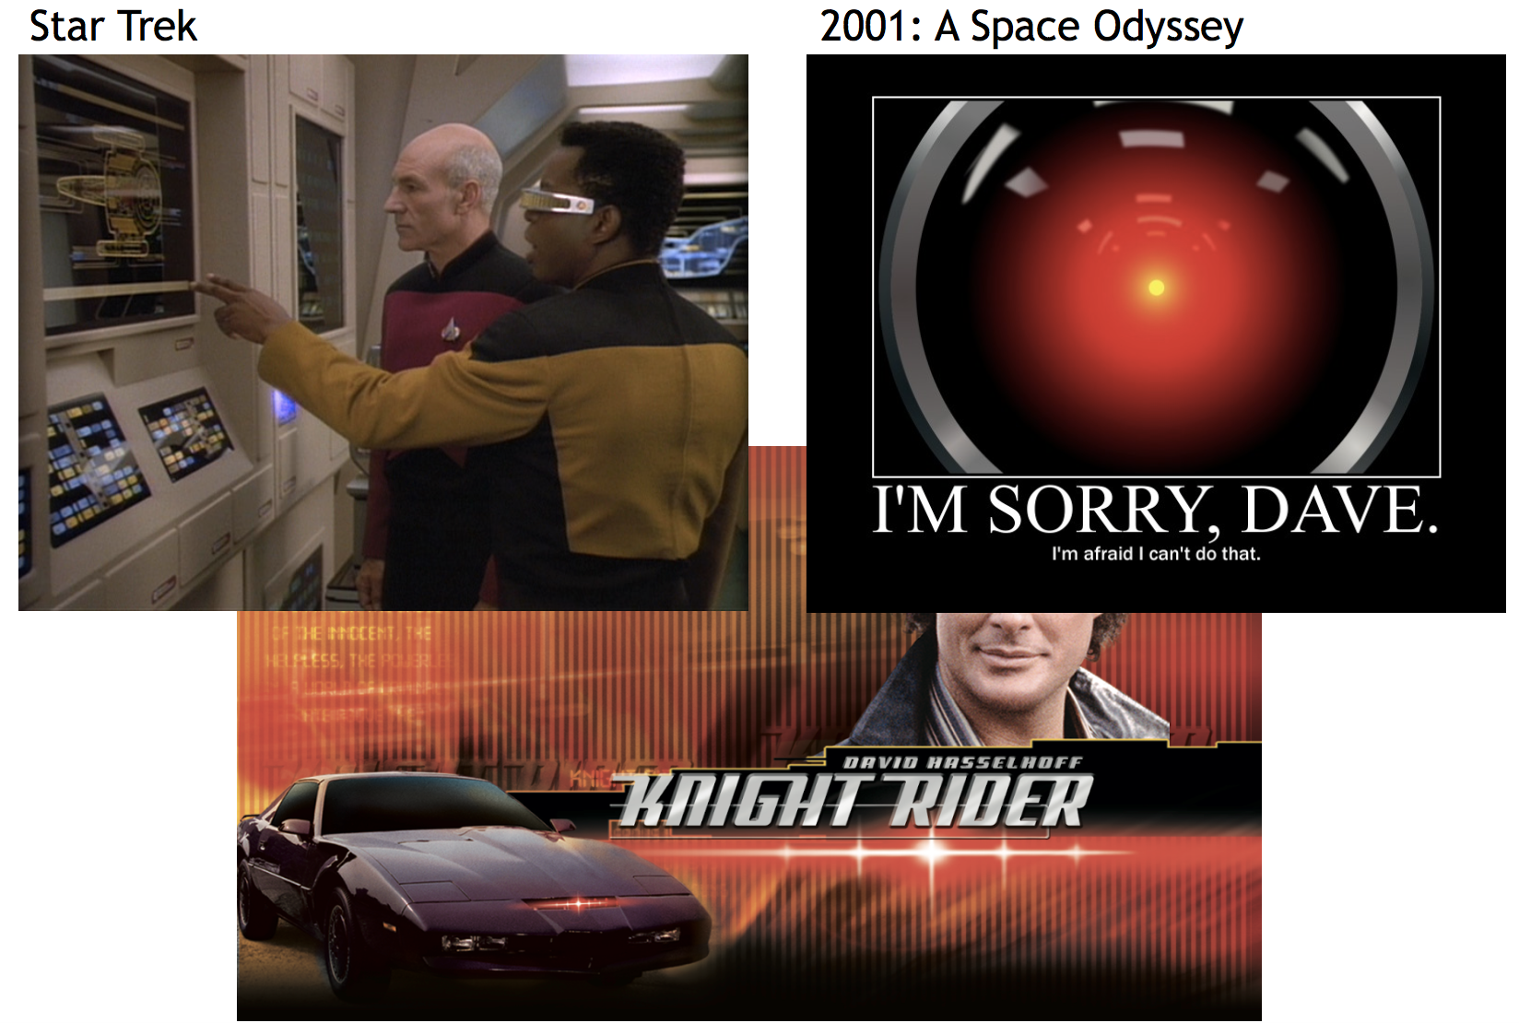
NLP in Science Fiction

Slide 6
Today’s NLP Applications
Speech Interfaces
Machine Translation
Search Engines
Information Extraction
Summarization
...

Slide 7
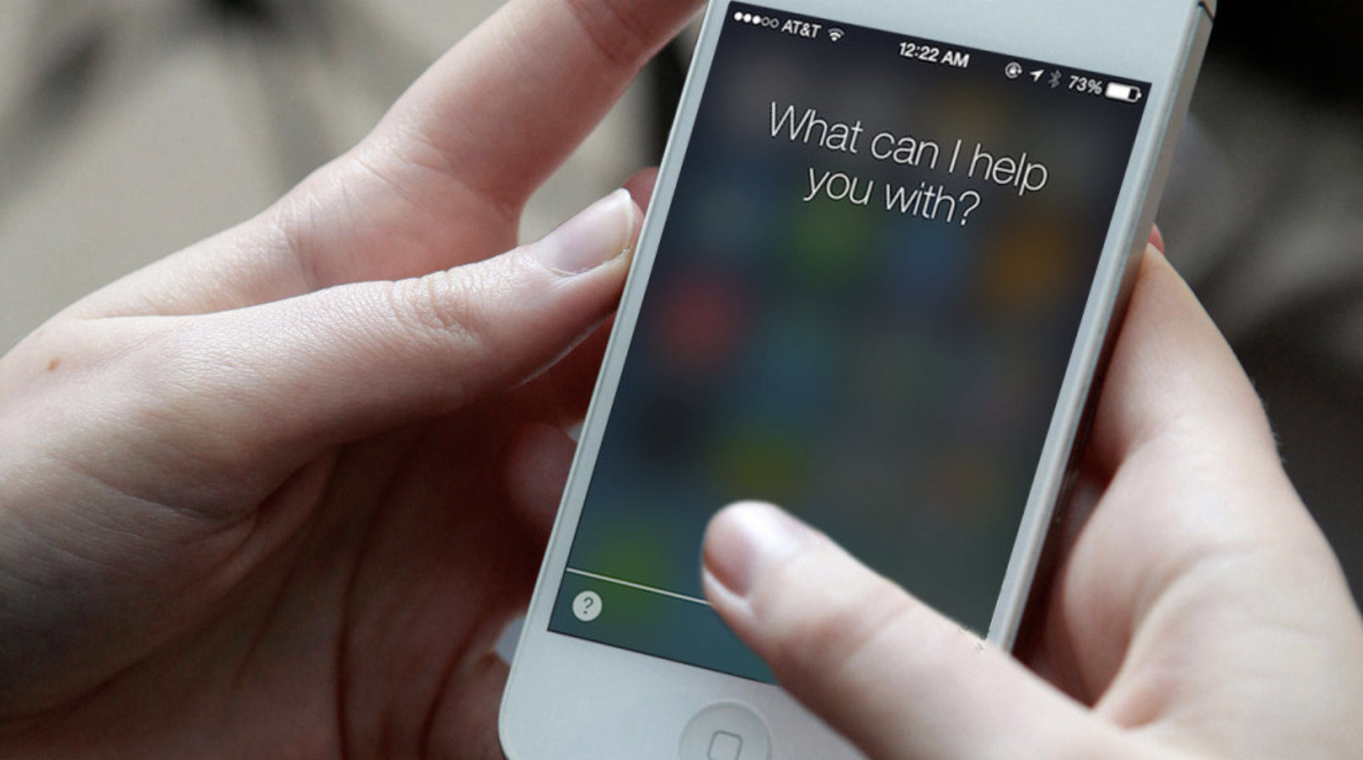
Speech Interfaces

Slide 8
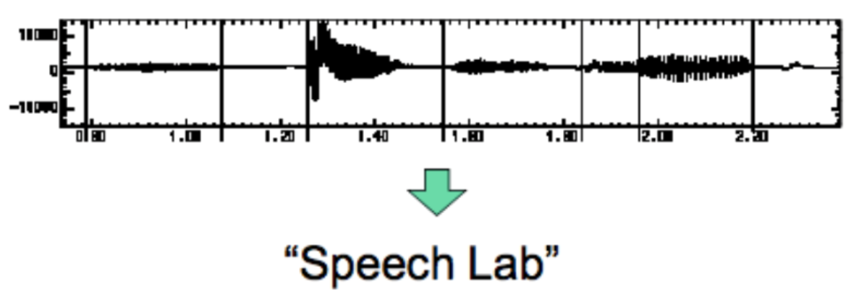
Speech Interfaces
Automatic Speech Recognition
– Audio In, text out
– State-of-the-art: 0.3% error for digit strings, 5% dictation, 50%+ for TV

Slide 9
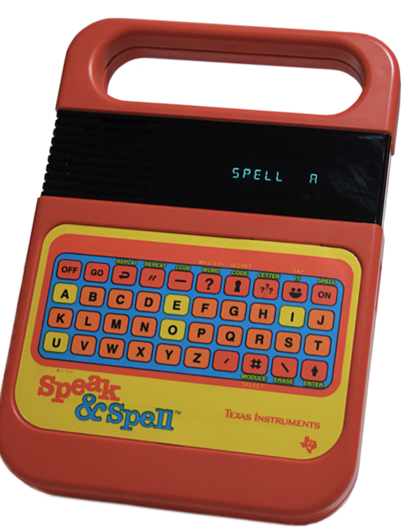
Speech Interfaces
Text to Speech
  Text in Audio Out
  https://www.youtube.com/watch?v=RpeegJ0J5mE

Slide 10
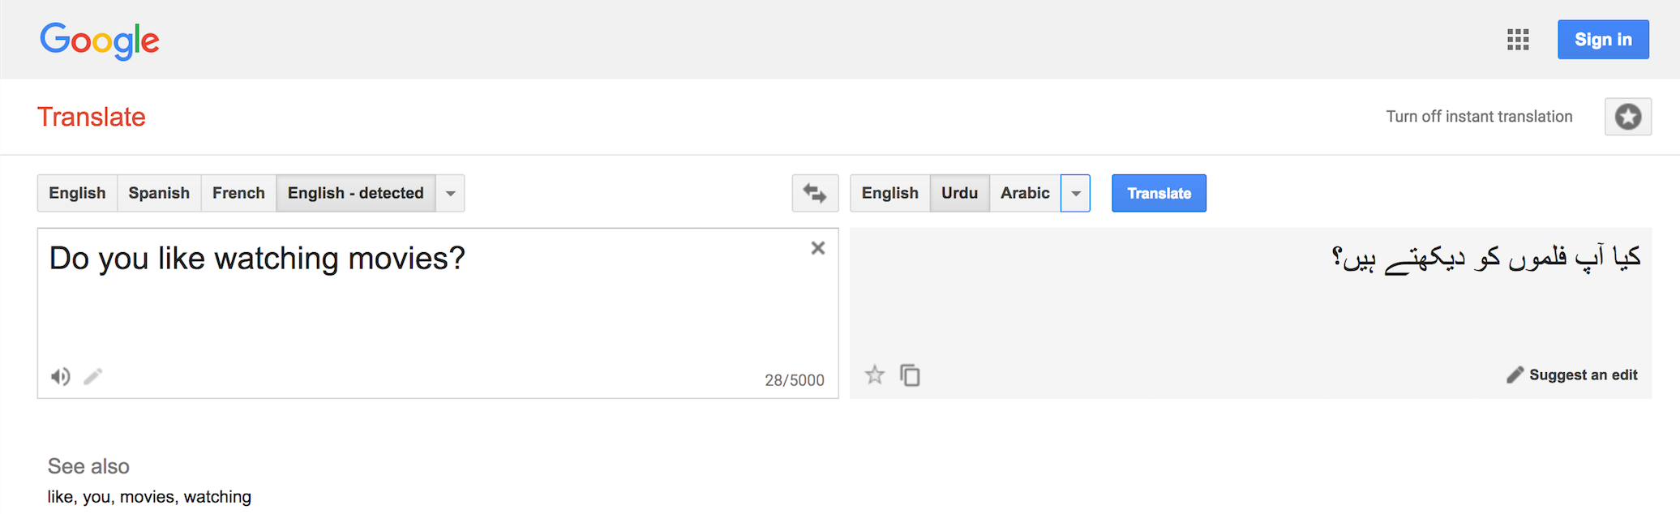
Machine Translation

Slide 11
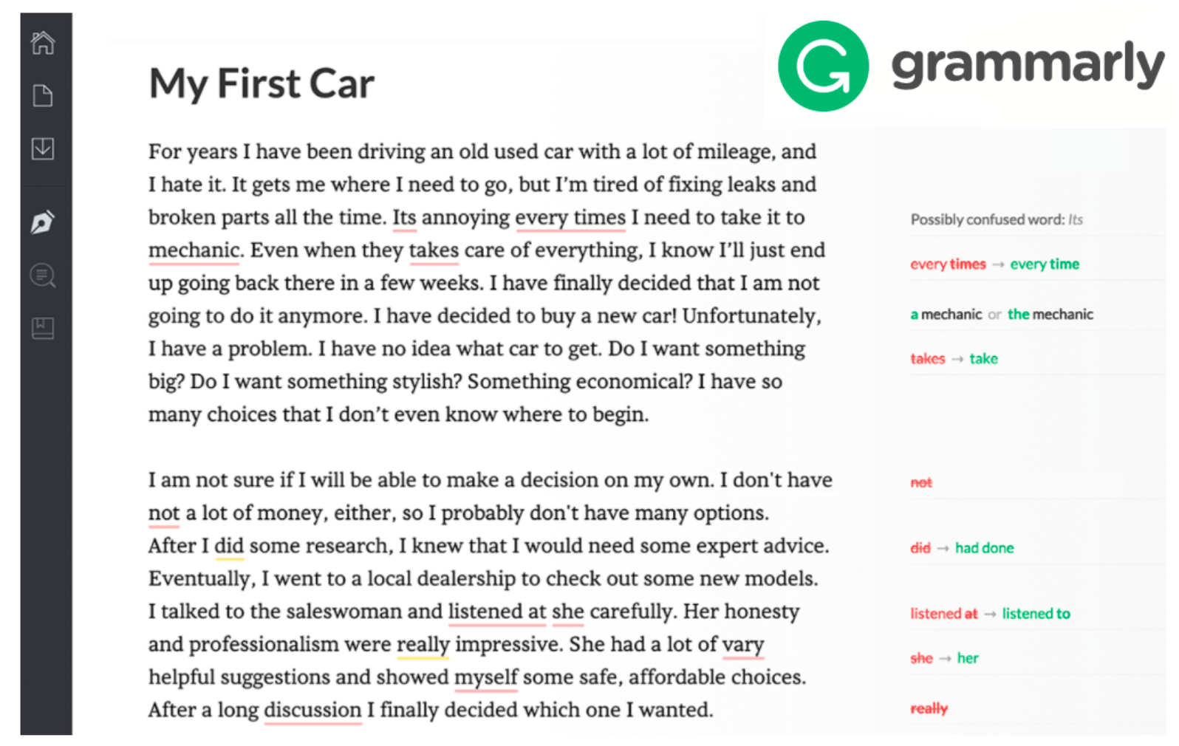
Error Correction

Slide 12
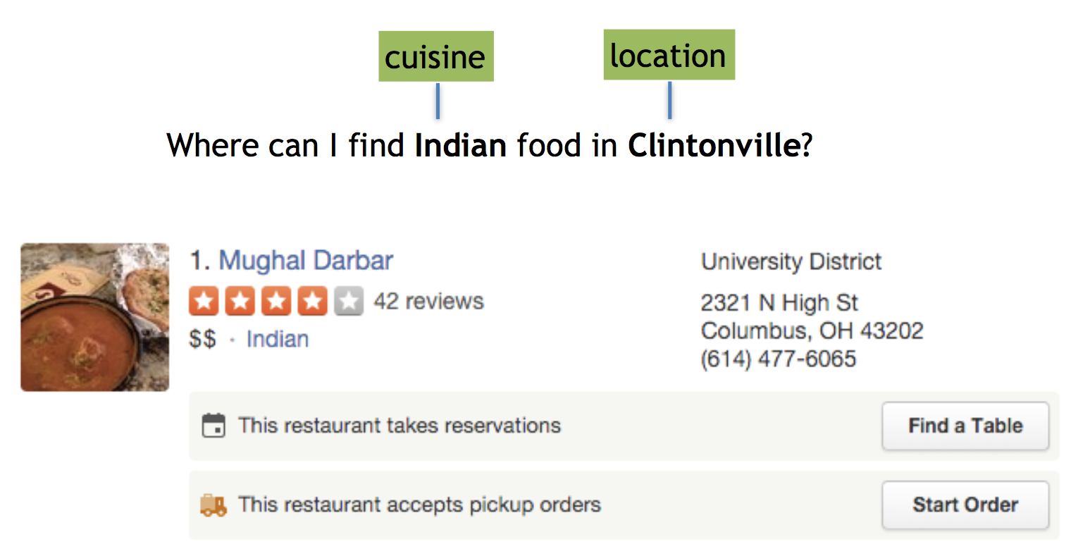
Natural Language Understanding
Convert words into semantic representation that can be used to query a database

Slide 13
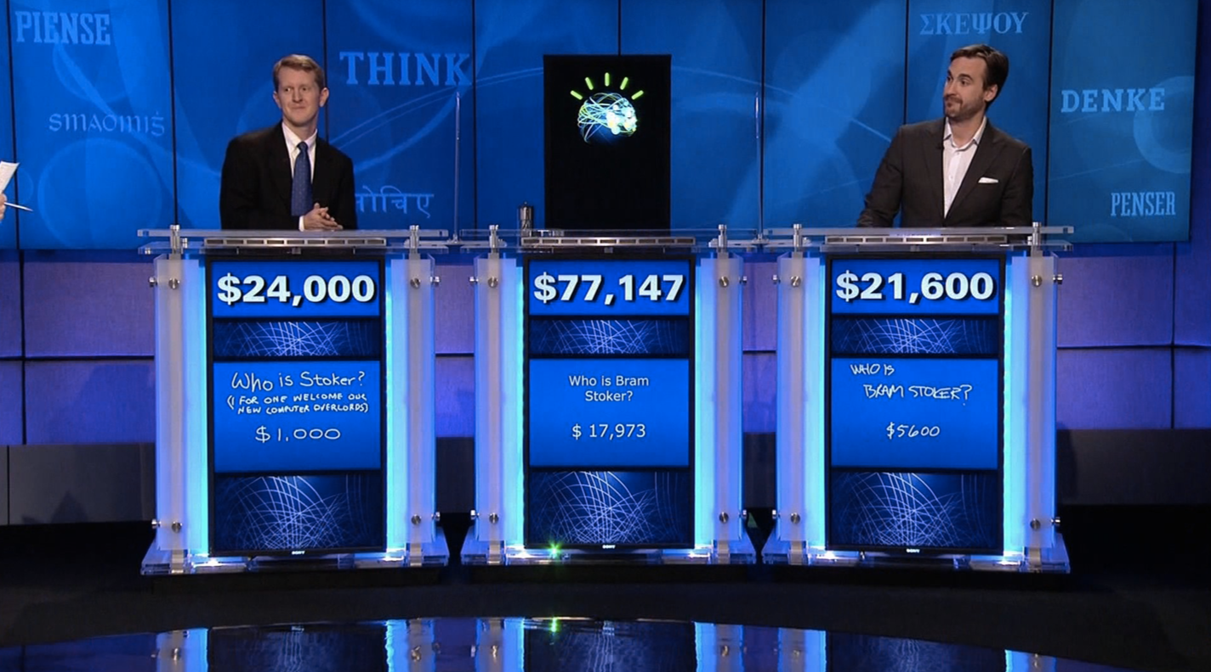
Question Answering

Slide 14
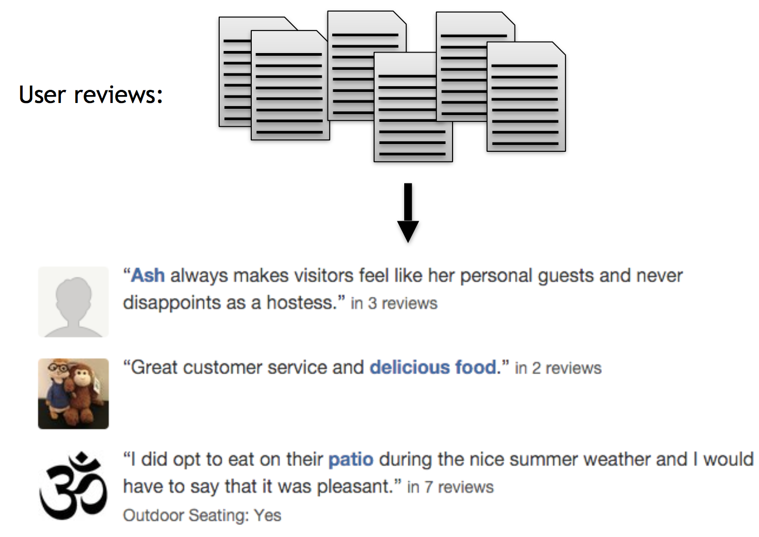
Summarization

Slide 15
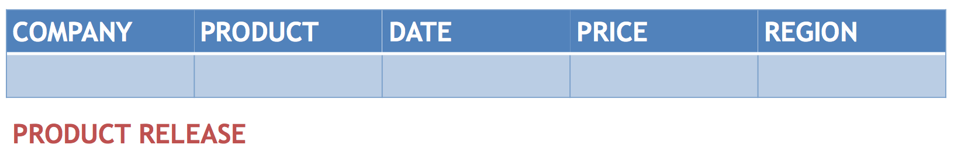
Information Extraction
“Yess! Yess! Its official Nintendo announced today that they Will release the Nintendo 3DS in north America march 27 for $250”
“Yess! Yess! Its official Nintendo announced today that they Will release the Nintendo 3DS in north America march 27 for $250”

Slide 16
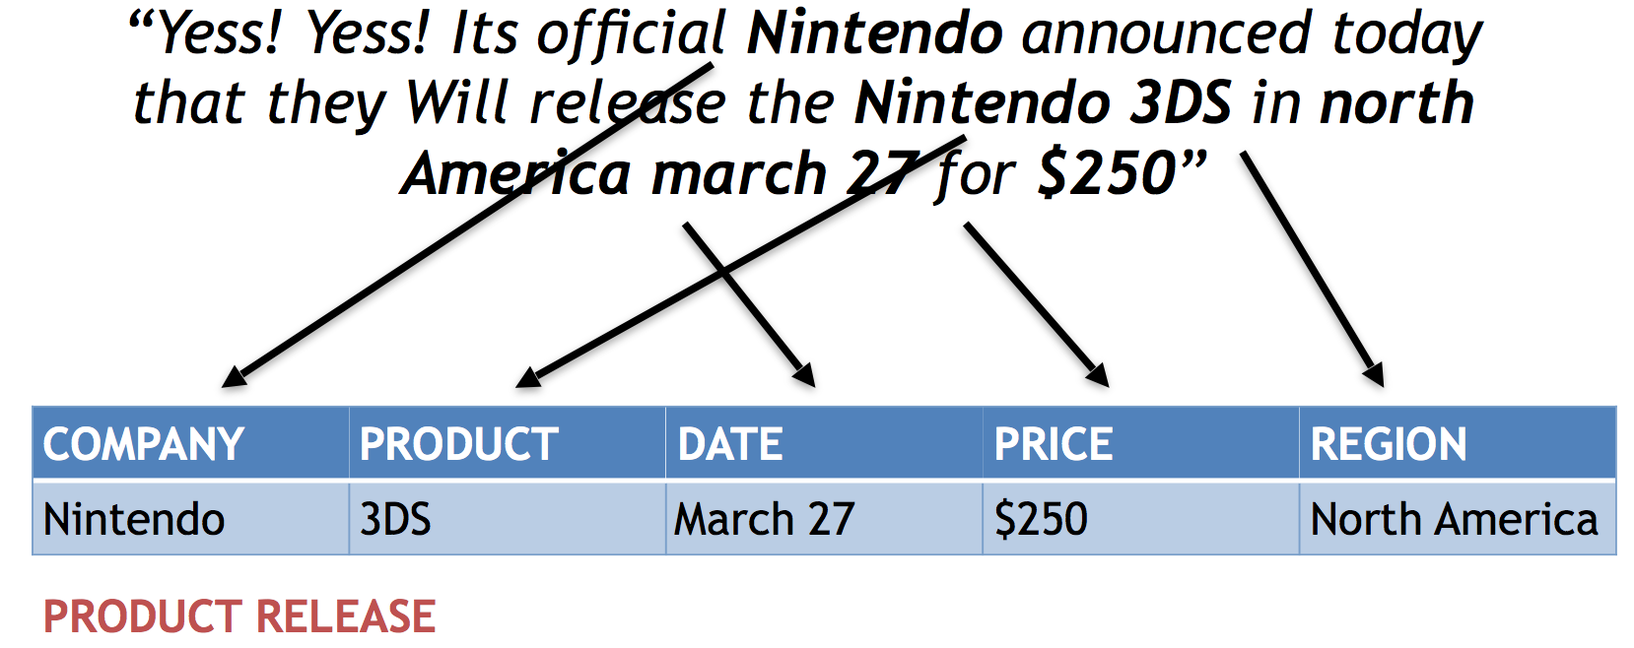
Information Extraction

Slide 17
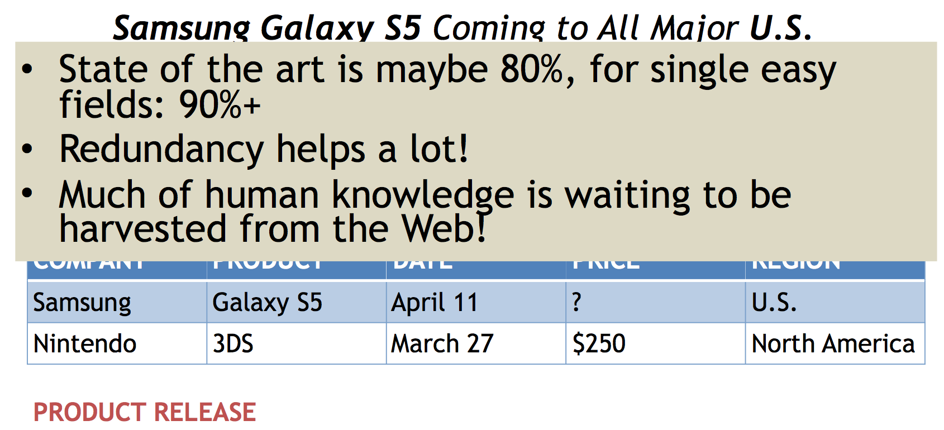
Information Extraction

Slide 18
NLP as a Field
Tasks (each have their own datasets and evaluations)
  Syntactic Parsing
  Summarization
  Machine Translation
  Information Extraction
  ...
Methods
  Heuristic / Rule-based Approaches (dominated until the 1990s statistical revolution)
  Probabilistic Graphical Models
  Neural Networks (deep learning) –...

Slide 19
Why is NLP hard?
“Any speaker of any human language can produce and understand an infinite number of sentences.”
(Fromkin, Rodman & Hyams. 2011. An Introcution to Language.)
Creativity!

Slide 20
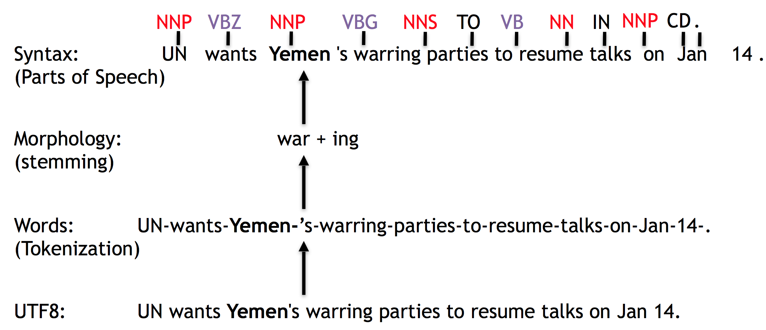
Layers of Linguistic Annotation

Slide 21
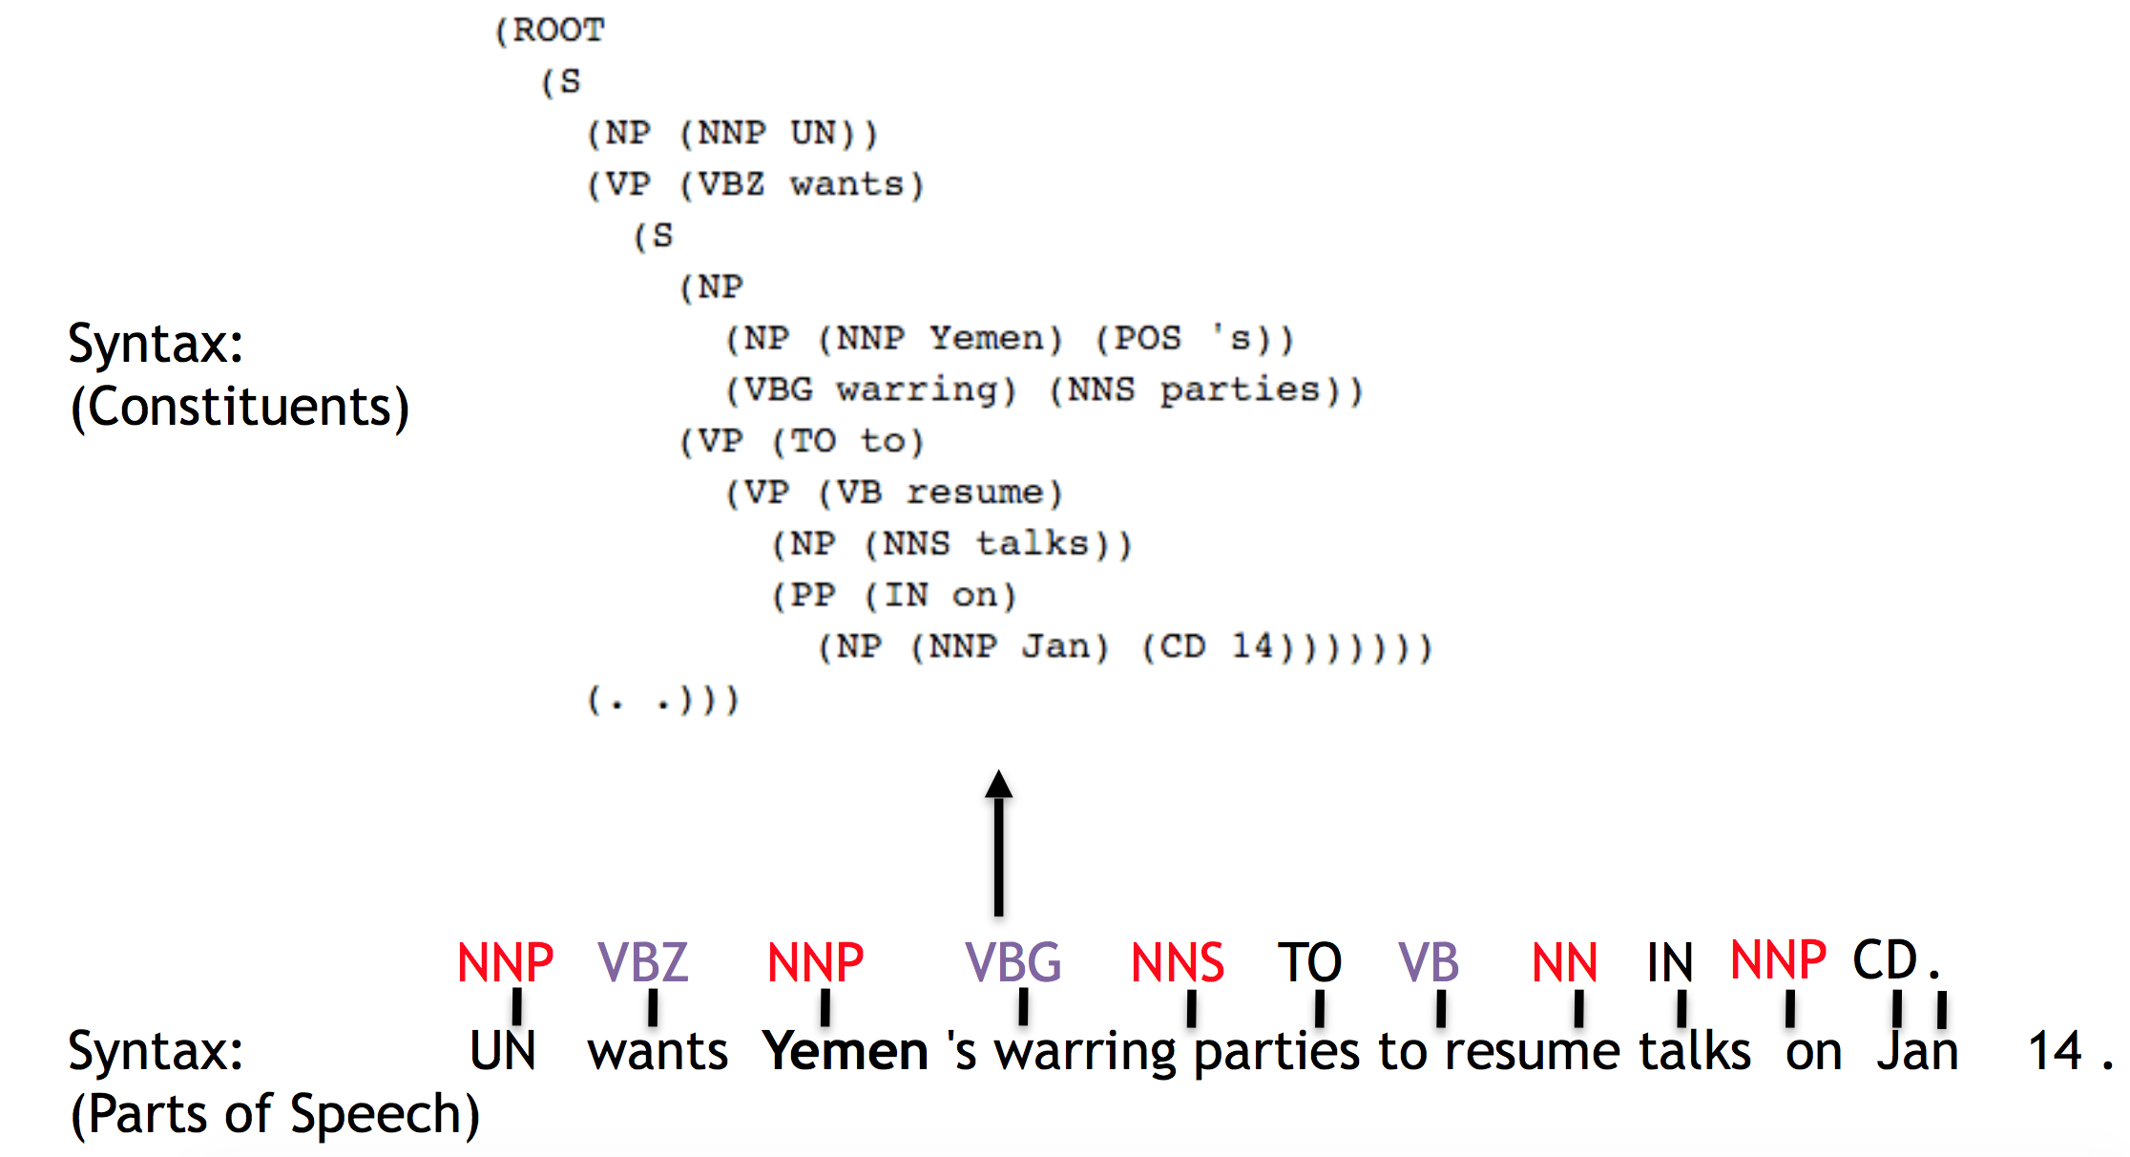
Layers of Linguistic Annotation

Slide 22
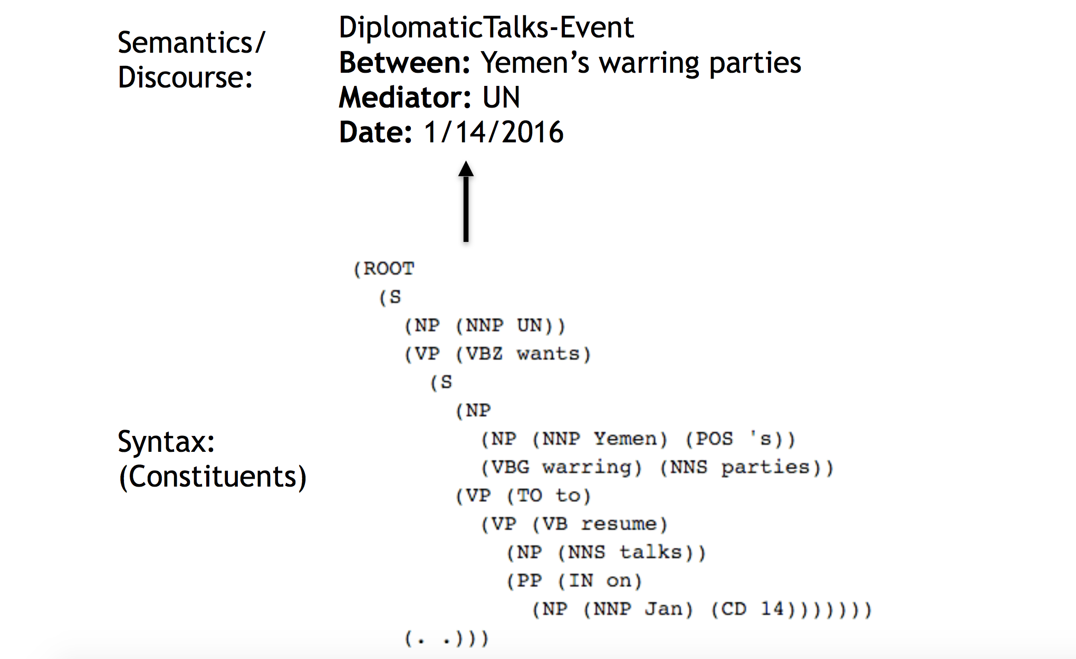
Layers of Linguistic Annotation

Slide 23
Why is NLP hard?
Why is it easy for computers to parse Python, but not English?
Ambiguity!

Slide 24

Structural Ambiguity

Slide 25

Structural Ambiguity

Slide 26
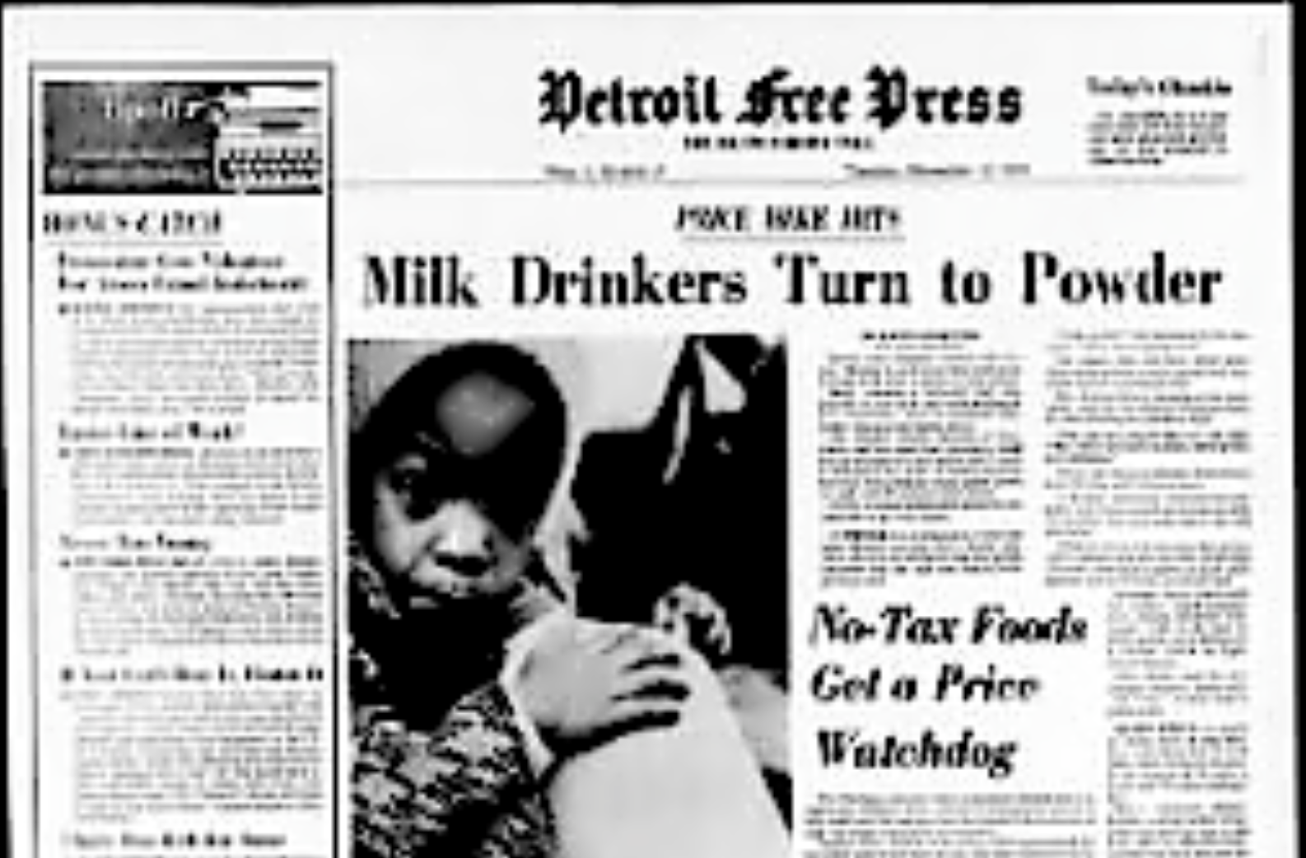
Lexical Ambiguity
(Detroit Free Press, Nov. 12, 1974)

Slide 27

Lexical Ambiguity

Slide 28
What will you get out of this class?
Understanding of a major field of Artificial Intelligence
Basic machine learning skills
Ideas that you could transform into a startup company or academic research
Summer interns?

Slide 29
What to Expect
Lots of math and programming
A bit of Linguistics
Computing Resources:
  Experiments could take hours to run or debug depending the efficiency and quality of your code. We recommend you start early on homework assignments and final project.

Slide 30
Prerequisites
Math:
  Basic Probability
  Basic Linear Algebra
Programming
  Python or ability to learn Python quickly
  Numpy/Scipy (Python libraries for scientific computing)
  Linux/Unix (for windows users: https:// www.cygwin.com/)

Slide 31

Textbook
Books
  Jurfasky and Martin (2nd and 3rd edition draft)
  Some other readings as well

Slide 32
Grading
Mid Term: 30%
Final Term: 50 %
Term Paper: 10%
Assignments and Quizzes: 10%

Slide 33
Term Paper (group of 2 at most)
Step 1: form a team and brainstorm 3 ideas
Step 2: select an idea (talk to the instructor during office hours) and collect your data
Step 3: conduct analyses of your data
Step 4: develop a working system
Step 5: write an 8 page report (minimum) and give an in-class presentation (last class of the semester)

Slide 34
Office Hours
09:30 to 11:00 Wednesday
09:30 to 11:00 Thursday
Please consider it to avoid inconvenience.

Slide 35
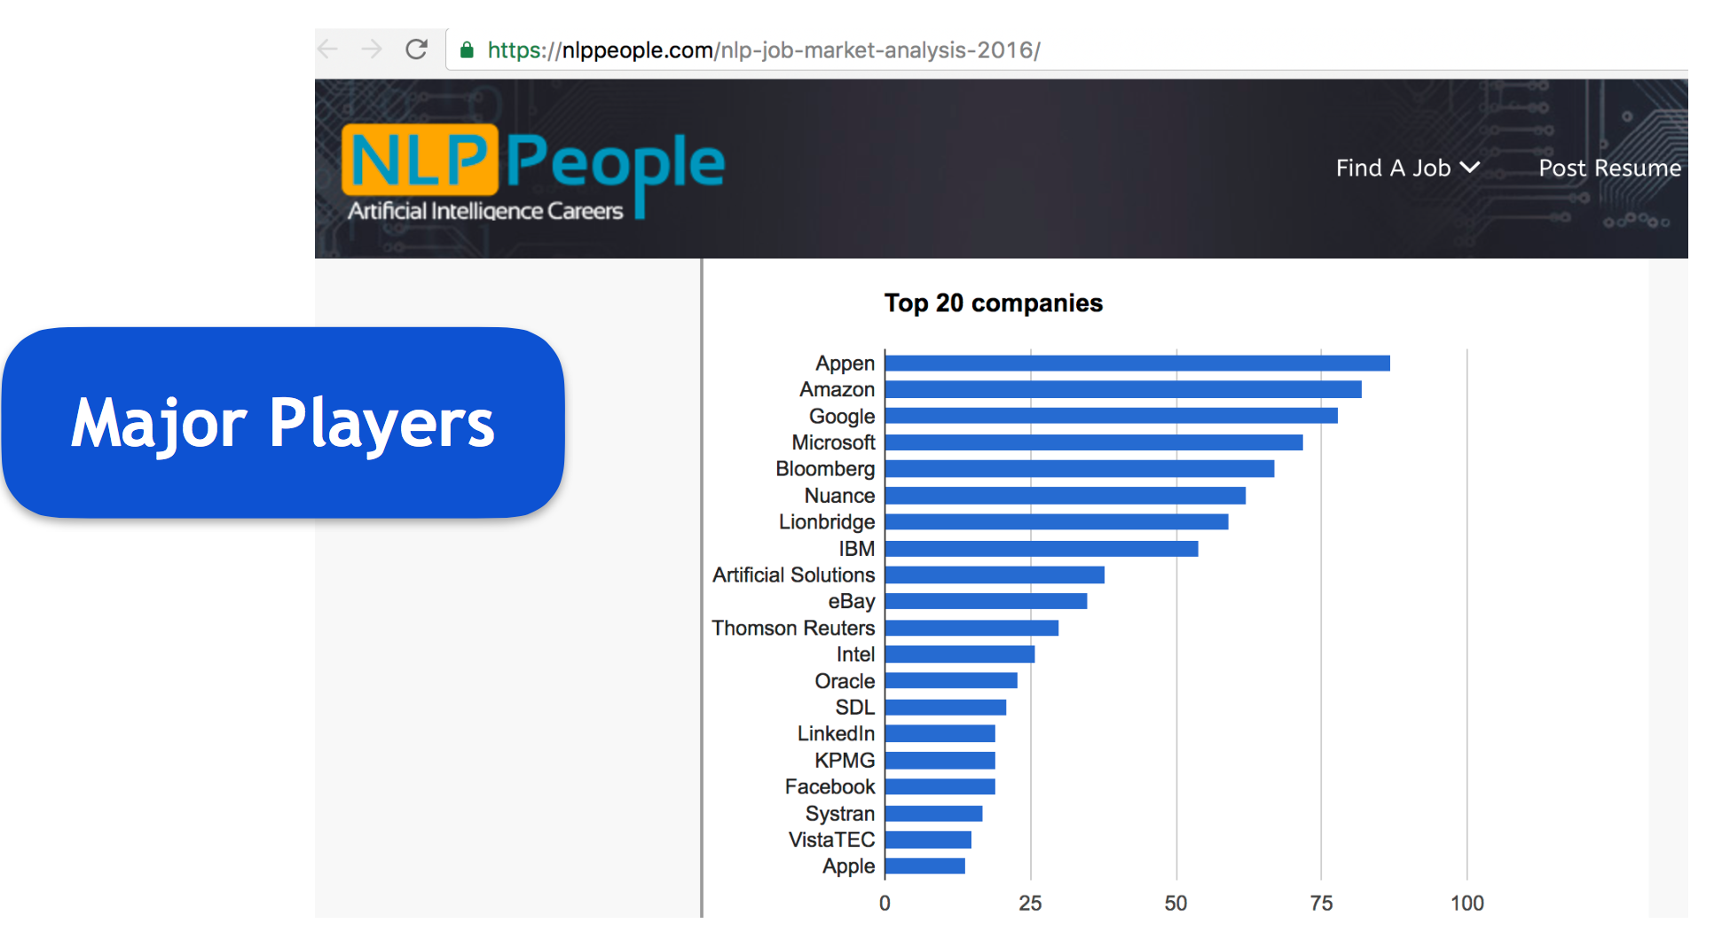
Industry Trend
Market Research on companies that use speech or language technologies.

Slide 36
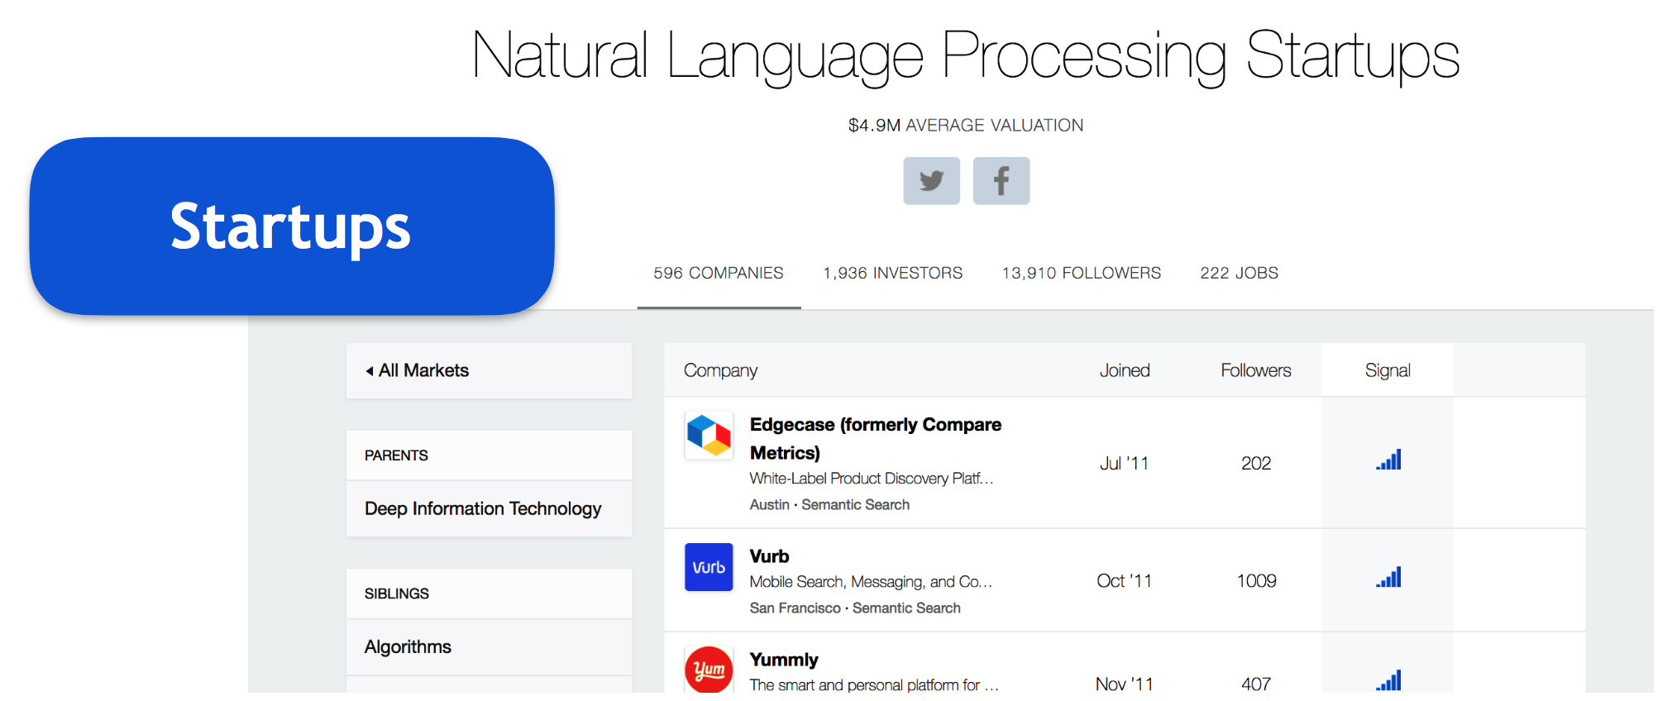
Industry Trend
Market Research on companies that use speech or language technologies.

Slide 37
Homework # 0
written assignment (simple):
  Probability & Programming Basics
Programming assignments (subject to change): -
  #1: Text Classification (Naive Bayes)
  #2: Tagging (Structured Perceptron)
  #3: Machine Translation (Word Alignment)

