Slide 1
Enterprise Application Development With Java EE
Dr. Qaiser Abbas
Department of Computer Science & IT,
University of Sargodha
qaiser.abbas@uos.edu.pk

Slide 2
jsp:useBean, jsp:setProperty and jsp:getProperty Action Tags
we will see how to use a bean class in JSP.
Syntax of jsp:useBean:
  <jsp: useBean id="unique_name_to_identify_bean" class="package_name.class_name" />
Syntax of jsp:setProperty:
  <jsp:setProperty name="unique_name_to_identify_bean" property="property_name" />
Syntax of jsp:getProperty:
  <jsp:getProperty name="unique_name_to_identify_bean" property="property_name" />

Slide 3
Details.java
package beginnersbook.com; public class Details { public Details() { } private String username; private int age; private String password; public String getUsername() { return username; } public void setUsername(String username) { this.username = username; } public int getAge() { return age; } public void setAge(int age) { this.age = age; } public String getPassword() { return password; } public void setPassword(String password) { this.password = password; } }

Slide 4
index.jsp
<html> <head><title> useBean, getProperty and setProperty example </title></head> <form action="userdetails.jsp" method="post"> User Name: <input type="text" name="username"><br> User Password: <input type="password" name="password"><br> User Age: <input type="text" name="age"><br> <input type="submit" value="register"> </form> </html>

Slide 5
userdetails.jsp
<jsp:useBean id="userinfo" class="beginnersbook.com.Details"></jsp:useBean> <jsp:setProperty property="*" name="userinfo"/> You have enterted below details:<br> <jsp:getProperty property="username" name="userinfo"/><br> <jsp:getProperty property="password" name="userinfo"/><br> <jsp:getProperty property="age" name="userinfo" /><br>

Slide 6
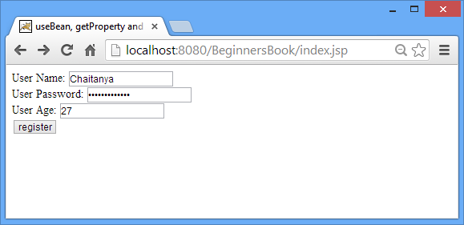
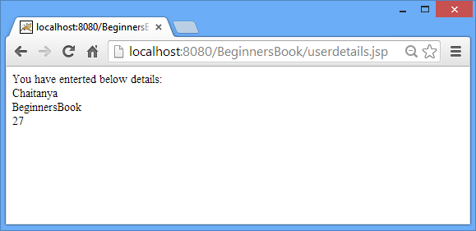
Output

Slide 7
Session Implicit Object in JSP with examples
Session is most frequently used implicit object in JSP. The main usage of it to gain access to all the user’s data till the user session is active.
Methods of session Implicit Object
  setAttribute(String, object) – This method is used to save an object in session by assigning a unique string to the object. Later, the object can be accessed from the session by using the same String till the session is active. setAttribute and getAttribute are the two most frequently used methods while dealing with session in JSP.
  getAttribute(String name) – The object stored by setAttribute method is fetched from session using getAttribute method. For example if we need to access userid on every jsp page till the session is active then we should store the user-id in session using setAttribute method and can be accessed using getAttribute method whenever needed.

Slide 8
Session Implicit Object in JSP with examples
  removeAttribute(String name) – The objects which are stored in session can be removed from session using this method. Pass the unique string identifier as removeAttribute’s method.
  getAttributeNames – It returns all the objects stored in session. Basically, it results in an enumeration of objects.
  getCreationTime – This method returns the session creation time, the time when session got initiated (became active).
  getId – Servlet container assigns a unique string identifier to session while creation of it.
  getId method returns that unique string identifier.
  isNew() – Used to check whether the session is new. It returns Boolean value (true or false). Mostly used to track whether the cookies are enabled on client side. If cookies are disabled the session.isNew() method would always return true.

Slide 9
Session Implicit Object in JSP with examples
  invalidate() – It kills a session and breaks the association of session with all the stored objects.
  getMaxInactiveInterval – Returns session’s maximum inactivate time interval in seconds.
  getLastAccessedTime – Generally used to know the last accessed time of a session.

Slide 10
Session Implicit Object Example
The below html page would display a text box along with a submit button. The submit action would transfer the control to session.jsp page.
index.html
  <html> <head> <title>Welcome Page: Enter your name</title> </head> <body> <form action="session.jsp"> <input type="text" name="inputname"> <input type="submit" value="click here!!"><br/> </form> </body> </html>

Slide 11
Session Implicit Object Example
The session.jsp page displays the name which user has entered in the index page and it stores the the same variable in the session object so that it can be fetched on any page until the session becomes inactive.
session.jsp
  <html> <head> <title>Passing the input value to a session variable</title> </head> <body> <% String uname=request.getParameter("inputname"); out.print("Welcome "+ uname); session.setAttribute("sessname",uname); %> <a href="output.jsp">Check Output Page Here </a> </body> </html>

Slide 12
Session Implicit Object Example
In this page we are fetching the variable’s value from session object and displaying it.
output.jsp
  <html> <head> <title>Output page: Fetching the value from session</title> </head> <body> <% String name=(String)session.getAttribute("sessname"); out.print("Hello User: You have entered the name: "+name); %> </body> </html>

Slide 13
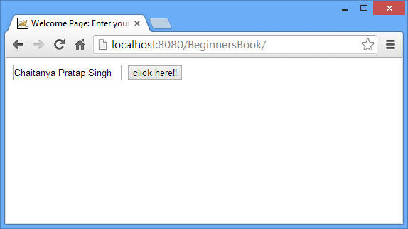
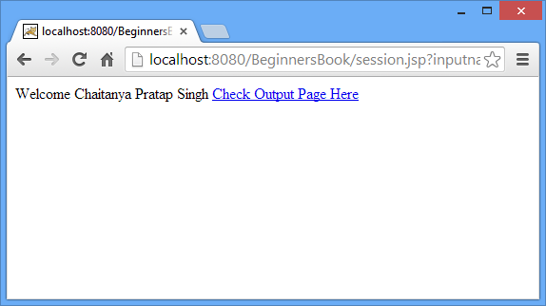
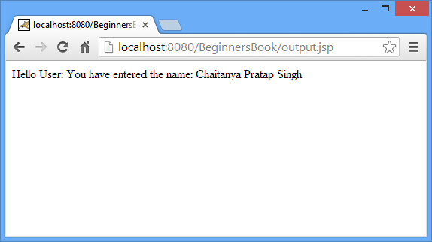
Output

Slide 14
JSP - Session Tracking
we will discuss session tracking in JSP. HTTP is a "stateless" protocol which means each time a client retrieves a Webpage, the client opens a separate connection to the Web server and the server automatically does not keep any record of previous client request.
Cookies
  A webserver can assign a unique session ID as a cookie to each web client and for subsequent requests from the client they can be recognized using the received cookie.
  This may not be an effective way as the browser at times does not support a cookie. It is not recommended to use this procedure to maintain the sessions.

Slide 15
JSP - Session Tracking
Hidden Form Fields
  A web server can send a hidden HTML form field along with a unique session ID as follows −
  <input type = "hidden" name = "sessionid" value = "12345">
  This entry means that, when the form is submitted, the specified name and value are automatically included in the GET or the POST data. Each time the web browser sends the request back, the session_id value can be used to keep the track of different web browsers.
  This can be an effective way of keeping track of the session but clicking on a regular (<A HREF...>) hypertext link does not result in a form submission, so hidden form fields also cannot support general session tracking.

Slide 16
JSP - Session Tracking
URL Rewriting
  You can append some extra data at the end of each URL. This data identifies the session; the server can associate that session identifier with the data it has stored about that session.
  For example, with http://tutorialspoint.com/file.htm;sessionid=12345, the session identifier is attached as sessionid = 12345 which can be accessed at the web server to identify the client.
  URL rewriting is a better way to maintain sessions and works for the browsers when they don't support cookies. The drawback here is that you will have to generate every URL dynamically to assign a session ID though page is a simple static HTML page.

Slide 17
JSP - Session Tracking
Session Object:
  By default, JSPs have session tracking enabled and a new HttpSession object is instantiated for each new client automatically. Disabling session tracking requires explicitly turning it off by setting the page directive session attribute to false as follows −
  <%@ page session = "false" %>

Slide 18
Session Tracking Example
This example describes how to use the HttpSession object to find out the creation time and the last-accessed time for a session. We would associate a new session with the request if one does not already exist.
Main.jsp
<%@ page import = "java.io.*,java.util.*" %>
<%
// Get session creation time.
Date createTime = new Date(session.getCreationTime());
// Get last access time of this Webpage.
Date lastAccessTime = new Date(session.getLastAccessedTime());
String title = "Welcome Back to my website";
Integer visitCount = 0;
String visitCountKey = new String("visitCount");
String userIDKey = new String("userID");
String userID = new String("ABCD");

Slide 19
Session Tracking Example
// Check if this is new comer on your Webpage.
if (session.isNew() ){
title = "Welcome to my website";
session.setAttribute(userIDKey, userID);
session.setAttribute(visitCountKey, visitCount);
}
visitCount = (Integer)session.getAttribute(visitCountKey);
visitCount = visitCount + 1;
userID = (String)session.getAttribute(userIDKey);
session.setAttribute(visitCountKey, visitCount);
%>
<html>
<head>
<title>Session Tracking</title>
</head>
<body>
<h1 style="text-align:center;">Session Tracking</h1>
<h2 style="text-align:center;"> <%out.print(title); %></h2>

Slide 20
Session Tracking Example
<table border = "1" style="text-align:center;">
<tr bgcolor = "#949494">
<th>Session info</th>
<th>Value</th>
</tr>
<tr>
<td>id</td>
<td><% out.print( session.getId()); %></td>
</tr>
<tr>
<td>Creation Time</td>
<td><% out.print(createTime); %></td>
</tr>
<tr>
<td>Time of Last Access</td>
<td><% out.print(lastAccessTime); %></td>
</tr>
<tr>
<td>User ID</td>
<td><% out.print(userID); %></td>
</tr>
<tr>
<td>Number of visits</td>
<td><% out.print(visitCount); %></td>
</tr>
</table>
</body>
</html>

Slide 21
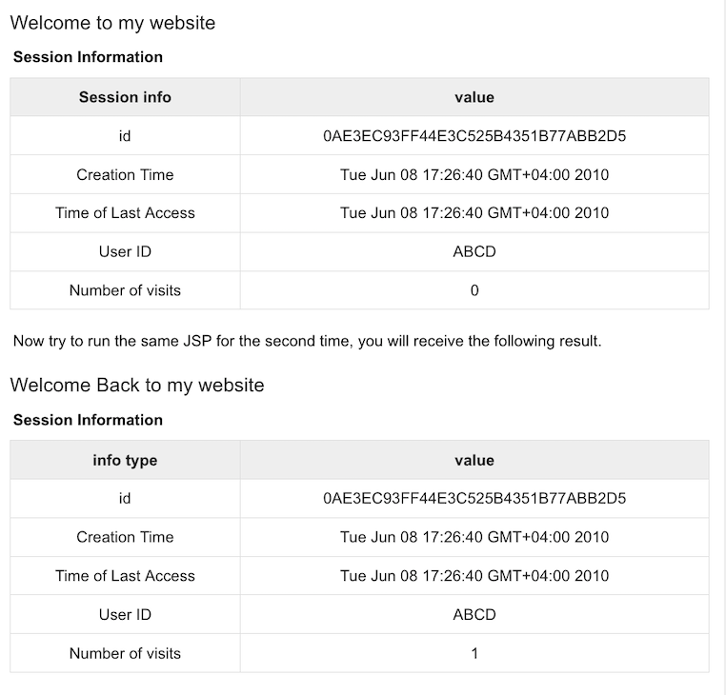
Output

