Slide 1
Enterprise Application Development With Java EE
Dr. Qaiser Abbas
Department of Computer Science & IT,
University of Sargodha
qaiser.abbas@uos.edu.pk

Slide 2
Java Server Pages
JSP technology is used to create web application just like Servlet technology. It can be thought of as an extension to Servlet because it provides more functionality than servlet.
A JSP page consists of HTML tags and JSP tags. The JSP pages are easier to maintain than Servlet because we can separate designing and development. It provides some additional features such as Expression Language, Custom Tags, etc.

Slide 3
Advantages of JSP over Servlet
1) Extension to Servlet
  JSP technology is the extension to Servlet technology. We can use all the features of the Servlet in JSP. In addition to, we can use implicit objects, predefined tags, expression language and Custom tags in JSP, that makes JSP development easy.
2) Easy to maintain
  JSP can be easily managed because we can easily separate our business logic with presentation logic. In Servlet technology, we mix our business logic with the presentation logic.
3) Fast Development: No need to recompile and redeploy
  If JSP page is modified, we don't need to recompile and redeploy the project. The Servlet code needs to be updated and recompiled if we have to change the look and feel of the application.
4) Less code than Servlet
  In JSP, we can use many tags such as action tags, JSTL, custom tags, etc. that reduces the code. Moreover, we can use EL, implicit objects, etc.

Slide 4
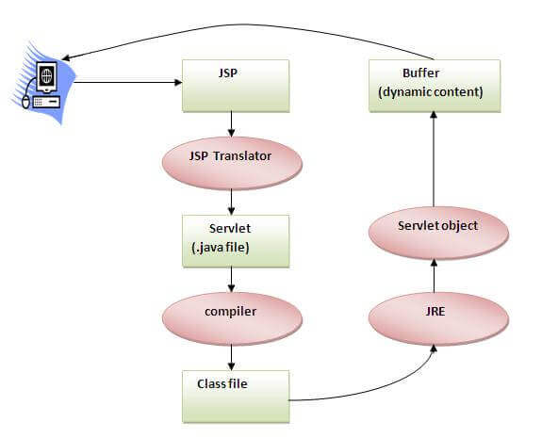
The Lifecycle of a JSP Page
As depicted in the above diagram, JSP page is translated into Servlet by the help of JSP translator. The JSP translator is a part of the web server which is responsible for translating the JSP page into Servlet. After that, Servlet page is compiled by the compiler and gets converted into the class file. Moreover, all the processes that happen in Servlet are performed on JSP later like initialization, committing response to the browser and destroy.

Slide 5
Creating a simple JSP Page
To create the first JSP page, write some HTML code as given below, and save it by .jsp extension. It will print 10 on the browser.
<html>
<body>
<% out.print(2*5); %>
</body>
</html>

Slide 6
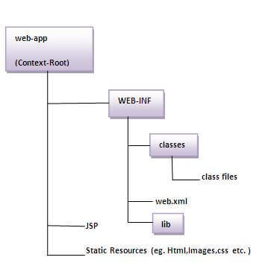
The Directory structure of JSP
The directory structure of JSP page is same as Servlet. We contain the JSP page outside the WEB-INF folder or in any directory.

Slide 7
JSP Scripting elements
The scripting elements provides the ability to insert java code inside the jsp. There are three types of scripting elements:
  scriptlet tag
  expression tag
  declaration tag

Slide 8
JSP scriptlet tag
A scriptlet tag is used to execute java source code in JSP. Syntax is as follows:
  <% java source code %>
Example of JSP scriptlet tag
  In this example, we have created two files index.html and welcome.jsp. The index.html file gets the username from the user and the welcome.jsp file prints the username with the welcome message.

Slide 9
Index.html
<html>
<body>
<form action="welcome.jsp">
<input type="text" name="uname">
<input type="submit" value="go"><br/>
</form>
</body>
</html>

Slide 10
welcome.jsp
<html>
<body>
<%
String name=request.getParameter("uname");
out.print("welcome "+name);
%>
</form>
</body>
</html>

Slide 11
JSP expression tag
The code placed within JSP expression tag is written to the output stream of the response. So you need not write out.print() to write data. It is mainly used to print the values of variable or method.
Syntax of JSP expression tag
  <%= statement %>
Example of JSP expression tag that prints current time
<html>
<body>
Current Time: <%= java.util.Calendar.getInstance().getTime() %>
</body>
</html>

Slide 12
JSP Declaration Tag
The JSP declaration tag is used to declare fields and methods.
Syntax of JSP declaration tag
  <%! field or method declaration %>
Difference between JSP Scriptlet tag and Declaration tag
Jsp Scriptlet Tag | Jsp Declaration Tag
The jsp scriptlet tag can only declare variables not methods. | The jsp declaration tag can declare variables as well as methods.
The declaration of scriptlet tag is placed inside the _jspService() method. | The declaration of jsp declaration tag is placed outside the _jspService() method.

Slide 13
JSP Declaration Tag
Example of JSP declaration tag that declares method
<html>
<body>
<%!
int cube(int n){
return n*n*n*;
}
%>
<%= "Cube of 3 is:"+cube(3) %>
</body>
</html>

