Slide 1
Enterprise Application Development With Java EE
Dr. Qaiser Abbas
Department of Computer Science & IT,
University of Sargodha
qaiser.abbas@uos.edu.pk

Slide 2
Java JDBC
JDBC stands for Java Database Connectivity. JDBC is a Java API to connect and execute the query with the database. It is a part of JavaSE (Java Standard Edition). JDBC API uses JDBC drivers to connect with the database. There are four types of JDBC drivers:
  JDBC-ODBC Bridge Driver,
  Native Driver,
  Network Protocol Driver, and
  Thin Driver

Slide 3
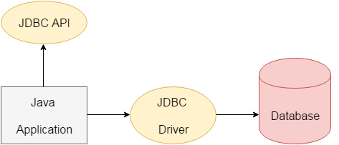
Java JDBC
We can use JDBC API to access tabular data stored in any relational database. By the help of JDBC API, we can save, update, delete and fetch data from the database. It is like Open Database Connectivity (ODBC) provided by Microsoft.

Slide 4
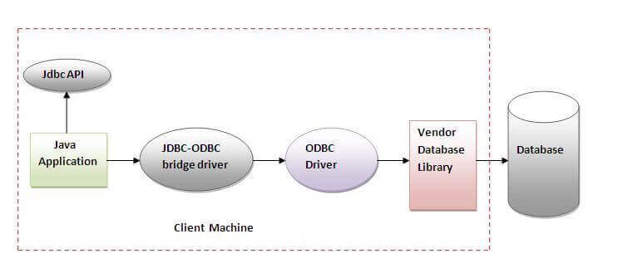
1) JDBC-ODBC bridge driver
The JDBC-ODBC bridge driver uses ODBC driver to connect to the database. The JDBC-ODBC bridge driver converts JDBC method calls into the ODBC function calls. This is now discouraged because of thin driver.
In Java 8, the JDBC-ODBC Bridge has been removed.

Slide 5
1) JDBC-ODBC bridge driver
Oracle does not support the JDBC-ODBC Bridge from Java 8. Oracle recommends that you use JDBC drivers provided by the vendor of your database instead of the JDBC-ODBC Bridge.
Advantages:
  easy to use.
  can be easily connected to any database.
Disadvantages:
  Performance degraded because JDBC method call is converted into the ODBC function calls.
  The ODBC driver needs to be installed on the client machine.

Slide 6
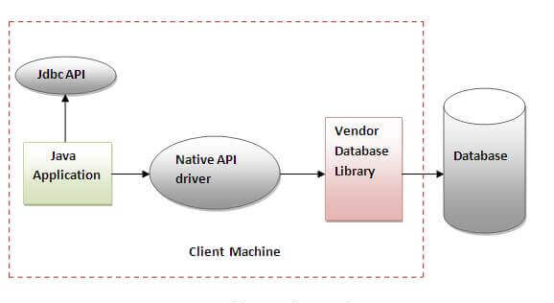
2) Native-API driver
The Native API driver uses the client-side libraries of the database. The driver converts JDBC method calls into native calls of the database API. It is not written entirely in java.
Advantage:
  performance upgraded than JDBC-ODBC bridge driver.
Disadvantage:
  The Native driver needs to be installed on the each client machine.
  The Vendor client library needs to be installed on client machine.

Slide 7
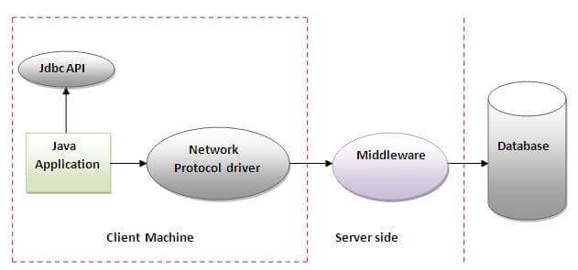
3) Network Protocol driver
The Network Protocol driver uses middleware (application server) that converts JDBC calls directly or indirectly into the vendor-specific database protocol. It is fully written in java.
Advantage:
  No client side library is required because of application server that can perform many tasks like auditing, load balancing, logging etc.
Disadvantages:
  Network support is required on client machine.
  Requires database-specific coding to be done in the middle tier.
  Maintenance of Network Protocol driver becomes costly because it requires database-specific coding to be done in the middle tier.

Slide 8
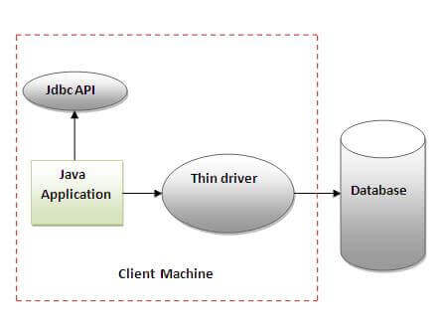
4) Thin driver
The thin driver converts JDBC calls directly into the vendor-specific database protocol. That is why it is known as thin driver. It is fully written in Java language.
Advantage:
  Better performance than all other drivers.
  No software is required at client side or server side.
Disadvantage:
  Drivers depend on the Database.

Slide 9
Java JDBC
The current version of JDBC is 4.3. It is the stable release since 21st September, 2017. It is based on the X/Open SQL Call Level Interface. The java.sql package contains classes and interfaces for JDBC API. A list of popular interfaces of JDBC API are given below:
Driver interface
Connection interface
Statement interface
PreparedStatement interface
CallableStatement interface
ResultSet interface
ResultSetMetaData interface
DatabaseMetaData interface
RowSet interface
A list of popular classes of JDBC API are given below:
DriverManager class
Blob class
Clob class
Types class

Slide 10
Why Should We Use JDBC
Before JDBC, ODBC API was the database API to connect and execute the query with the database. But, ODBC API uses ODBC driver which is written in C language (i.e. platform dependent and unsecured). That is why Java has defined its own API (JDBC API) that uses JDBC drivers (written in Java language).
We can use JDBC API to handle database using Java program and can perform the following activities:
  Connect to the database
  Execute queries and update statements to the database
  Retrieve the result received from the database.

Slide 11
Do You Know?
How to connect Java application with Oracle and Mysql database using JDBC?
What is the difference between Statement and PreparedStatement interface?
How to print total numbers of tables and views of a database using JDBC?
How to store and retrieve images from Oracle database using JDBC?
How to store and retrieve files from Oracle database using JDBC?

Slide 12
What is API
API (Application programming interface) is a document that contains a description of all the features of a product or software. It represents classes and interfaces that software programs can follow to communicate with each other. An API can be created for applications, libraries, operating systems, etc.

Slide 13
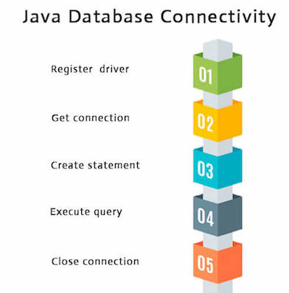
Java Database Connectivity with 5 Steps
There are 5 steps to connect any java application with the database using JDBC.
  Register the Driver class
  Create connection
  Create statement
  Execute queries
  Close connection

Slide 14
1) Register the driver class
The forName() method of Class class is used to register the driver class. This method is used to dynamically load the driver class.
Syntax of forName() method
  public static void forName(String className)throws ClassNotFoundException
Since JDBC 4.0, explicitly registering the driver is optional. We just need to put vender's Jar in the classpath, and then JDBC driver manager can detect and load the driver automatically.
Example to register the OracleDriver class
  Here, Java program is loading oracle driver to esteblish database connection.
    Class.forName("oracle.jdbc.driver.OracleDriver");

Slide 15
2) Create the connection object
The getConnection() method of DriverManager class is used to establish connection with the database.
Syntax of getConnection() method
  1) public static Connection getConnection(String url)throws SQLException
  2) public static Connection getConnection(String url,String name,String password) throws SQLException
Example to establish connection with the Oracle database
  Connection con=DriverManager.getConnection( "jdbc:oracle:thin:@localhost:1521:xe","system","password");

Slide 16
3) Create the Statement object
The createStatement() method of Connection interface is used to create statement. The object of statement is responsible to execute queries with the database.
Syntax of createStatement() method
  public Statement createStatement()throws SQLException
Example to create the statement object
  Statement stmt=con.createStatement();

Slide 17
4) Execute the query
The executeQuery() method of Statement interface is used to execute queries to the database. This method returns the object of ResultSet that can be used to get all the records of a table.
Syntax of executeQuery() method
  public ResultSet executeQuery(String sql)throws SQLException
Example to execute query
  ResultSet rs=stmt.executeQuery("select * from emp");
  while(rs.next()){
  System.out.println(rs.getInt(1)+" "+rs.getString(2));
  }

Slide 18
5) Close the connection object
By closing connection object statement and ResultSet will be closed automatically. The close() method of Connection interface is used to close the connection.
Syntax of close() method
  public void close()throws SQLException
Example to close connection
  con.close();
Since Java 7, JDBC has ability to use try-with-resources statement to automatically close resources of type Connection, ResultSet, and Statement. It avoids explicit connection closing step.

Slide 19
Java Database Connectivity with MySQL
To connect Java application with the MySQL database, we need to follow 5 following steps.
  Driver class: The driver class for the mysql database is com.mysql.cj.jdbc.Driver.
  Connection URL: The connection URL for the mysql database is jdbc:mysql://localhost:3306/books where jdbc is the API, mysql is the database, localhost is the server name on which mysql is running, we may also use IP address, 3306 is the port number and books is the database name. We may use any database, in such case, we need to replace the sonoo with our database name.
  Username: The default username for the mysql database is root.
  Password: It is the password given by the user at the time of installing the mysql database.

Slide 20
Configuration for MySQL and its Connector
First download and install MySQL
  Visit https://dev.mysql.com/downloads/mysql/
To connect java application with the MySQL database, mysqlconnector.jar file is required to be loaded.
  Visit https://dev.mysql.com/downloads/connector/j/
Set the classpath using Eclipse 2021 option by right clicking on your project >properties>libraries>Add External JARs

Slide 21
Database Creation
Let's first create a table in the mysql database, but before creating table, we need to create database first.
  create database books;
  use books;
  create table table_example(id int(10),name varchar(50),description varchar(100));
  INSERT INTO table_example (id, name, description)
  VALUES (10, “C++”, “Programming text book”);

Slide 22
Example to Connect Java Application with MySQL database
import java.sql.*;
class MysqlCon{
public static void main(String args[]){
try{
Class.forName("com.mysql.cj.jdbc.Driver");
Connection con = DriverManager.getConnection("jdbc:mysql://localhost:3306/books", "root","mysql@123");
//here books is database name, root is username and password
Statement stmt=con.createStatement();
ResultSet rs=stmt.executeQuery("select * from table_example");
while(rs.next())
System.out.println(rs.getInt(1)+" "+rs.getString(2)+" "+rs.getString(3));
con.close();
}
catch(Exception e){ System.out.println(e);}
}
}

