Slide 1
Enterprise Application Development With Java EE
Dr. Qaiser Abbas
Department of Computer Science & IT,
University of Sargodha
qaiser.abbas@uos.edu.pk

Slide 2
Java AWT
Java AWT (Abstract Window Toolkit) is an API to develop Graphical User Interface (GUI) or windows-based applications in Java.
Java AWT components are platform-dependent i.e. components are displayed according to the view of operating system. AWT is heavy weight i.e. its components are using the resources of underlying operating system (OS).
The java.awt package provides classes for AWT API such as TextField, Label, TextArea, RadioButton, CheckBox, Choice, List etc.

Slide 3
Why AWT is platform independent?
Java AWT calls the native platform calls the native platform (operating systems) subroutine for creating API components like TextField, ChechBox, button, etc.
For example, an AWT GUI with components like TextField, label and button will have different look and feel for the different platforms like Windows, MAC OS, and Unix. The reason for this is the platforms have different view for their native components and AWT directly calls the native subroutine that creates those components.
In simple words, an AWT application will look like a windows application in Windows OS whereas it will look like a Mac application in the MAC OS.

Slide 4
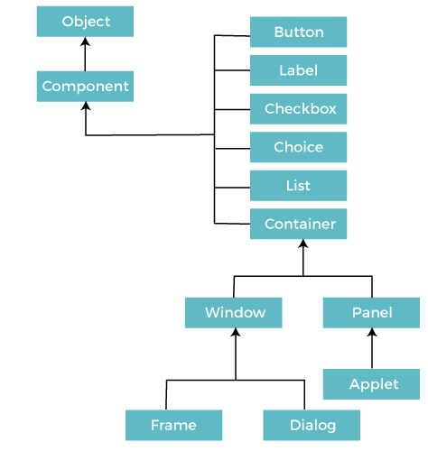
Java AWT Hierarchy

Slide 5
Components
All the elements like the button, text fields, scroll bars, etc. are called components. In Java AWT, there are classes for each component as shown in above diagram. In order to place every component in a particular position on a screen, we need to add them to a container.

Slide 6
Container
The Container is a component in AWT that can contain another components like buttons, textfields, labels etc. The classes that extends Container class are known as container such as Frame, Dialog and Panel.
It is basically a screen where the components are placed at their specific locations. Thus it contains and controls the layout of components.
A container itself is a component (see the above diagram), therefore we can add a container inside container.

Slide 7
Types of containers
There are four types of containers in Java AWT:
  Window
  Panel
  Frame
  Dialog
Window
  The window is the container that have no borders and menu bars. You must use frame, dialog or another window for creating a window. We need to create an instance of Window class to create this container.

Slide 8
Types of containers
Panel
  The Panel is the container that doesn't contain title bar, border or menu bar. It is generic container for holding the components. It can have other components like button, text field etc. An instance of Panel class creates a container, in which we can add components.
Frame
  The Frame is the container that contain title bar and border and can have menu bars. It can have other components like button, text field, scrollbar etc. Frame is most widely used container while developing an AWT application.

Slide 9
Useful Methods of Component Class
Method | Description
public void add(Component c) | Inserts a component on this component.
public void setSize(int width,int height) | Sets the size (width and height) of the component.
public void setLayout(LayoutManager m) | Defines the layout manager for the component.
public void setVisible(boolean status) | Changes the visibility of the component, by default false.

Slide 10
Java AWT Example
To create simple AWT example, you need a frame. There are two ways to create a GUI using Frame in AWT.
  By extending Frame class (inheritance)
  By creating the object of Frame class (association)

Slide 11
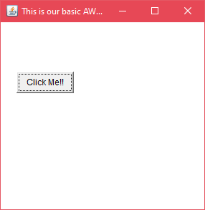
AWT Example by Inheritance
Let's see a simple example of AWT where we are inheriting Frame class. Here, we are showing Button component on the Frame.
import java.awt.*;
class First extends Frame{
First(){
Button b=new Button("click me");
b.setBounds(30,100,80,30);// setting button position
add(b);//adding button into frame
setSize(300,300);//frame size 300 width and 300 height
setLayout(null);//no layout now bydefault BorderLayout
setVisible(true);//now frame willbe visible, bydefault not visible
}
public static void main(String args[]){
First f=new First();
}
}

Slide 12
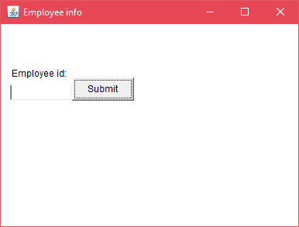
AWT Example by Association
Let's see a simple example of AWT where we are creating instance of Frame class. Here, we are creating a TextField, Label and Button component on the Frame.
import java.awt.*;
class First2{
First2(){
Frame f=new Frame();
Button b=new Button("click me");
b.setBounds(30,50,80,30);
f.add(b);
f.setSize(300,300);
f.setLayout(null);
f.setVisible(true);
}
public static void main(String args[]){
First2 f=new First2();
}
}

Slide 13
Java Event Handling
Changing the state of an object is known as an event. For example, click on button, dragging mouse etc. The java.awt.event package provides many event classes and Listener interfaces for event handling.

Slide 14
Java Event classes and Listener interfaces
Event Classes | Listener Interfaces
ActionEvent | ActionListener
MouseEvent | MouseListener and MouseMotionListener
MouseWheelEvent | MouseWheelListener
KeyEvent | KeyListener
ItemEvent | ItemListener
TextEvent | TextListener
AdjustmentEvent | AdjustmentListener
WindowEvent | WindowListener
ComponentEvent | ComponentListener
ContainerEvent | ContainerListener
FocusEvent | FocusListener

Slide 15
Steps to perform Event Handling
Following steps are required to perform event handling:
  Register the component with the Listene
Registration Methods
  For registering the component with the Listener, many classes provide the registration methods. For example:
  Button
    public void addActionListener(ActionListener a){}
  MenuItem
    public void addActionListener(ActionListener a){}
  TextField
    public void addActionListener(ActionListener a){}
    public void addTextListener(TextListener a){}
  TextArea
    public void addTextListener(TextListener a){}
  Checkbox
    public void addItemListener(ItemListener a){}
  Choice
    public void addItemListener(ItemListener a){}
  List
    public void addActionListener(ActionListener a){}
    public void addItemListener(ItemListener a){}

Slide 16
Java Event Handling Code
We can put the event handling code into one of the following places:
  Within class
  Other class
  Anonymous class

Slide 17
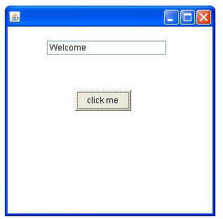
1: Java event handling by implementing ActionListener
public void setBounds(int xaxis, int yaxis, int width, int height); have been used in the above example that sets the position of the component it may be button, textfield etc.
import java.awt.*;
import java.awt.event.*;
class AEvent extends Frame implements ActionListener{
TextField tf;
AEvent(){
//create components
tf=new TextField();
tf.setBounds(60,50,170,20);
Button b=new Button("click me");
b.setBounds(100,120,80,30);
//register listener
b.addActionListener(this);//passing current instance
//add components and set size, layout and visibility
add(b);add(tf);
setSize(300,300);
setLayout(null);
setVisible(true);
}
public void actionPerformed(ActionEvent e){
tf.setText("Welcome");
}
public static void main(String args[]){
new AEvent();
}
}

Slide 18
2: Java event handling by outer class
//Java Class 2
import java.awt.event.*;
class Outer implements ActionListener{
AEvent2 obj;
Outer(AEvent2 obj){
this.obj=obj;
}
public void actionPerformed(ActionEvent e){
obj.tf.setText("welcome");
}
}
//Java class 1
import java.awt.*;
import java.awt.event.*;
class AEvent2 extends Frame{
TextField tf;
AEvent2(){
//create components
tf=new TextField();
tf.setBounds(60,50,170,20);
Button b=new Button("click me");
b.setBounds(100,120,80,30);
//register listener
Outer o=new Outer(this);
b.addActionListener(o);//passing outer class instance
//add components and set size, layout and visibility
add(b);add(tf);
setSize(300,300);
setLayout(null);
setVisible(true);
}
public static void main(String args[]){
new AEvent2();
}
}

Slide 19
3: Java event handling by anonymous class
import java.awt.*;
import java.awt.event.*;
class AEvent3 extends Frame{
TextField tf;
AEvent3(){
tf=new TextField();
tf.setBounds(60,50,170,20);
Button b=new Button("click me");
b.setBounds(50,120,80,30);
b.addActionListener(new ActionListener(){
public void actionPerformed(){
tf.setText("hello");
}
});
add(b);add(tf);
setSize(300,300);
setLayout(null);
setVisible(true);
}
public static void main(String args[]){
new AEvent3();
}
}

Slide 20
Read and Practice
Java AWT Button
Java AWT Label
Java AWT TextField
Java AWT TextArea
Java AWT Checkbox
Java AWT CheckboxGroup
Java AWT Choice
Java AWT List
Java AWT Canvas
Java AWT Scrollbar
Java AWT MenuItem and Menu
Java AWT PopupMenu
Java AWT Panel
Java AWT Dialog
Java AWT Toolkit
Java ActionListener Interface
Java MouseListener Interface
Java MouseMotionListener Interface
Java ItemListener Interface
Java KeyListener Interface
Java WindowListener Interface
Java Adapter Classes
Close AWT Window

