Slide 1
Enterprise Application Development With Java EE
Dr. Qaiser Abbas
Department of Computer Science & IT,
University of Sargodha
qaiser.abbas@uos.edu.pk

Slide 2
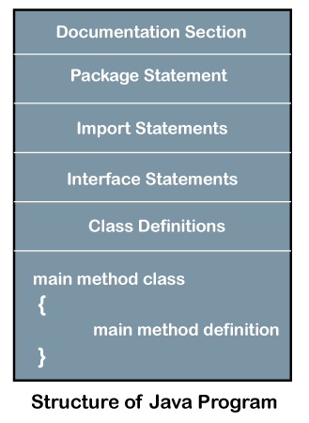
Structure of Java Program
Documentation Section: The documentation section is an important section but optional for a Java program. It includes basic information about a Java program. The information includes the author's name, date of creation, version, program name, company name, and description of the program. It improves the readability of the program.
//Single Line Comment
/*It is an example of
multiline comment*/
/**It is an example of documentation comment*/

Slide 3
Structure of Java Program
Package Declaration: The package declaration is optional. It is placed just after the documentation section. In this section, we declare the package name in which the class is placed. Note that there can be only one package statement in a Java program.
Import Statements: The package contains the many predefined classes and interfaces. If we want to use any class of a particular package, we need to import that class. It is written before the class declaration and after the package statement. We can use multiple import statements.
package javatpoint; //where javatpoint is the package name
package com.javatpoint; //where com is the root directory and javatpoint is the subdirectory
import java.util.Scanner; //it imports the Scanner class only
import java.util.*; //it imports all the class of the java.util package

Slide 4
Structure of Java Program
Interface Section: It is an optional section. We can create an interface in this section if required. We use the interface keyword to create an interface. An interface is a slightly different from the class. It contains only constants and method declarations. Another difference is that it cannot be instantiated. We can use interface in classes by using the implements keyword. An interface can also be used with other interfaces by using the extends keyword.
interface car
{
void start();
void stop();
}

Slide 5
Structure of Java Program
Class Definition: In this section, we define the class. It is vital part of a Java program. Without the class, we cannot create any Java program. A Java program may conation more than one class definition. We use the class keyword to define the class. The class is a blueprint of a Java program. It contains information about user-defined methods, variables, and constants. Every Java program has at least one class that contains the main() method.
class Student //class definition
{
}

Slide 6
Structure of Java Program
Class Variables and Constants: In this section, we define variables and constants that are to be used later in the program. In a Java program, the variables and constants are defined just after the class definition. The variables and constants store values of the parameters.
class Student //class definition
{
String sname; //variable
int id;
double percentage;
}

Slide 7
Structure of Java Program
Main Method Class: In this section, we define the main() method. It is essential for all Java programs. Because the execution of all Java programs starts from the main() method. It must be inside the class. Inside the main method, we create objects and call the methods. We use the following statement to define the main() method:
public class Student //class definition
{
public static void main(String args[])
{
//statements
}
}

Slide 8
Structure of Java Program
Methods and behavior: In this section, we define the functionality of the program by using the methods. The methods are the set of instructions that we want to perform. These instructions execute at runtime and perform the specified task.
public class Demo //class definition
{
public static void main(String args[])
{
void display()
{
System.out.println("Welcome to javatpoint");
}
//statements
}
}

Slide 9
/*Program name: Palindrome*/
//Author's name: Mathew
/*Palindrome is number or string that will remains the same
When we write that in reverse order. Some example of
palindrome is 393, 010, madam, etc.*/
//imports the Scanner class of the java.util package
import java.util.Scanner;
//class definition
public class CheckPalindromeNumber
{
//main method
public static void main(String args[])
{
//variables to be used in program
int r, s=0, temp;
int x; //It is the number variable to be checked for palindrome
Scanner sc=new Scanner(System.in);
System.out.println("Enter the number to check: ");
//reading a number from the user
x=sc.nextInt();
//logic to check if the number id palindrome or not
temp=x;
while(x>0)
{
r=x%10; //finds remainder
s=(s*10)+r;
x=x/10;
}
if(temp==s)
System.out.println("The given number is palindrome.");
else
System.out.println("The given number is not palindrome.");
}
}

Slide 10
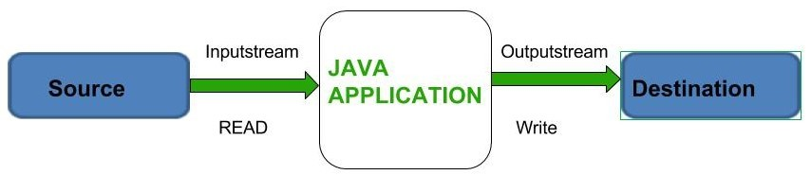
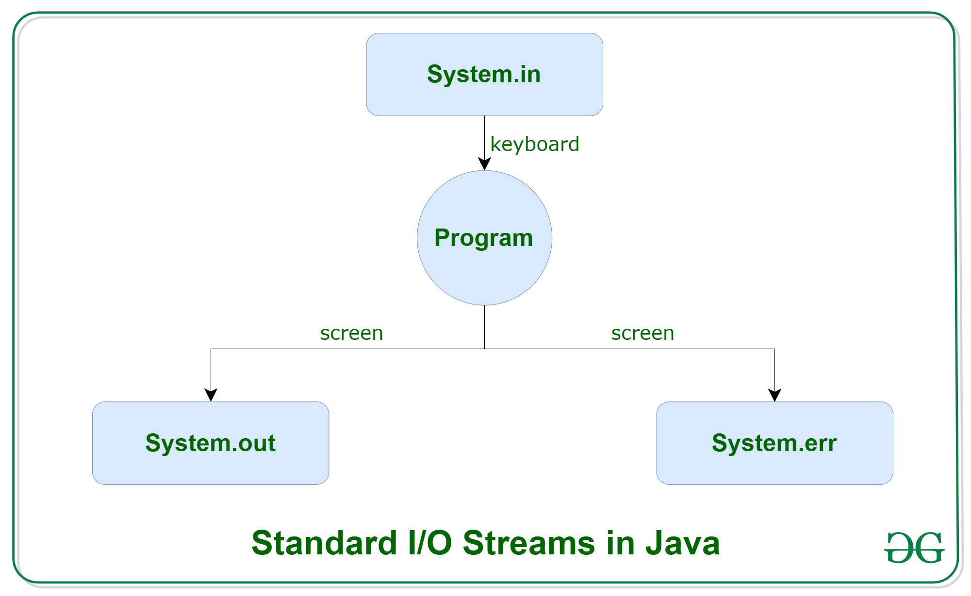
Java I/O
Java brings various Streams with its I/O package that helps the user to perform all the input-output operations.
3 standard or default streams that Java provides which are also most common in use.
For System.out and System.err
  print()
  println()
  printf()

Slide 11
Java I/O
// Java code to illustrate standard input output streams
import java.io.*;
public class SimpleIO {
public static void main(String args[]) throws IOException
{
// InputStreamReader class to read input
InputStreamReader inp = null;
// Storing the input in inp
inp = new InputStreamReader(System.in);
System.out.println("Enter characters, "+ " and '0' to quit.");
char c;
do {
c = (char)inp.read();
System.out.println(c);
} while (c != '0');
}
}
Input:
GeeksforGeeks0
Output:
Enter characters, and '0' to quit.
G
e
e
k
s
f
o
r
G
e
e
k
s
0

Slide 12
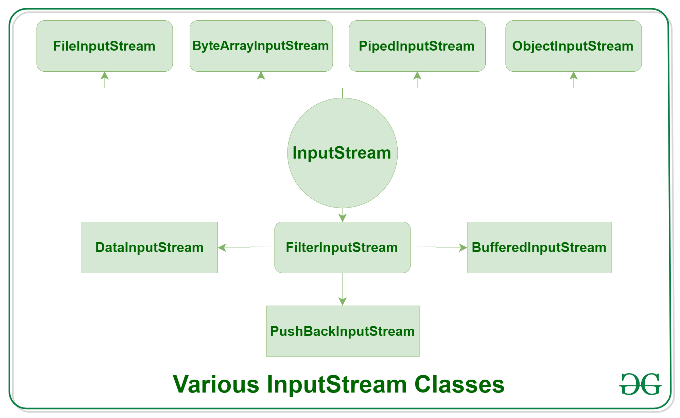
Java I/O
Types of Streams: Depending on the type of operations, streams can be divided into two primary classes:
  Input Stream: These streams are used to read data that must be taken as an input from a source array or file or any peripheral device. For eg., FileInputStream, BufferedInputStream, ByteArrayInputStream etc.

Slide 13
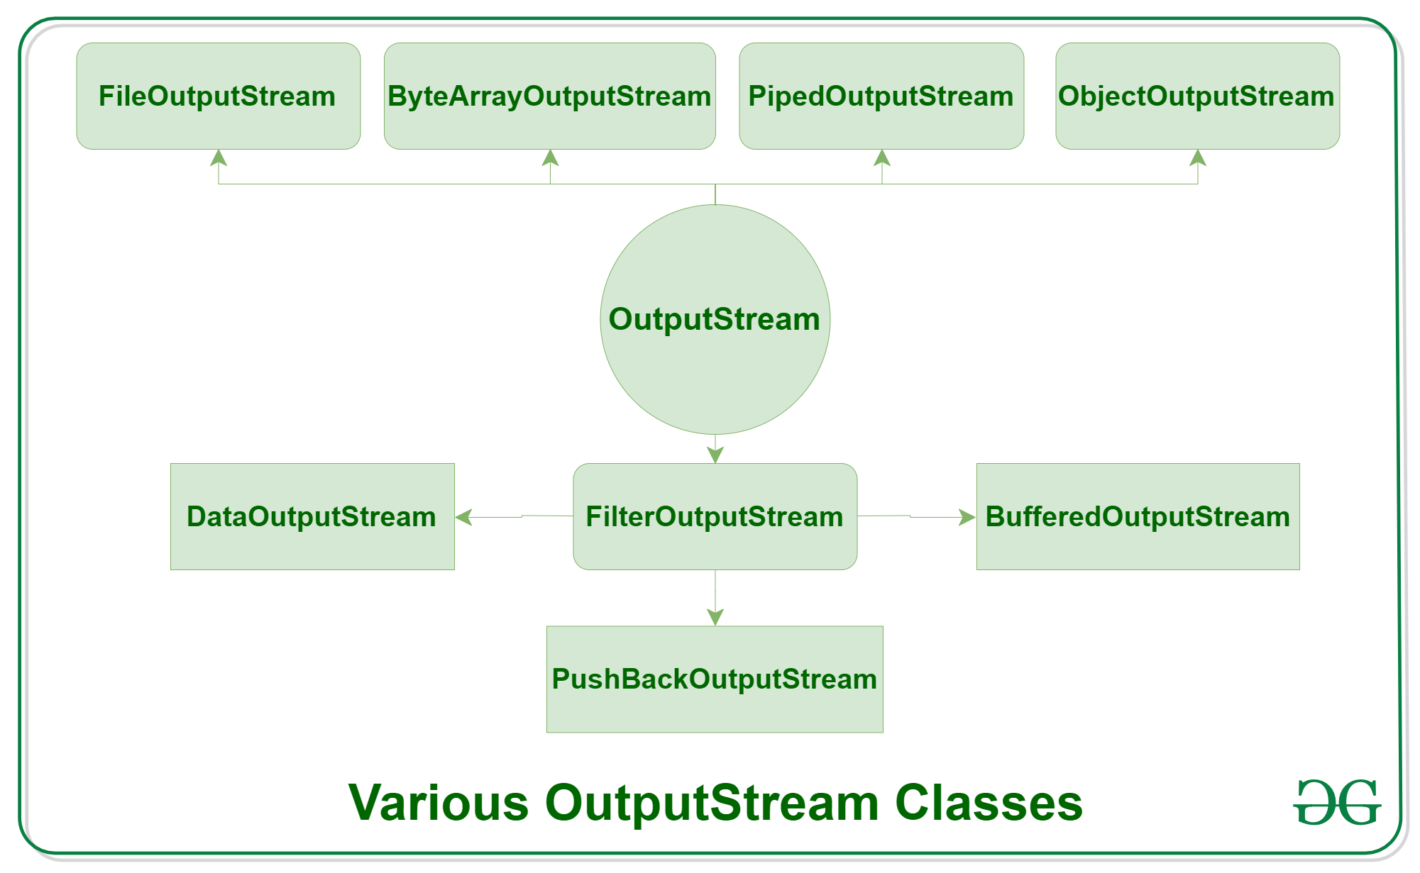
Java I/O
  Output Stream: These streams are used to write data as outputs into an array or file or any output peripheral device. For eg., FileOutputStream, BufferedOutputStream, ByteArrayOutputStream etc.

Slide 14
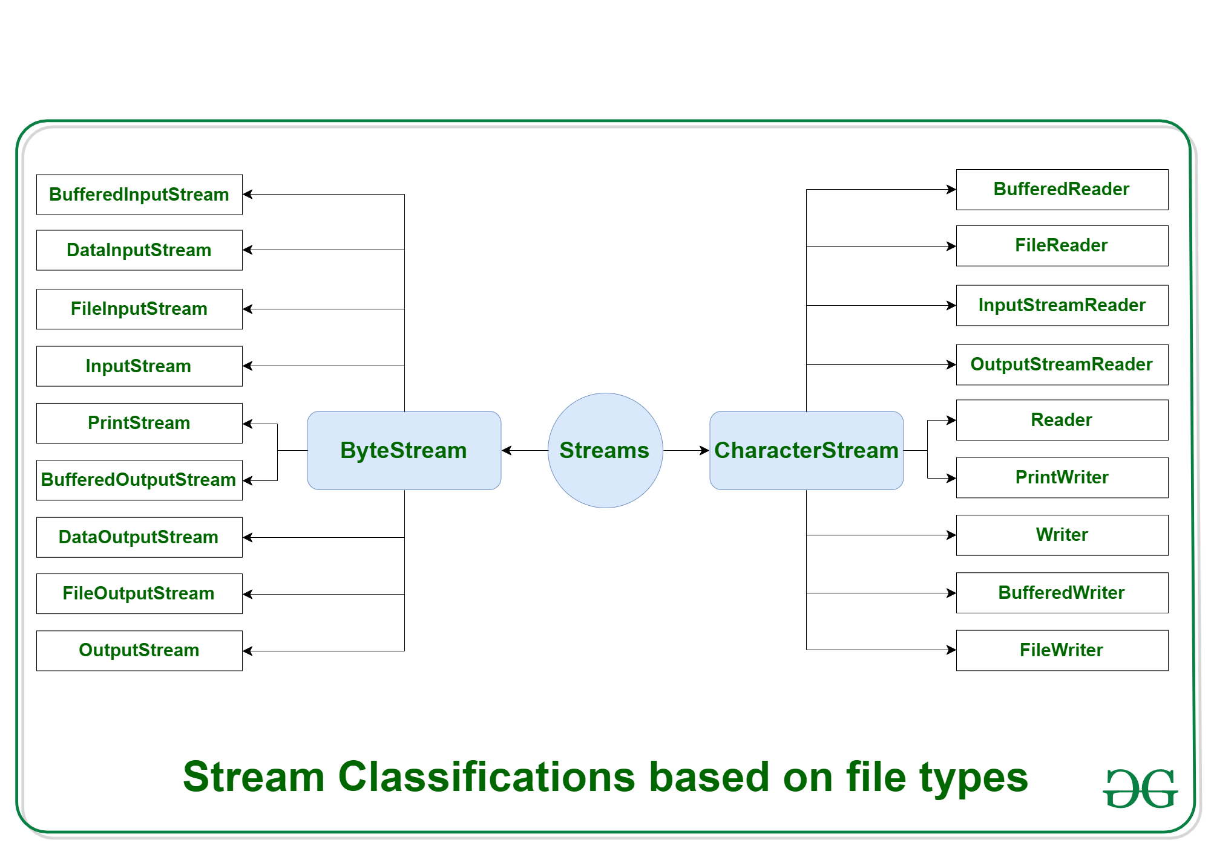
Java I/O
Depending on the types of file, Streams can be divided into two primary classes which can be further divided into other classes as can be seen through the diagram below followed by the explanations.

Slide 15
Java I/O
Byte Stream
Stream class | Description
BufferedInputStream | It is used for Buffered Input Stream.
DataInputStream | It contains method for reading java standard datatypes.
FileInputStream | This is used to reads from a file
InputStream | This is an abstract class that describes stream input.
PrintStream | This contains the most used print() and println() method
BufferedOutputStream | This is used for Buffered Output Stream.
DataOutputStream | This contains method for writing java standard data types.
FileOutputStream | This is used to write to a file.
OutputStream | This is an abstract class that describe stream output.

Slide 16
Java I/O
// Java Program illustrating the Byte Stream to copy contents of one file to another file.
import java.io.*;
public class BStream {
public static void main(String[] args) throws IOException
{
FileInputStream sourceStream = null;
FileOutputStream targetStream = null;
try {
sourceStream = new FileInputStream("sorcefile.txt");
targetStream = new FileOutputStream("targetfile.txt");
// Reading source file and writing content to target file byte by byte
int temp;
while ((temp = sourceStream.read())!= -1)
targetStream.write((byte)temp);
}
finally {
if (sourceStream != null)
sourceStream.close();
if (targetStream != null)
targetStream.close();
}
}
}

Slide 17
Java I/O
CharacterStream: In Java, characters are stored using Unicode conventions. Character stream automatically allows us to read/write data character by character. Here is the list of various CharacterStream Classes:
Stream class | Description
BufferedReader | It is used to handle buffered input stream.
FileReader | This is an input stream that reads from file.
InputStreamReader | This input stream is used to translate byte to character.
OutputStreamReader | This output stream is used to translate character to byte.
Reader | This is an abstract class that define character stream input.
PrintWriter | This contains the most used print() and println() method
Writer | This is an abstract class that define character stream output.
BufferedWriter | This is used to handle buffered output stream.
FileWriter | This is used to output stream that writes to file.

Slide 18
Banking Project
import java.io.*;
class BankWork
{
// initialize and declare objects.
final int max_limit=20;
final int min_limit=1;
final double min_bal=500;
private String name[]=new String[20];
private int accNo[]=new int[20];
private String accType[]=new String[20];
private double balamount[]=new double[20];
static int totRec=0;
// create a constructor here of Bank.
BankWork()
{
for(int i=0;i<max_limit;i++)
{
name[i]="";
accNo[i]=0;
accType[i]="";
balamount[i]=0.0;
}
}
// Create method to create New entry.
public void newEntry()
{
String str;
int account;
double amount;
boolean permit;
permit=true;
if (totRec>max_limit)
{
System.out.println("\n\n\nSorry we cannot admit you in our bank...\n\n\n");
permit=false;
}
// create new entry.
if(permit = true)
{
totRec++;
// Incrementing Records
System.out.println("\n\n\n=====SAVING NEW ENTRY=====");
try
{
accNo[totRec]=totRec; //Created AutoNumber to accNo so no invalid id occurs
System.out.println("Account Number : "+accNo[totRec]);
// create object.
BufferedReader obj = new BufferedReader(new InputStreamReader(System.in));
// enter the name of customer here.
System.out.print("Enter the name of the Customer : ");
System.out.flush();
name[totRec]=obj.readLine();

Slide 19
Banking Project
// enter the type of account.
System.out.print("Enter Account Type : ");
System.out.flush();
accType[totRec]=obj.readLine();
do
{
// enter the starting amount.
// minimum amount must be 1000.
System.out.print("Enter Initial Amount to be deposited : ");
System.out.flush();
str=obj.readLine();
balamount[totRec]=Double.parseDouble(str);
}
while(balamount[totRec]<min_bal);
System.out.println("\n\n\n");
}
catch(Exception e)
{
System.out.println("Exception in Entering a record.....");
}
}
}
// create method to display records.
public void display()
{
String str;
int account=0;
boolean valid=true;
System.out.println("\n\n=====DISPLAYING THE RECORDS=====\n");
try
{
// create object.
BufferedReader obj = new BufferedReader(new InputStreamReader(System.in));
// enter account number.
System.out.print("Enter the account number for display record : ");
System.out.flush();
str=obj.readLine();
account=Integer.parseInt(str);
// check for valid account number
if (account<min_limit || account>totRec)
{
System.out.println("\n\n\nInvalid Account Number \n\n");
valid=false;
}
if (valid==true)
{
System.out.println("\n\nAccount Number : "+accNo[account]);
System.out.println("Name : "+name[account]);
System.out.println("Account Type : "+accType[account]);
System.out.println("Balance Amount : "+balamount[account]+"\n\n\n");
}
}
catch(Exception e)
{
System.out.println("Exception in Displaying record.....");
}
}

Slide 20
Banking Project
// create method to deposit amount.
public void deposit()
{
String str;
double amount;
int account;
boolean valid=true;
System.out.println("\n\n\n=====DEPOSIT AMOUNT=====");
try
{
// create object.
BufferedReader obj = new BufferedReader(new InputStreamReader(System.in));
System.out.print("Enter Account No : ");
System.out.flush();
str=obj.readLine();
account=Integer.parseInt(str);
// check valid account number.
if (account<min_limit || account>totRec)
{
System.out.println("\n\n\nInvalid Account Number \n\n");
valid=false;
}
if (valid==true)
{
System.out.print("Enter Amount you want to Deposit : ");
System.out.flush();
str=obj.readLine();
amount=Double.parseDouble(str);
balamount[account]=balamount[account]+amount;
//Displaying Depsit Details
System.out.println("\nAfter Updation...");
System.out.println("Account Number : "+account);
System.out.println("Balance Amount : "+balamount[account]+"\n\n\n");
}
}
catch(Exception e)
{
System.out.println("Exception in Depositing record.....");
}
}
// creating method for withdraw money.
public void withdraw()
{
String str;
double amount,checkamount;
int account;
boolean valid=true;
System.out.println("\n\n\n=====WITHDRAW MONEY=====");
try
{
// create object.
BufferedReader obj = new BufferedReader(new InputStreamReader(System.in));
// enter account number for entering money
System.out.print("Enter the account number to withdraw money : ");
System.out.flush();
str=obj.readLine();
account=Integer.parseInt(str);
// check for valid account number.
if (account<min_limit || account>totRec)
{
System.out.println("\n\n\nInvalid Account Number \n\n");
valid=false;
}

Slide 21
Banking Project
if (valid==true)
{
System.out.println("Balance is : "+balamount[account]);
System.out.print("Enter Amount you want to withdraw : ");
System.out.flush();
str=obj.readLine();
amount=Double.parseDouble(str);
checkamount=balamount[account]-amount;
if(checkamount >= min_bal)
{
balamount[account]=checkamount;
// Updating the amount after withdraw.
System.out.println("\nAfter Updation...");
System.out.println("Account Number : "+account);
System.out.println("Balance Amount : "+balamount[account]+"\n\n\n");
}
else
{
System.out.println("\n\nAs per Bank Rule you should maintain minimum balance of Rs 500\n\n\n");
}
}
}
catch(Exception e)
{
System.out.println("Exception in Withdrawing record.....");
}
}
};
class Bank
{
public static void main(String args[])
{
String str;
int choice;
choice=0;
BankWork BW_obj = new BankWork();
do
{
// creating Menu.
System.out.println("Choose Your Choices ...");
System.out.println("1) New Record Entry ");
System.out.println("2) Display Record Details ");
System.out.println("3) Deposit...");
System.out.println("4) Withdraw...");
System.out.println("5) Exit");
System.out.print("Enter your choice : ");
System.out.flush();
try
{
// creating objects.
BufferedReader obj = new BufferedReader(new InputStreamReader(System.in));
str=obj.readLine();
choice=Integer.parseInt(str);
switch(choice)
{
case 1 :
// for new entry.
BW_obj.newEntry();
break;
case 2 :
// for display.
BW_obj.display();
break;

Slide 22
Banking Project
case 3 :
// for deposit.
BW_obj.deposit();
break;
case 4 :
// for display.
BW_obj.withdraw();
break;
case 5 :
System.out.println("\n\n.....THANKS FOR VISITING.....");
break;
default : System.out.println("\nInvalid Choice \n\n");
}
}
catch(Exception e)
{
System.out.println("Exception in Main....");
}
}
while(choice!=5);
}
}

Slide 23
Project # 1 (10)
Develop an Enterprise Solution by converting this banking project with file operations such that all the information will be stored, updated, retrieved from a file.

