Slide 1
Enterprise Application Development With Java EE
Dr. Qaiser Abbas
Department of Computer Science & IT,
University of Sargodha
qaiser.abbas@uos.edu.pk

Slide 2
What is a Servlet?
Servlet can be described in many ways, depending on the context.
  Servlet is a technology which is used to create a web application.
  Servlet is an API that provides many interfaces and classes including documentation.
  Servlet is an interface that must be implemented for creating any Servlet.
  Servlet is a class that extends the capabilities of the servers and responds to the incoming requests. It can respond to any requests.
  Servlet is a web component that is deployed on the server to create a dynamic web page.

Slide 3
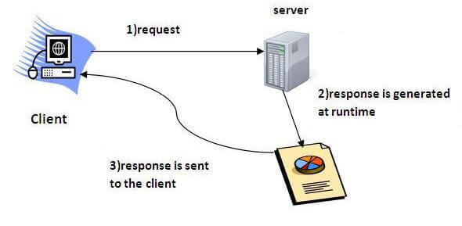
What is a Servlet?

Slide 4
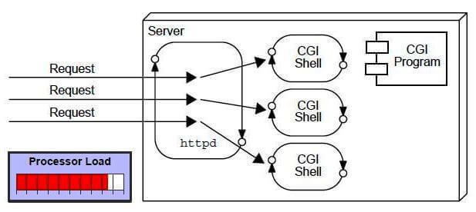
CGI (Common Gateway Interface)
CGI technology enables the web server to call an external program and pass HTTP request information to the external program to process the request. For each request, it starts a new process.

Slide 5
Disadvantages of CGI
There are many problems in CGI technology:
  If the number of clients increases, it takes more time for sending the response.
  For each request, it starts a process, and the web server is limited to start processes.
  It uses platform dependent language e.g. C, C++, perl.

Slide 6
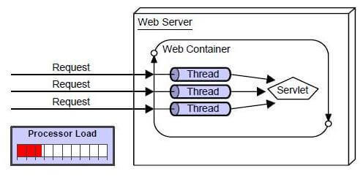
Advantages of CGI
There are many advantages of Servlet over CGI. The web container creates threads for handling the multiple requests to the Servlet. Threads have many benefits over the Processes such as they share a common memory area, lightweight, cost of communication between the threads are low. The advantages of Servlet are as follows:
  Better performance: because it creates a thread for each request, not process.
  Portability: because it uses Java language.
  Robust: JVM manages Servlets, so we don't need to worry about the memory leak, garbage collection, etc.
  Secure: because it uses java language.

Slide 7
Servlet API
The javax.servlet and javax.servlet.http packages represent interfaces and classes for servlet api.
The javax.servlet package contains many interfaces and classes that are used by the servlet or web container. These are not specific to any protocol.
The javax.servlet.http package contains interfaces and classes that are responsible for http requests only.

Slide 8
Interfaces in javax.servlet package
There are many interfaces in javax.servlet package. They are as follows:
  Servlet
  ServletRequest
  ServletResponse
  RequestDispatcher
  ServletConfig
  ServletContext
  SingleThreadModel
  Filter
  FilterConfig
  FilterChain
  ServletRequestListener
  ServletRequestAttributeListener
  ServletContextListener
  ServletContextAttributeListener

Slide 9
Classes in javax.servlet package
There are many classes in javax.servlet package. They are as follows:
  GenericServlet
  ServletInputStream
  ServletOutputStream
  ServletRequestWrapper
  ServletResponseWrapper
  ServletRequestEvent
  ServletContextEvent
  ServletRequestAttributeEvent
  ServletContextAttributeEvent
  ServletException
  UnavailableException

Slide 10
Interfaces in javax.servlet.http package
There are many interfaces in javax.servlet.http package. They are as follows:
  HttpServletRequest
  HttpServletResponse
  HttpSession
  HttpSessionListener
  HttpSessionAttributeListener
  HttpSessionBindingListener
  HttpSessionActivationListener
  HttpSessionContext (deprecated now)

Slide 11
Classes in javax.servlet.http package
There are many classes in javax.servlet.http package. They are as follows:
  HttpServlet
  Cookie
  HttpServletRequestWrapper
  HttpServletResponseWrapper
  HttpSessionEvent
  HttpSessionBindingEvent
  HttpUtils (deprecated now)

Slide 12
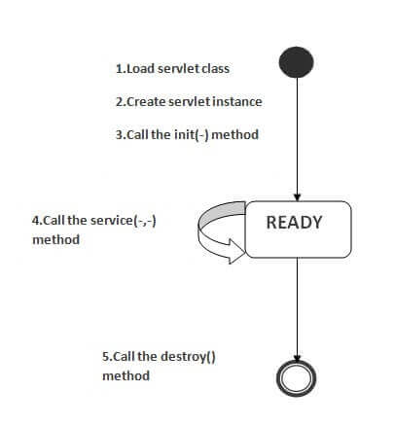
Life Cycle of a Servlet (Servlet Life Cycle)
The web container maintains the life cycle of a servlet instance. Let's see the life cycle of the servlet:
  Servlet class is loaded.
  Servlet instance is created.
  init method is invoked.
  service method is invoked.
  destroy method is invoked.

Slide 13
Life Cycle of a Servlet (Servlet Life Cycle)
1) Servlet class is loaded
  The classloader is responsible to load the servlet class. The servlet class is loaded when the first request for the servlet is received by the web container.
2) Servlet instance is created
  The web container creates the instance of a servlet after loading the servlet class. The servlet instance is created only once in the servlet life cycle.
3) init method is invoked
  The web container calls the init method only once after creating the servlet instance. The init method is used to initialize the servlet. It is the life cycle method of the javax.servlet.Servlet interface. Syntax of the init method is given below:
  public void init(ServletConfig config) throws ServletException

Slide 14
Life Cycle of a Servlet (Servlet Life Cycle)
4) service method is invoked
  The web container calls the service method each time when request for the servlet is received. If servlet is not initialized, it follows the first three steps as described above then calls the service method. If servlet is initialized, it calls the service method. Notice that servlet is initialized only once. The syntax of the service method of the Servlet interface is given below:
  public void service(ServletRequest request, ServletResponse response) throws ServletException, IOException
5) destroy method is invoked
  The web container calls the destroy method before removing the servlet instance from the service. It gives the servlet an opportunity to clean up any resource for example memory, thread etc. The syntax of the destroy method of the Servlet interface is given below
  public void destroy()

Slide 15
Servlet Life Cycle Example
package servlet;
import java.io.IOException;
import java.io.PrintWriter;
import jakarta.servlet.Servlet;
import jakarta.servlet.ServletConfig;
import jakarta.servlet.ServletException;
import jakarta.servlet.ServletRequest;
import jakarta.servlet.ServletResponse;
import jakarta.servlet.annotation.WebServlet;
@WebServlet("/ServletInterface")
public class DemoServlet implements Servlet {
private ServletConfig config = null;
@Override
public void init(ServletConfig config) throws ServletException {
this.config = config;
System.out.println("iniside init method : " + config.getServletName());
}
@Override
public ServletConfig getServletConfig() {
return this.config;
}
@Override
public void service(ServletRequest req, ServletResponse res) throws ServletException, IOException {
System.out.println("inside service method");
res.setContentType("text/html");
PrintWriter out = res.getWriter();
out.print("<html><body>");
out.print("<b> Servlet Interface Example</b>");
out.print("</body></html>");
}
@Override
public String getServletInfo() {
return "Demonstrated implementaton of Servlet interface";
}
@Override
public void destroy() {
System.out.println("inside destroy method");
}
}
DemoServlet.java (as type servlet in IDE)

Slide 16
Servlet Life Cycle Example
<html> <head> <title>Servlet's Practice</title> </head> <body>
<form method ="get" action="DemoServlet">
UserId: <input type="text" name="id" /> <br><br>
<input type="submit" value="Click Me To See Servlet!"/> </form> </body> </html>
Servlet.html

Slide 17
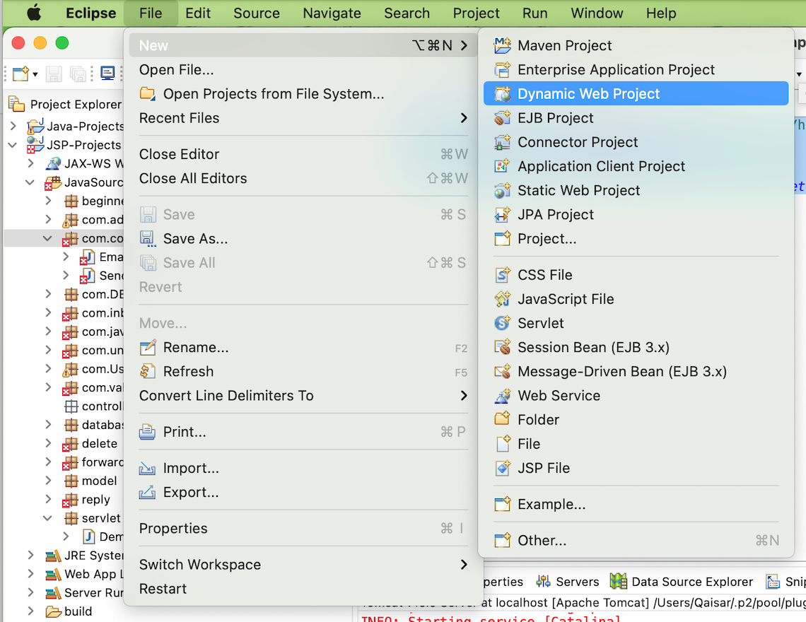
Creating Servlet in myeclipse IDE
You need to follow the following steps to create the servlet in the Eclipse IDE. The steps are as follows:
  Create a web project
  create a html file
  create a servlet
  start Eclipse Tomcat Server and deploy project
1) Create the web project:
  For creating a web project click on File Menu -> New -> Dynamic Web Project -> write your project name e.g. first -> Finish.

Slide 18
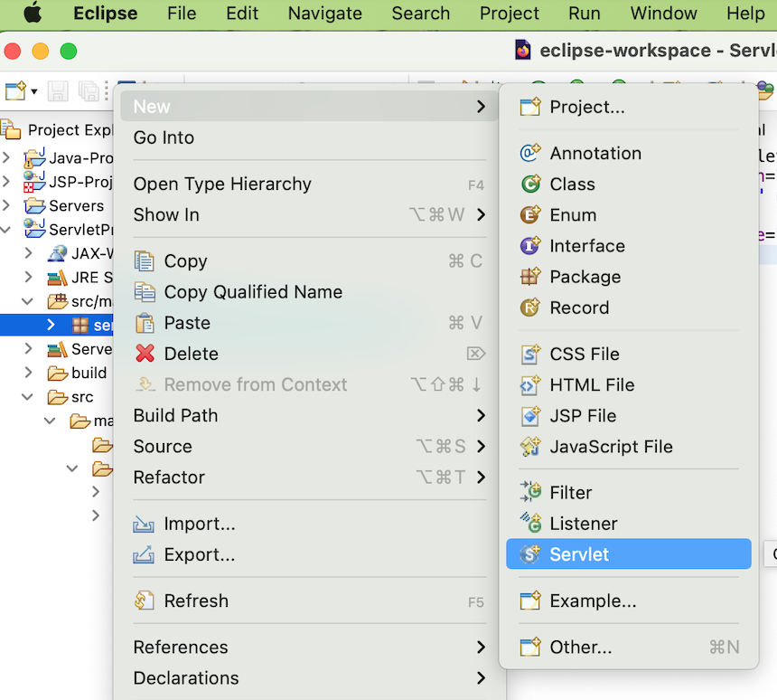
Creating Servlet in myeclipse IDE
2) Create the html file:
  Create the myHtml.html file as follows:
  <form action="servlet/Hello">Name:<input type="text" name="user"/><input type="submit" value="go"/></form>
3) Create the servlet:
  For creating a servlet click on File Menu -> New -> servlet -> write your servlet name e.g. Hello -> uncheck all the checkboxes except doGet() -> next -> Finish.
  As you can see that a servlet file is created named Hello.java. Now let's write the servlet code here.
  Now let's make the MyHtml.html file as the default page of our project. For this, open web.xml file and change the welcome file name as MyHtml.html

Slide 19
Creating Servlet in myeclipse IDE
import java.io.IOException;
import java.io.PrintWriter;
import javax.servlet.ServletException;
import javax.servlet.http.HttpServlet;
import javax.servlet.http.HttpServletRequest;
import javax.servlet.http.HttpServletResponse;
public class Hello extends HttpServlet {
public void doGet(HttpServletRequest request, HttpServletResponse response)
throws ServletException, IOException {
response.setContentType("text/html");
PrintWriter out = response.getWriter();
String name=request.getParameter("user");
out.print("Hello "+name);
out.close();
}
}
4) Start the server and deploy the project:
  For starting the server and deploying the project in one step Right click on your project -> Run As -> MyEclipse server application.
Hello.java as servlet

