Slide 1
Lecture material augmented with Dan Jurafsky’s presentation slides
Chapter 8:
Part-of-Speech Tagging

Slide 2
Part of Speech (POS)
Part-of-speech: noun, verb, pronoun, preposition, adverb, conjunction, participle, article, etc. It is also known as POS, word classes
Reveal a lot about a word and its neighbors.
Word classes may be either open or closed. An open class is one that commonly accepts the addition of new words, while a closed class is one to which new items are very rarely added.
For example in IT:
  Open class
      Noun: Internet, website, URL, CD-ROM, email, newsgroup, bitmap, modem, multimedia
      Verb: download, upload, reboot, right-click, double-click
      Similar is the case of adjectives and adverbs
  Close class
      On the other hand, we never invent new prepositions, determiners, or conjunctions. These classes include words like of, the, and but.

Slide 3
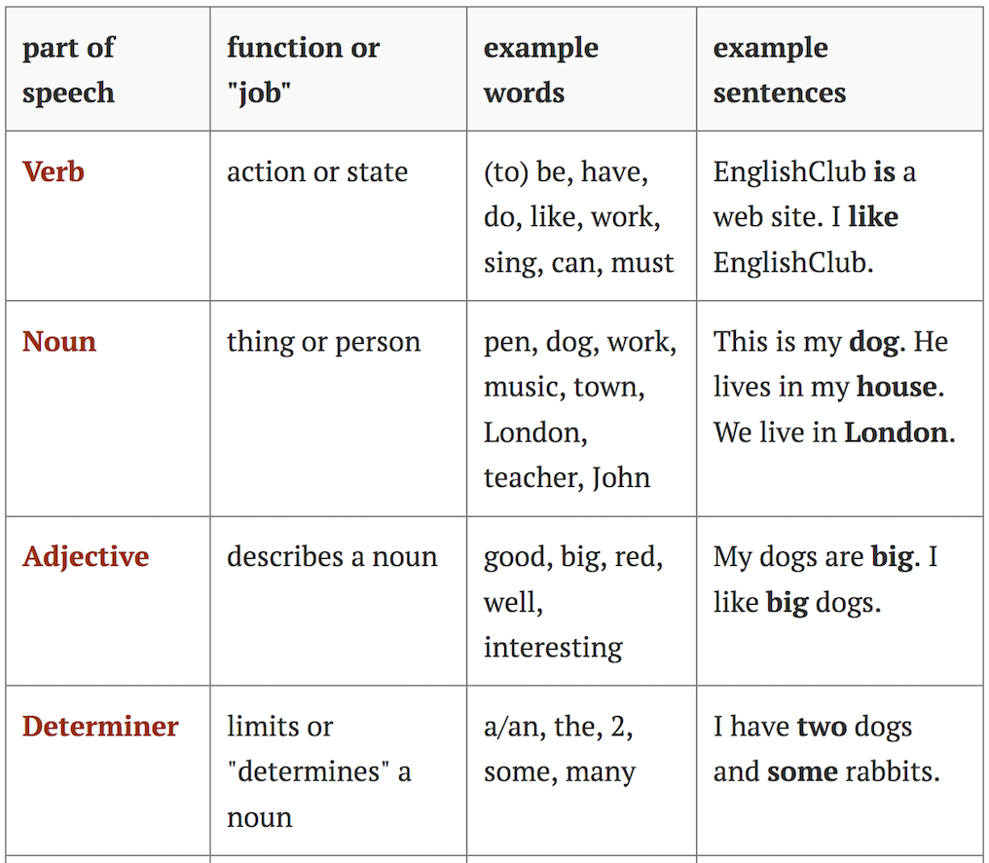
English Part of Speech (POS)

Slide 4
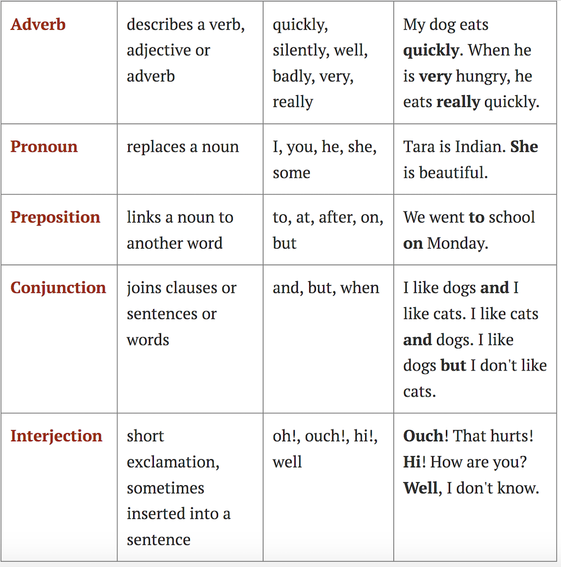
English Part of Speech (POS)

Slide 5
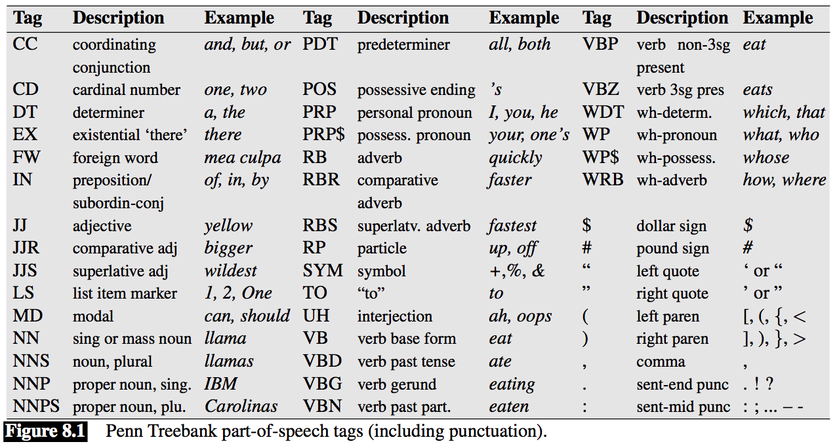
The Penn Treebank Part-of-Speech Tagset

Slide 6
The Penn Treebank Part-of-Speech Tagset
(8.1) The/DT grand/JJ jury/NN commented/VBD on/IN a/DT number/NN of/IN other/JJ topics/NNS ./.
(8.2) There/EX are/VBP 70/CD children/NNS there/RB
The Brown corpus is a million words of samples from 500 written texts from different genres published in the WSJ United States in 1961.
The WSJ corpus contains a million words published in the Switchboard Wall Street Journal in 1989.
The Switchboard corpus consists of 2 million words of telephone conversations collected in 1990-1991.
There are some minor differences in the tagsets used by the corpora.
Universal POS tag set of the Universal Dependencies project (Nivre et al., 2016a), is used when building systems that can tag many languages.

Slide 7
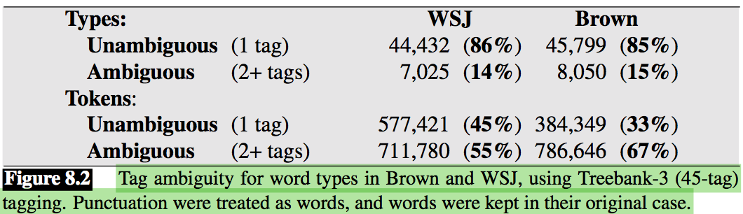
Part-of-Speech Tagging
Part-of-speech tagging is the process of assigning a part-of-speech marker to each word in an input text.
The input to a tagging algorithm is a sequence of (tokenized) words and a tagset, and the output is a sequence of tags, one per token.
Example:
  earnings growth took a back/JJ seat
  a small building in the back/NN
  a clear majority of senators back/VBP the bill Dave began to back/VB toward the door enable the country to buy back/RP about debt I was twenty-one back/RB then

Slide 8
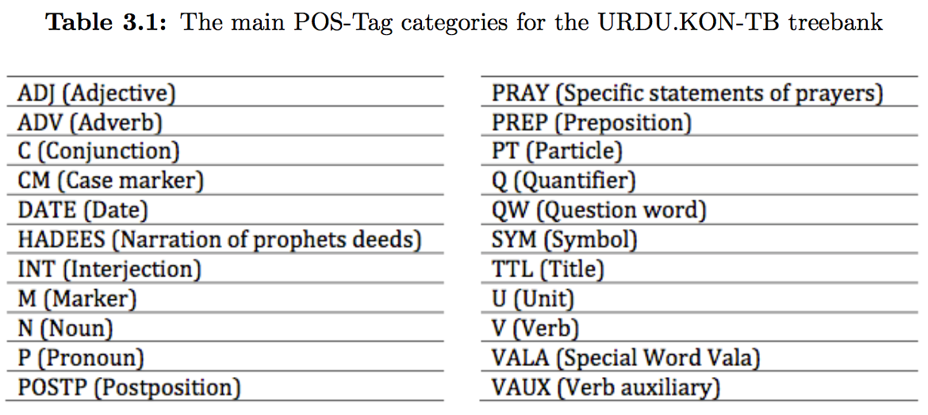
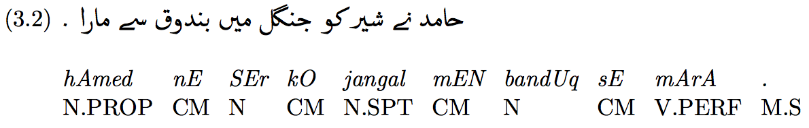
The URDU.KON-TB Part-of-Speech Tagset
(Abbas, 2012, 2014b, 2015)

Slide 9
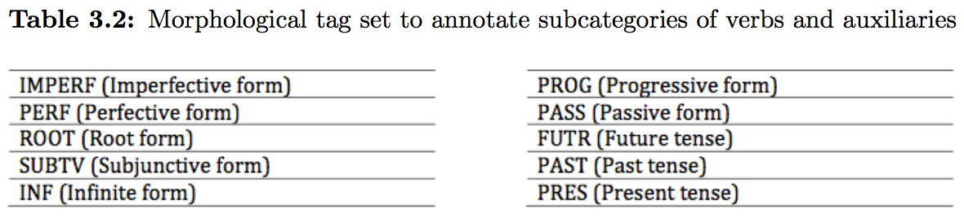
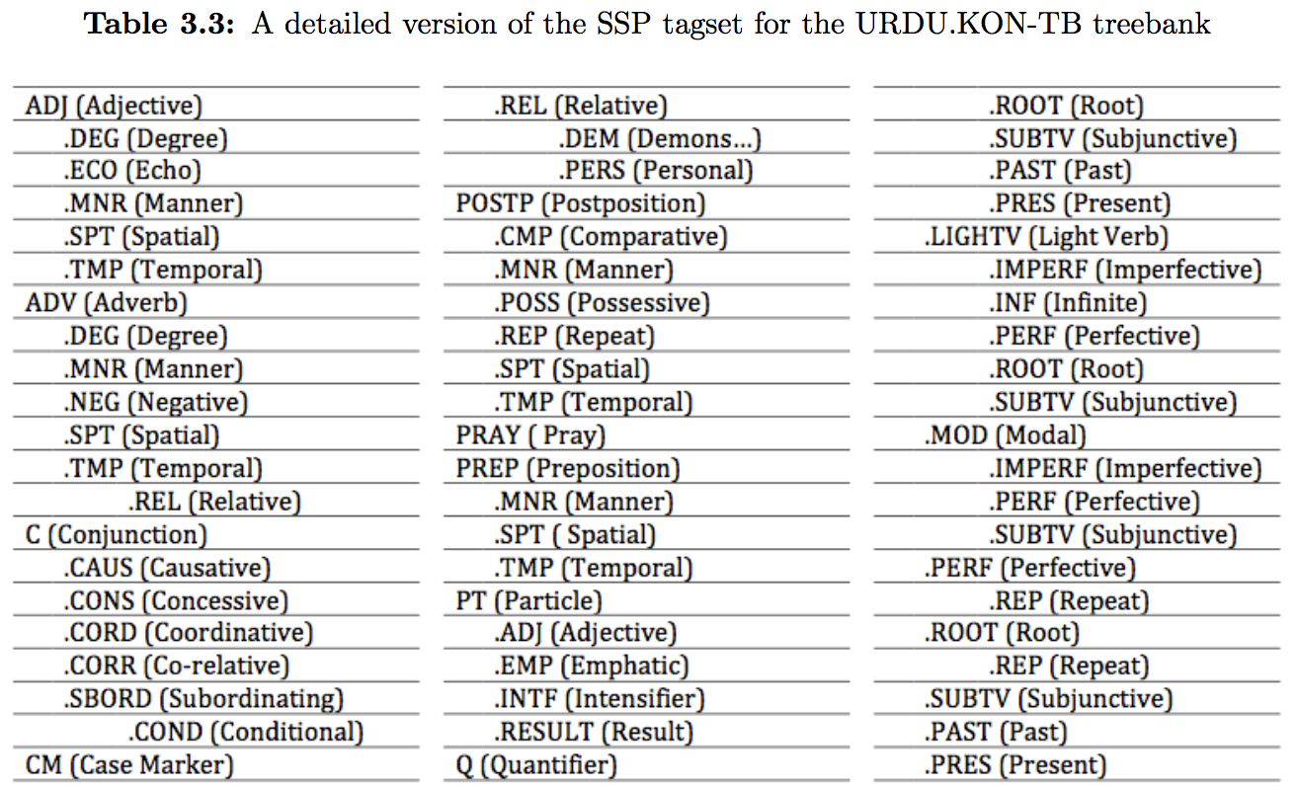
The URDU.KON-TB Part-of-Speech Tagset
(Abbas, 2014b, 2015)

Slide 10
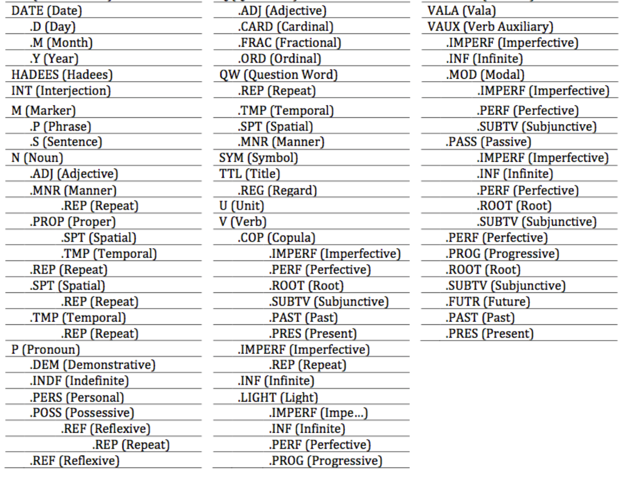
The URDU.KON-TB Part-of-Speech Tagset
(Abbas, 2014b)

Slide 11
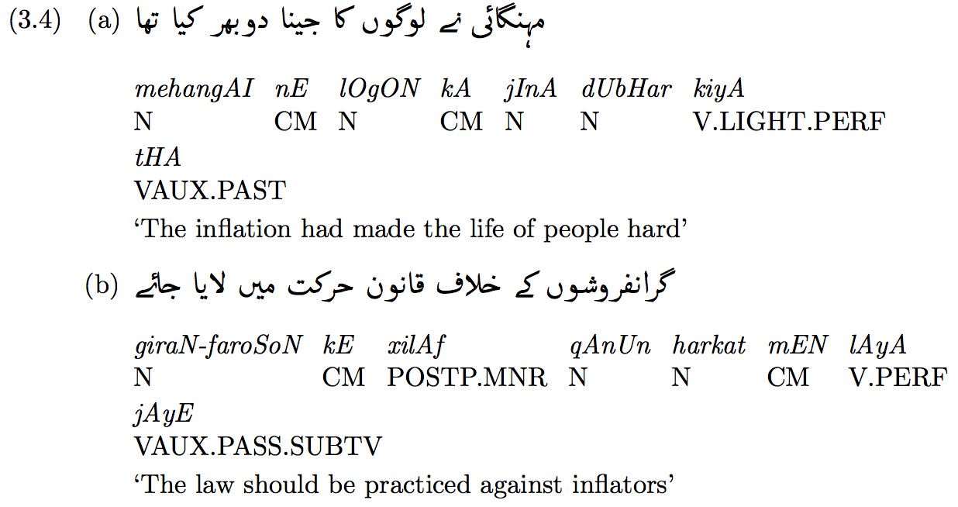
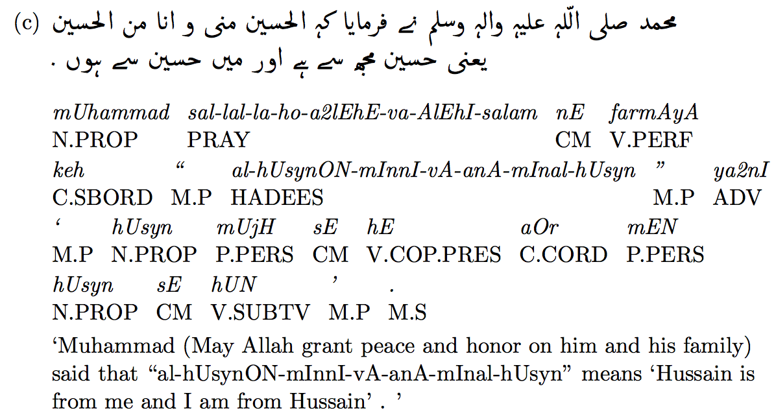
The URDU.KON-TB Part-of-Speech Tagset
(Abbas, 2014b)

Slide 12
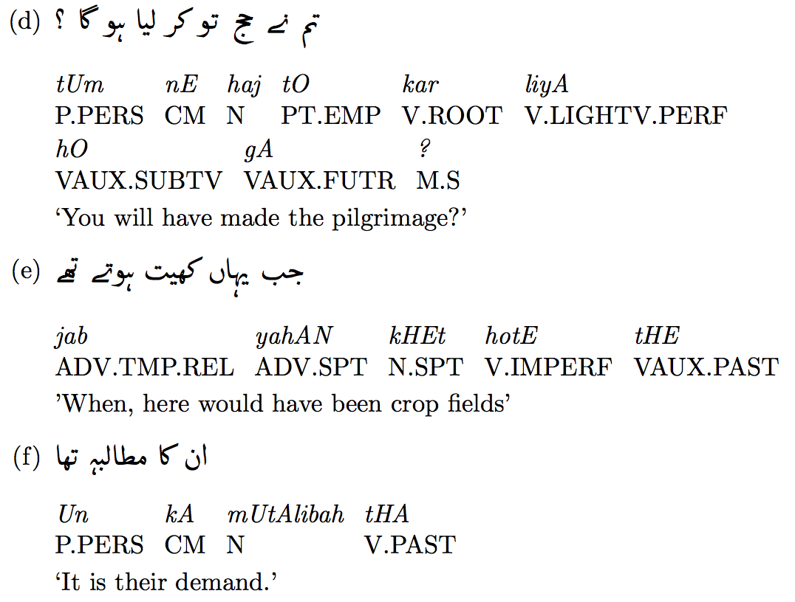
The URDU.KON-TB Part-of-Speech Tagset
(Abbas, 2014b)

Slide 13
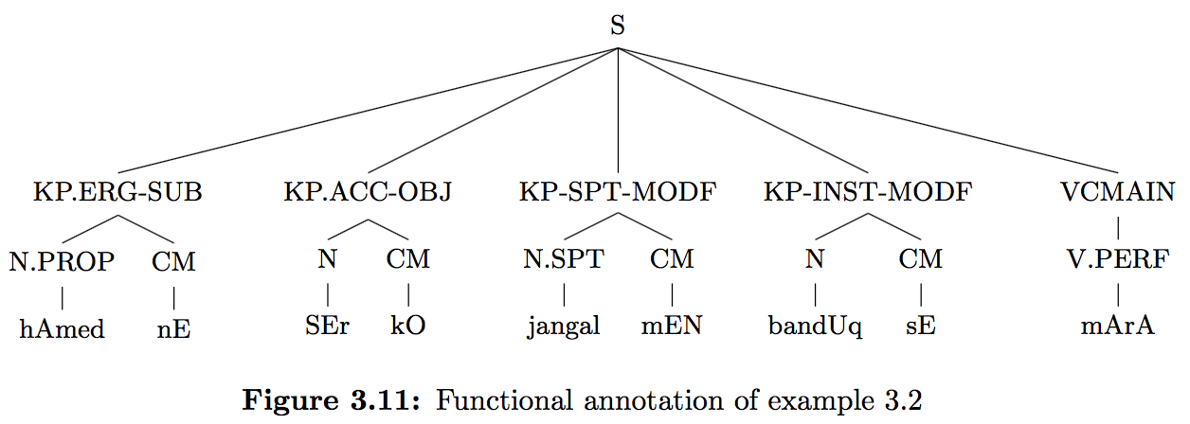
The URDU.KON-TB Annotation (Abbas, 2016)

Slide 14
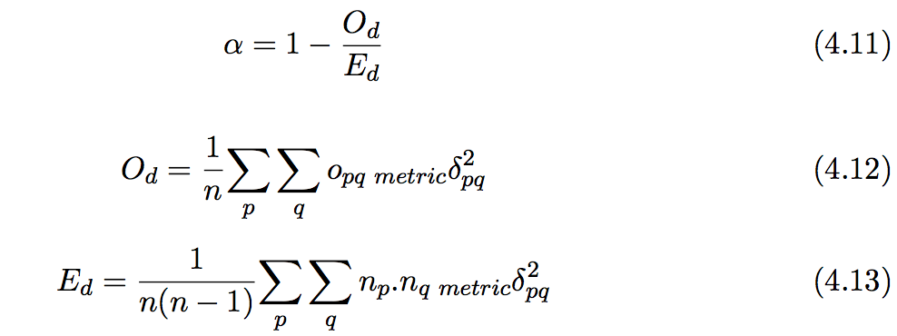
Annotation Evaluation (Abbas, 2014b)
Evaluation is the process of evaluating the reliability (consistency plus feasibility) of a annotation. This can be measured by calculating the agreement among annotators.
Some generally accepted statistical methods exist for the evaluation include S (Bennett et al., 1954), π (Scott, 1955), κ (Cohen et al., 1960) and α (Krippendorff’ α, 2004, 2012) used for either single, double or multi (more than two) annotators/coders.
where O_{d} is the observed disagreement and E_{d} is the expected disagreement. For perfect agreement among annotators, α becomes 1 and α = 0 is for absence of agreement. Variables o_{pq}, n_{p}, n_{q} and n are the frequencies of values in coincidence matrix, which will be discussed later.

Slide 15
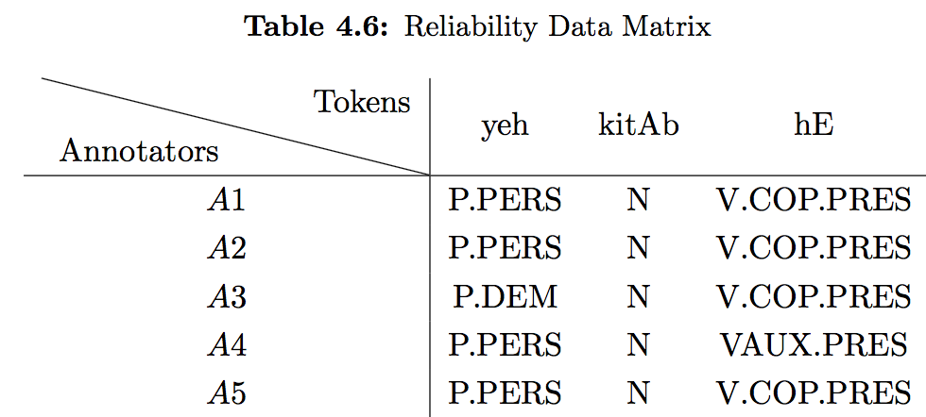
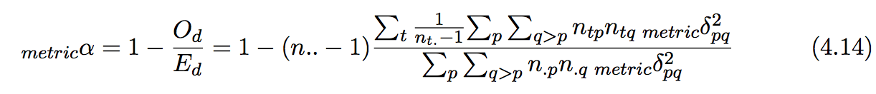
Annotation Evaluation (Abbas, 2014b)

Slide 16
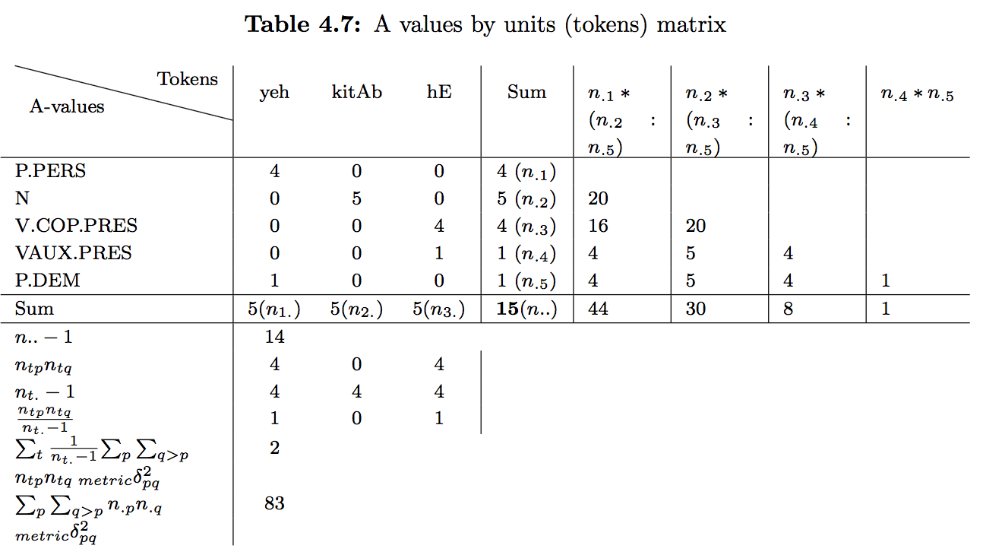

Annotation Evaluation (Abbas, 2014b)

Slide 17
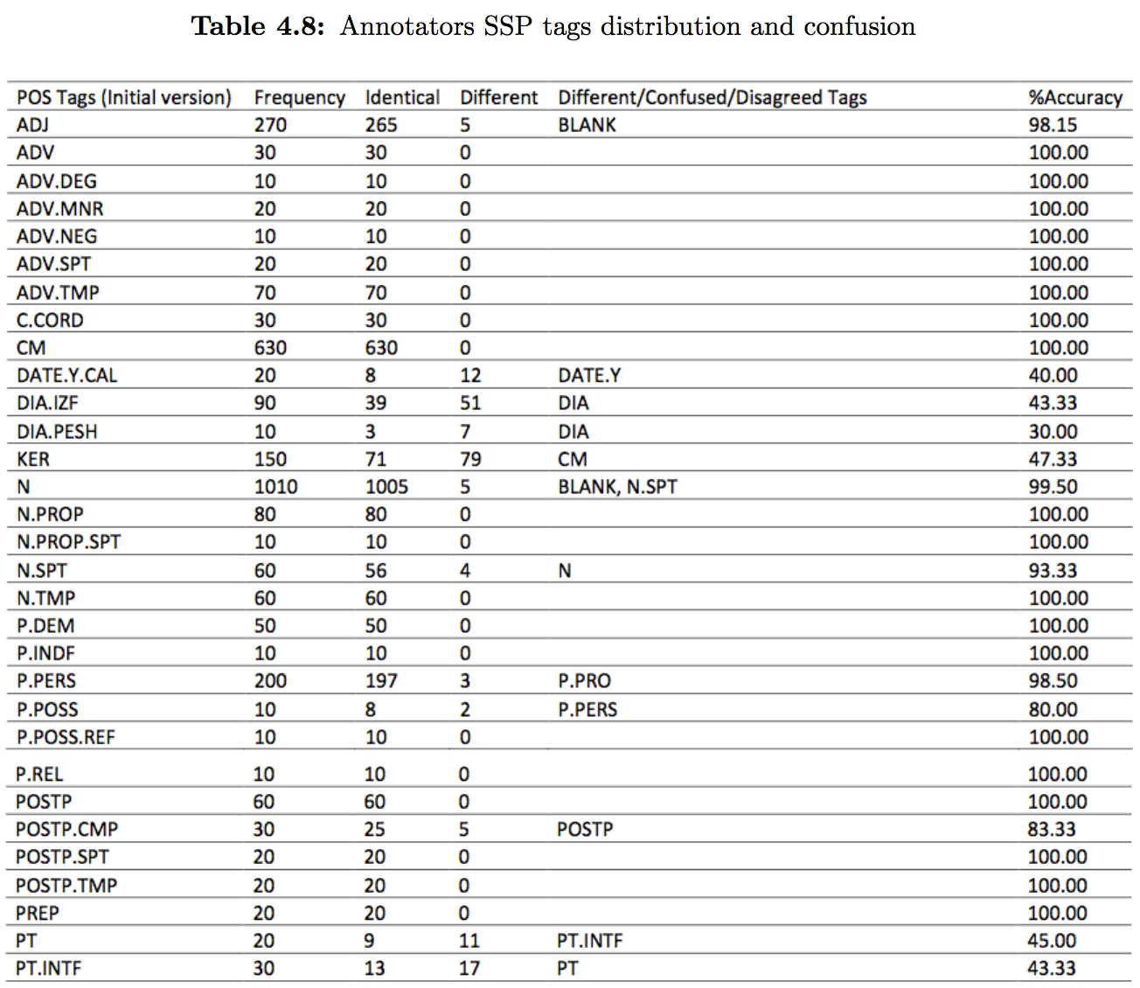
Tags Distribution and Confusion (Abbas, 2014b)

Slide 18
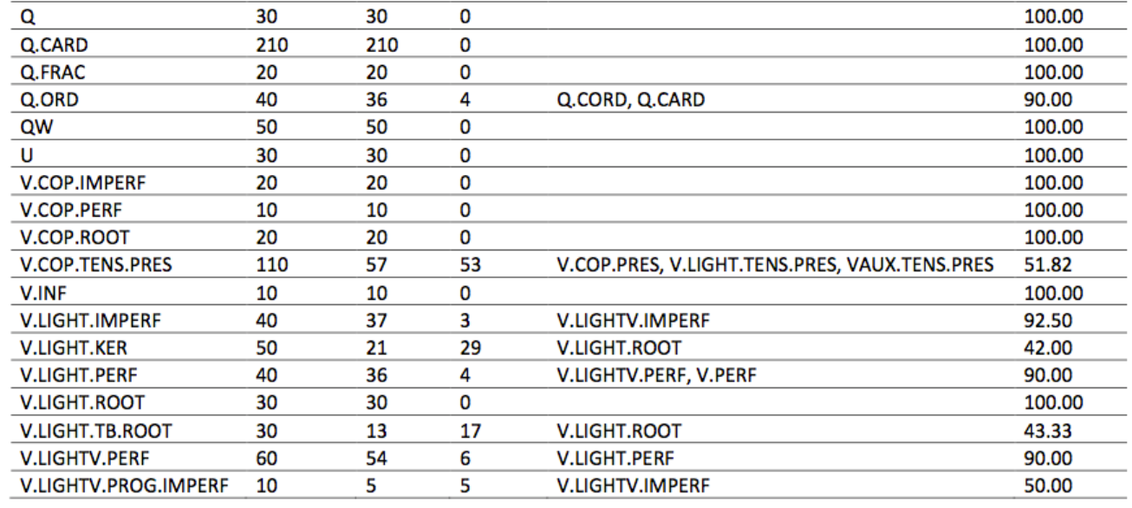
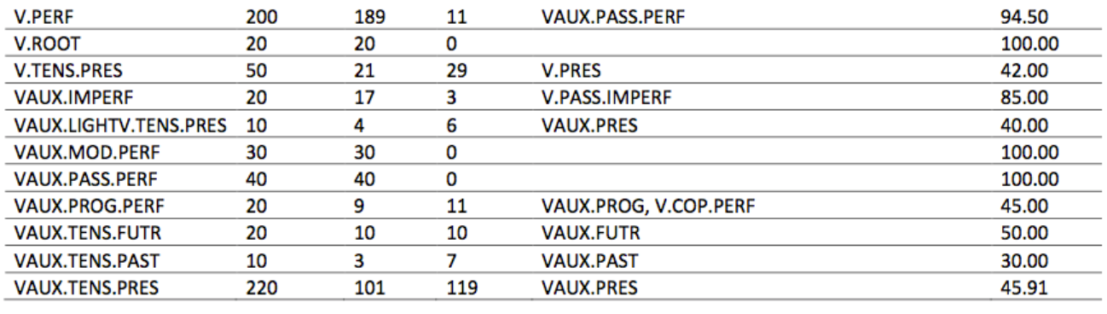
Tags Distribution and Confusion (Abbas, 2014b)

Slide 19
HMM Part-of-Speech Tagging
An HMM is a probabilistic sequence model: given a sequence of units (words, letters, morphemes, sentences, whatever), it computes a probability distribution over possible sequences of labels and chooses the best label sequence.
To understand HMM first we will get introduction of Markov Chains.

Slide 20
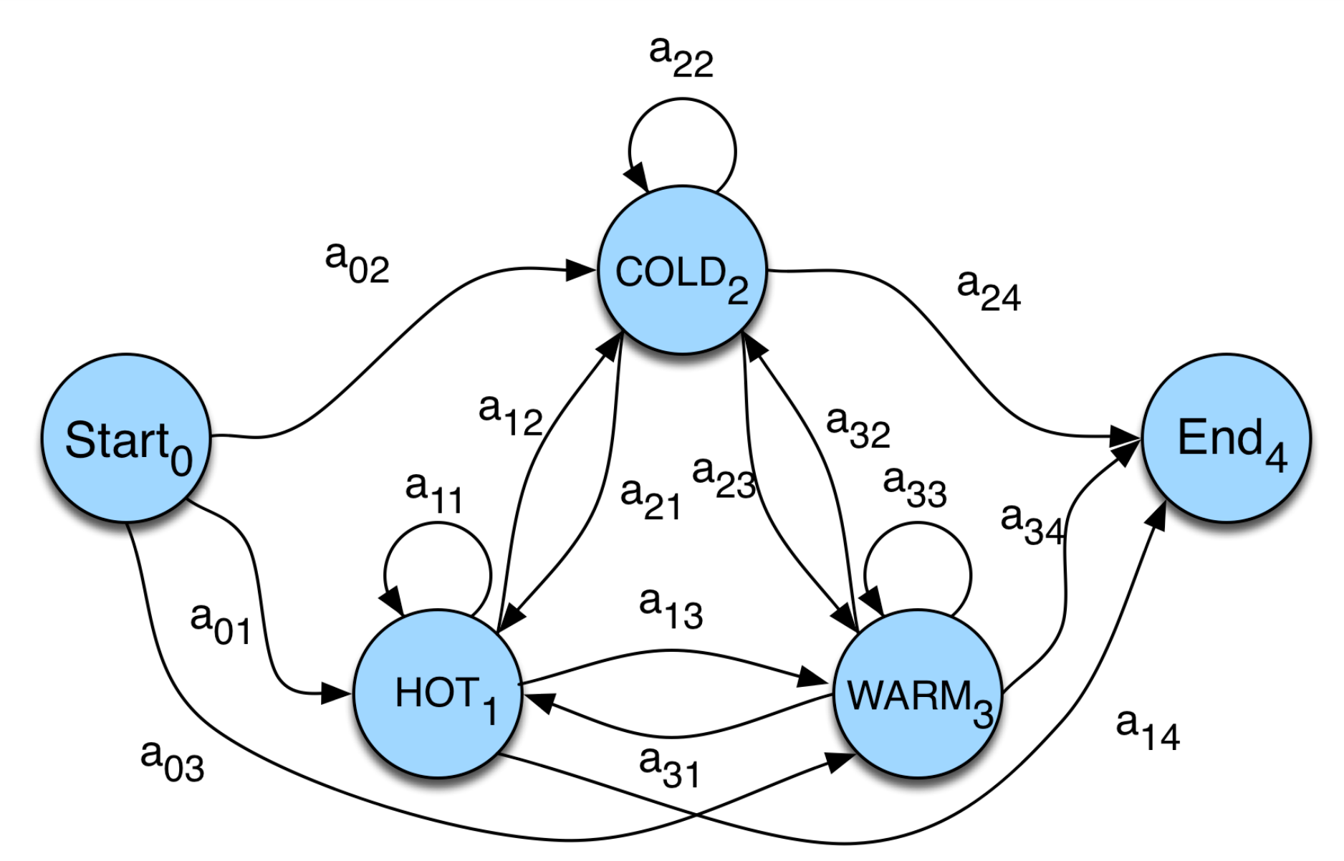
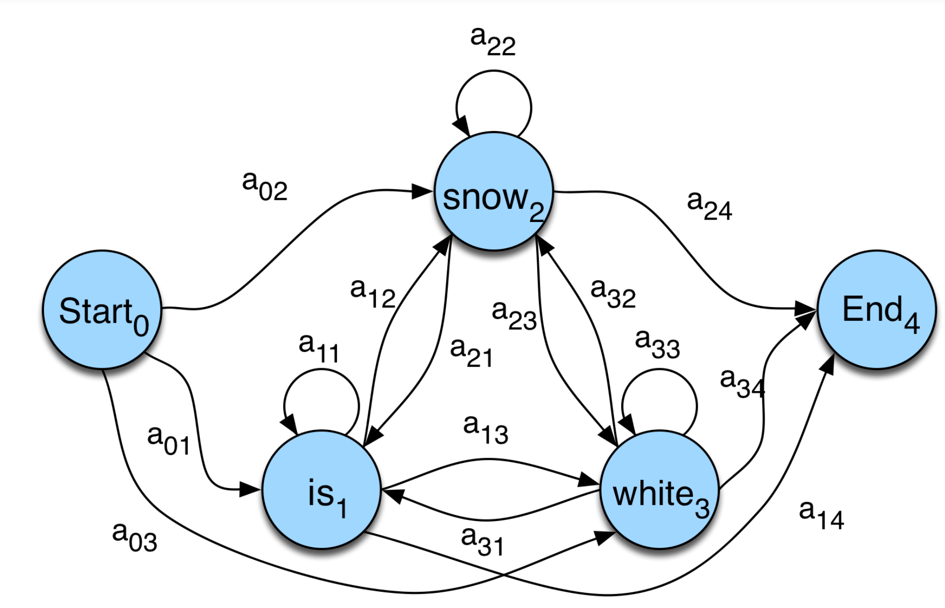
Markov Chains
A weighted finite-state automaton
  An FSA with probabilities on the arcs
  The sum of the probabilities leaving any arc must sum to one
  Useful for observable events like from Hot temperature to Cold temperature
Markov chain for weather (L) and words (R)

Slide 21
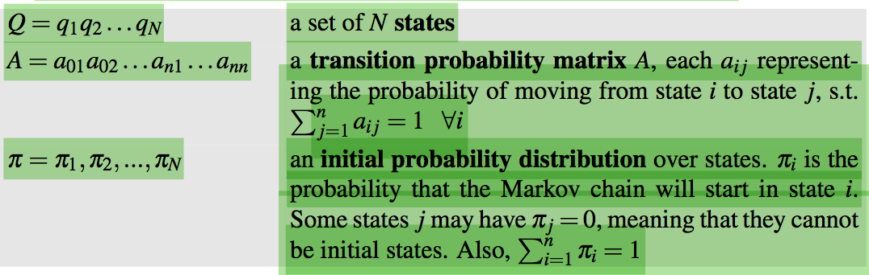
Markov Chains
Formally, a Markov chain is specified by the following components:
First-order observable Markov Model:
  Current state only depends on previous state
  Markov Assumption : P(q_{i} | q₁...q_{i−1}) = P(q_{i} | q_{i−1})

Slide 22
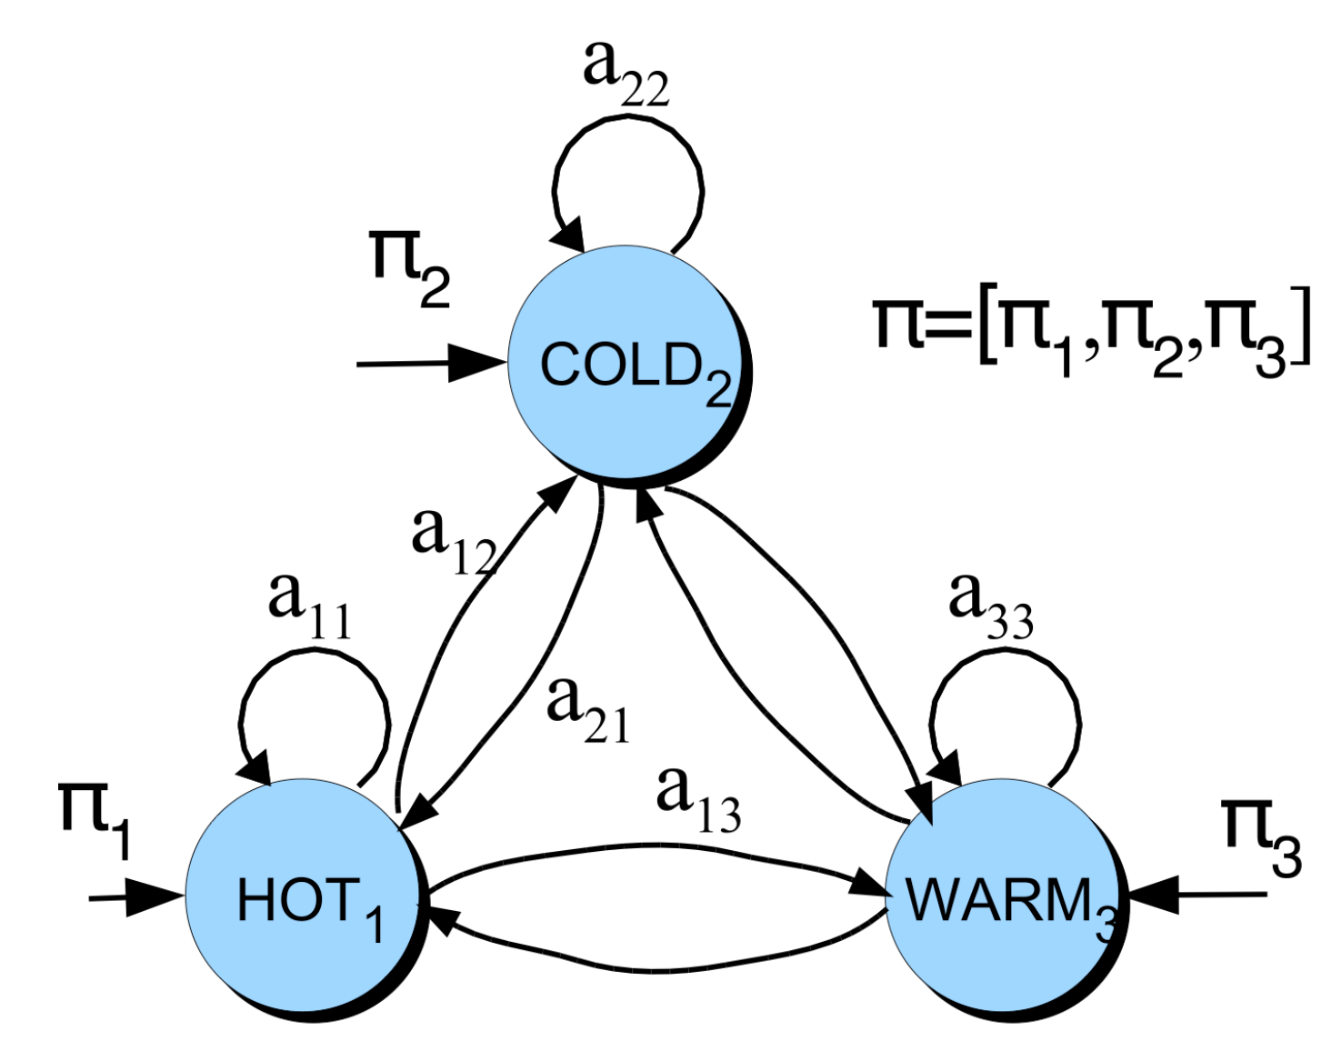
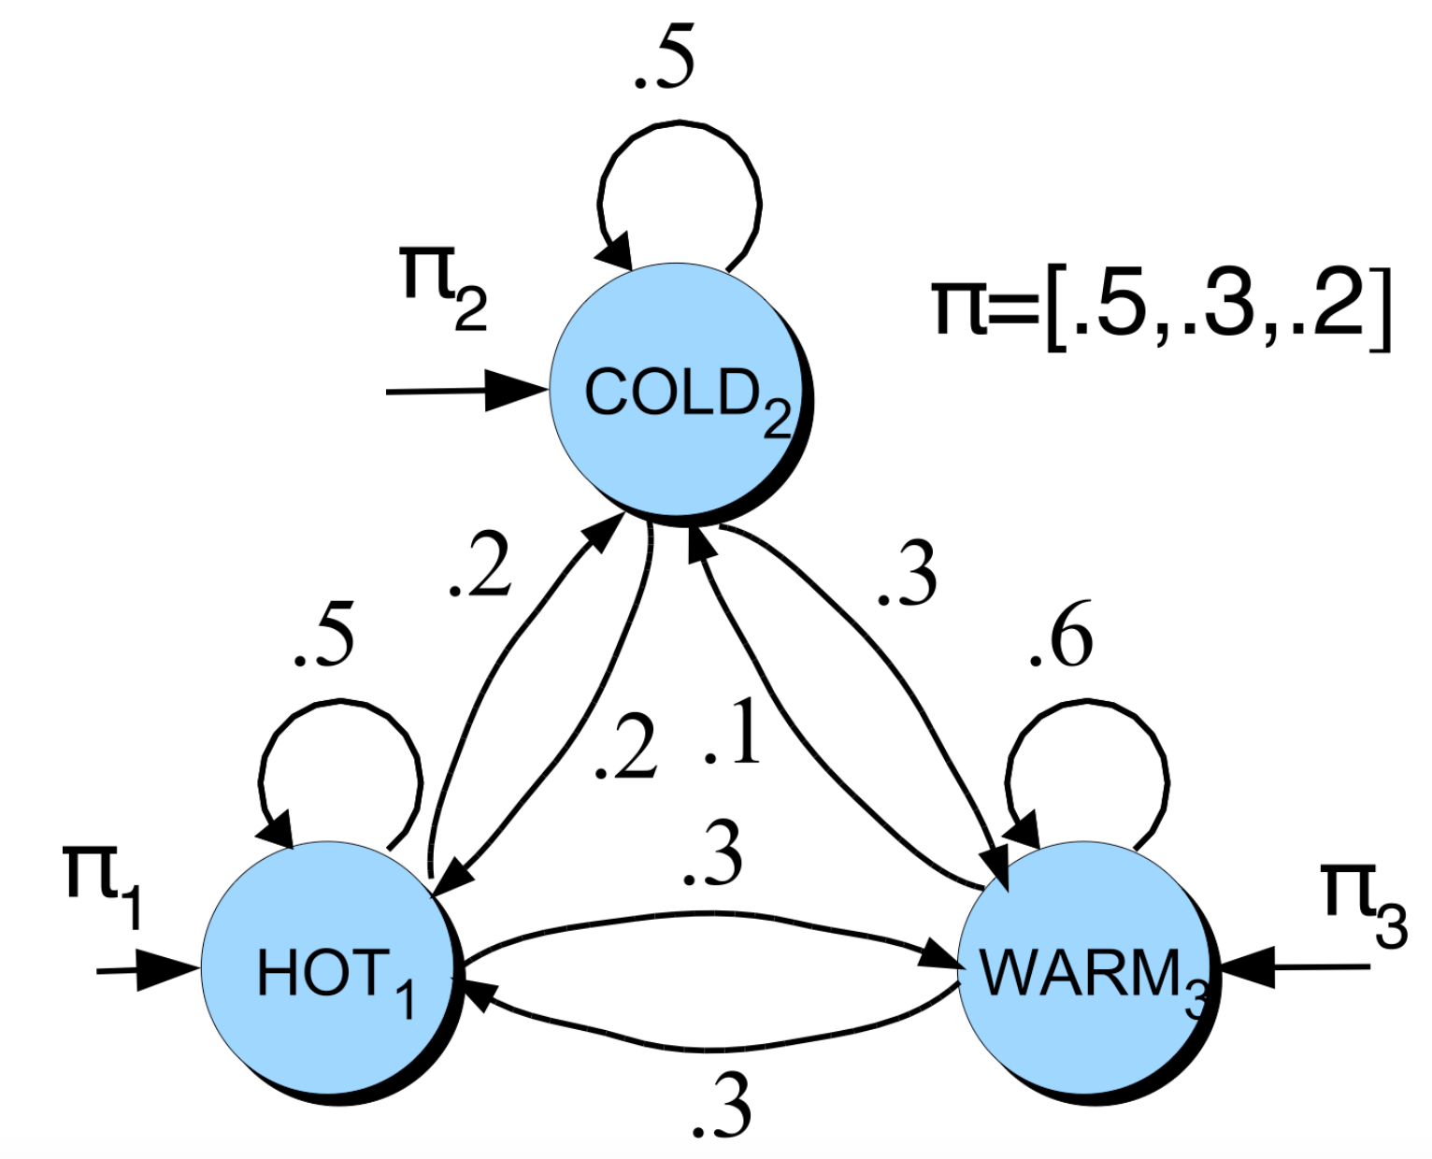
Markov Chains
Another representation for start state
What is the probability of 4 consecutive warm days?
  Sequence is warm-warm-warm-warm
  i.e., state sequence is 3-3-3-3
  P(3,3,3,3) = π3a3a3a3a= 0.2 x (0.6)3 = 0.0432

Slide 23
Hidden Markov Model (HMM)
So far we have been discussing Markov Models. We will move to Hidden Markov Models now.
Hidden Markov Model for Ice Cream
  You are a climatologist in the year 2799. Studying global warming. You can’t find any records of the weather in Sargodha, PU for summer of 2019. But you find Abu Sameer’s diary which lists how many ice-creams Abu Sameer ate every day that summer.
Our job: figure out how hot it was?

Slide 24
Hidden Markov Model (HMM)
For Markov chains, the output symbols are the same as the states.
  See hot weather: we’re in state hot
But in named-entity or part-of-speech tagging (and speech recognition and other things)
  The output symbols are words
  But the hidden states are something else
    Part-of-speech tags
    Named entity tags
So we need an extension!
A hidden Markov model (HMM) allows us to talk about both observed events (like words that we see in the input) and hidden events (like part-of-speech tags)

Slide 25
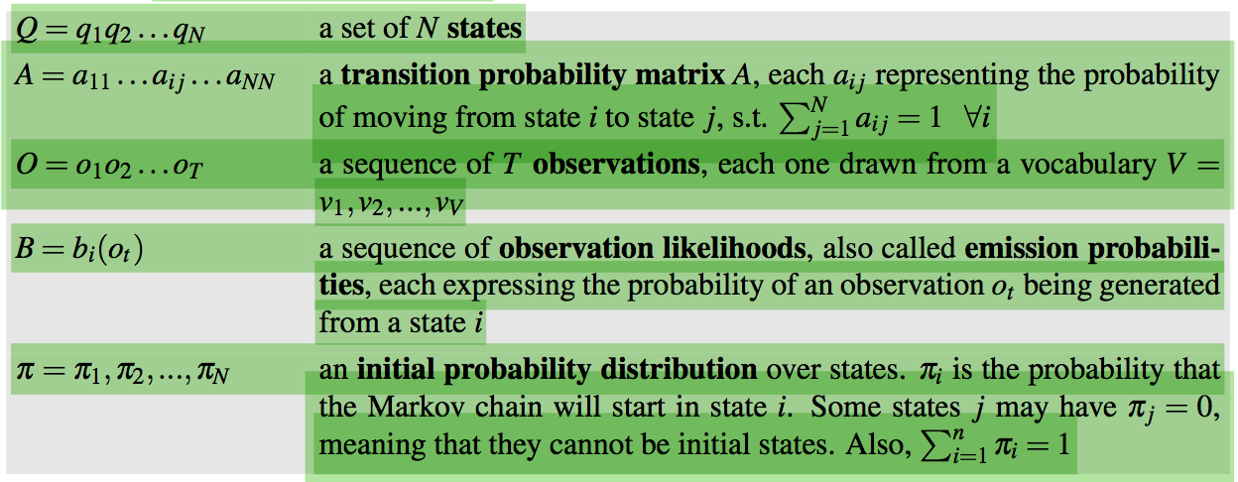
Hidden Markov Model (HMM)
An HMM is specified by the following components:
HMM Assumptions:
  Markov Assumption : P(q_{i} | q₁...q_{i−1}) = P(q_{i} | q_{i−1})
  Output Independence: P(o_{i}|q₁ ...q_{i},...,q_{T} ,o₁,...,o_{i},...,o_{T} ) = P(o_{i}|q_{i})

Slide 26




Components Of An HMM Tagger
An HMM has two components, the A and B probabilities.
  A matrix contains the tag transition probabilities P(t_{i}|t_{i-1})
    For example, modal verbs like will are very likely to be followed by a verb in the base form, a VB, like race.
    In HMM tagging, the probabilities are estimated by counting on a tagged training corpus e.g. tagged WSJ corpus.
  The B emission probabilities, P(w_{i}|t_{i})

Slide 27
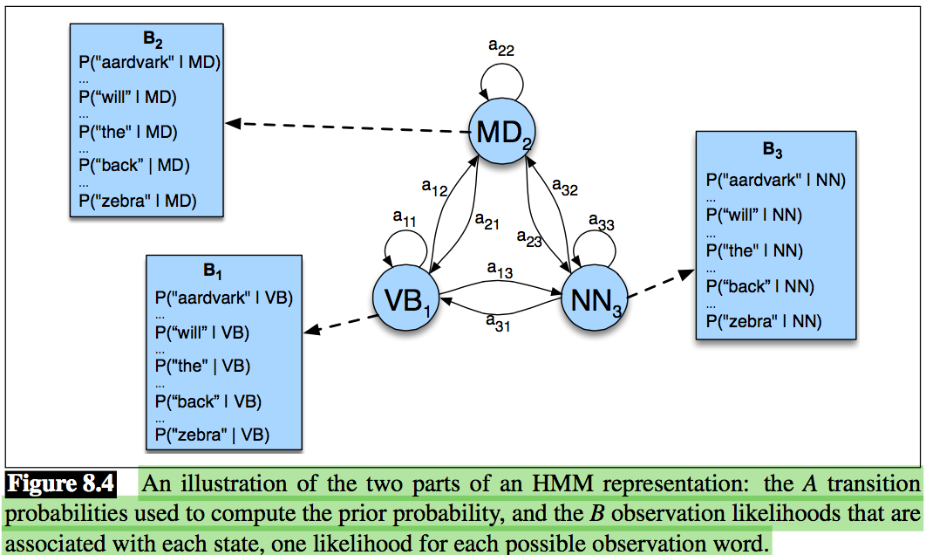
Components Of An HMM Tagger

Slide 28
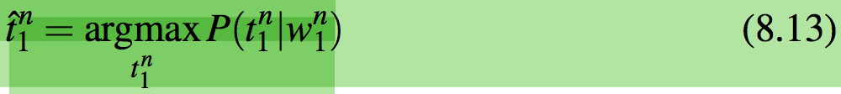
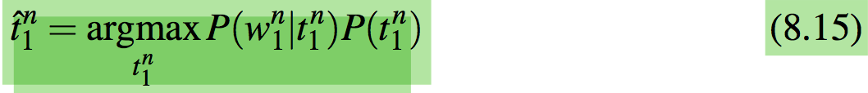
HMM tagging as decoding
Decoding: Given as input an HMM λ = (A, B) and a sequence of observations O = o₁ , o₂ , ..., o_{T} , find the most probable sequence of states Q = q₁q₂q₃ ...q_{T} .
For part of speech tagging, the goal of HMM decoding is to choose the tag sequence t₁^{n} that is most probable given the observation sequence of n words W₁^{n}.
Using Baye’s rule and by dropping the denominator P(w₁^{n}):

Slide 29
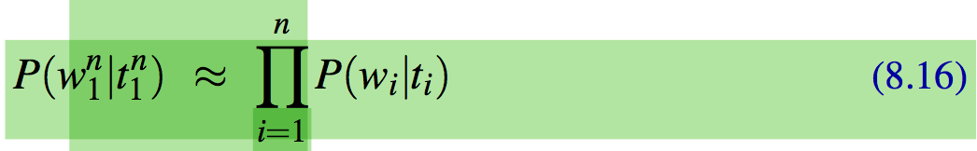
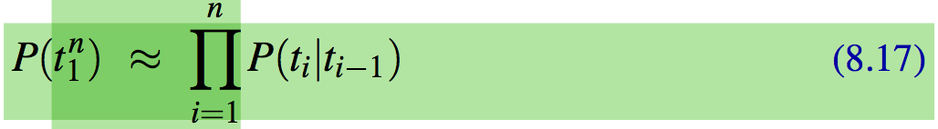
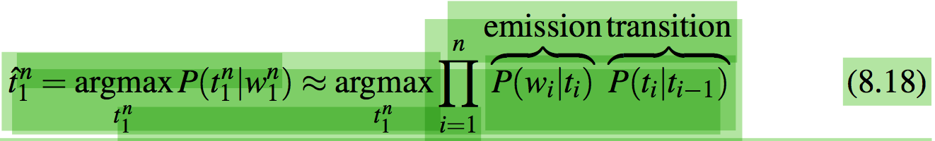
HMM tagging as decoding

Slide 30
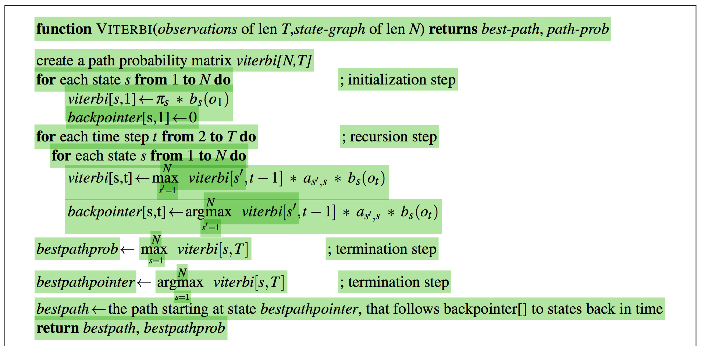
The Viterbi Algorithm
The decoding algorithm for HMMs is the Viterbi algorithm.

Slide 31
The Viterbi Algorithm
For a given state q_{j} at time t, the value v_{t}(j) is computed as
  V_{t-1}(i) the previous Viterbi path probability from the previous time step
  a_{ij} the transition probability from previous state q_{i} to current state q_{j}
  b_{j}(o_{t}) the state observation likelihood of the observation symbol o_{t} given the current state j

Slide 32
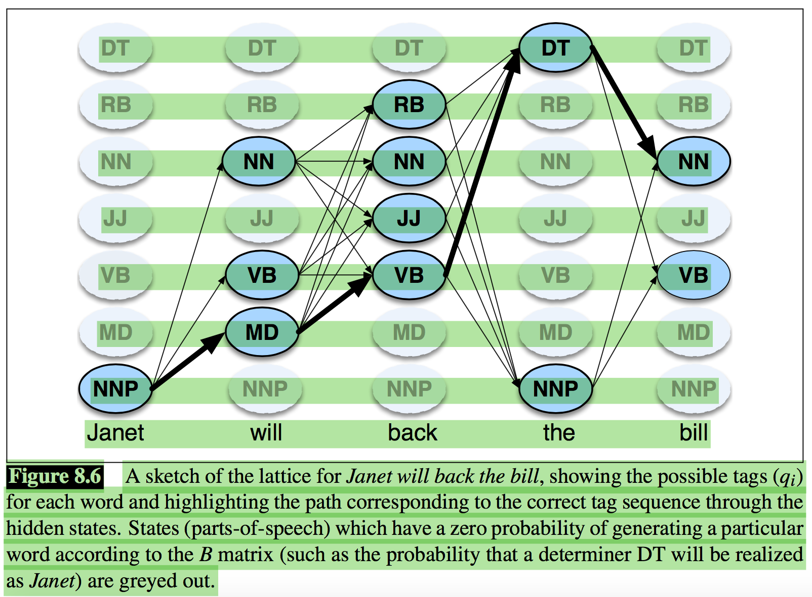
The Viterbi Algorithm

Slide 33
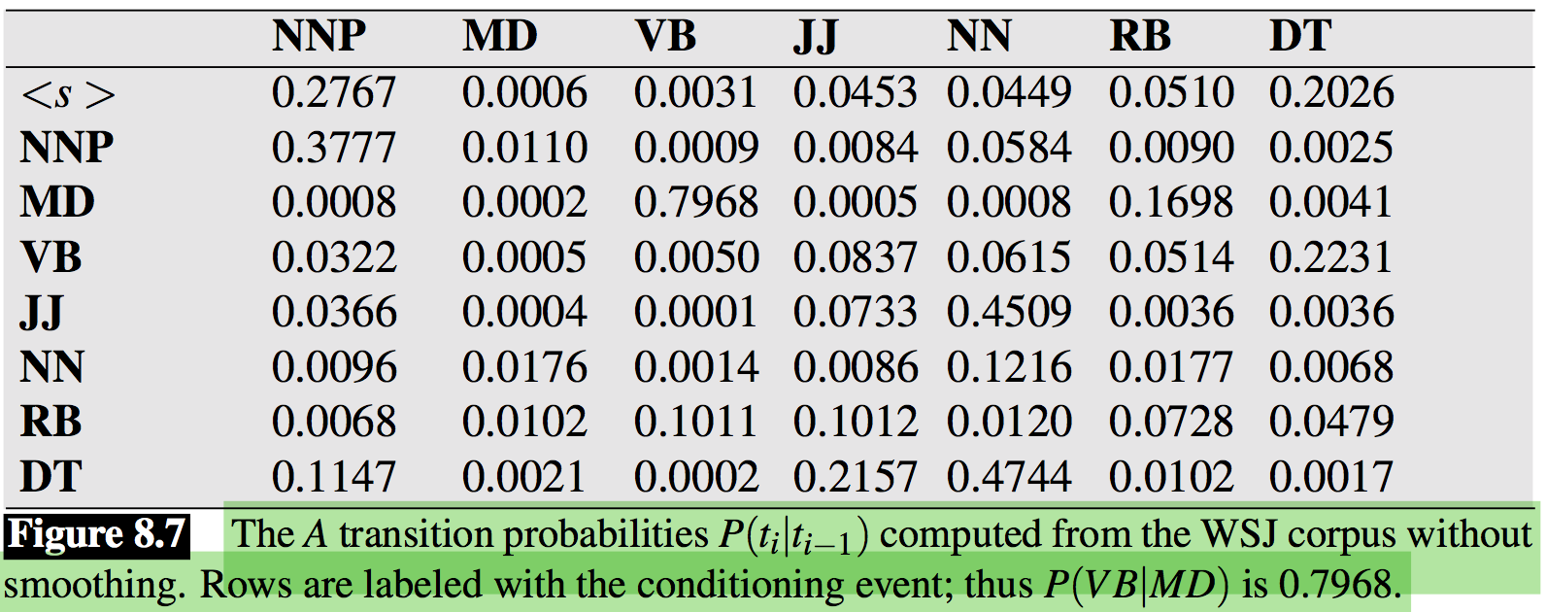
Working through an example
Let’s tag the sentence Janet will back the bill; the goal is the correct series of tags
Let the HMM is already defined by the two tables in Fig. 8.7 and Fig. 8.8 as follows.

Slide 34
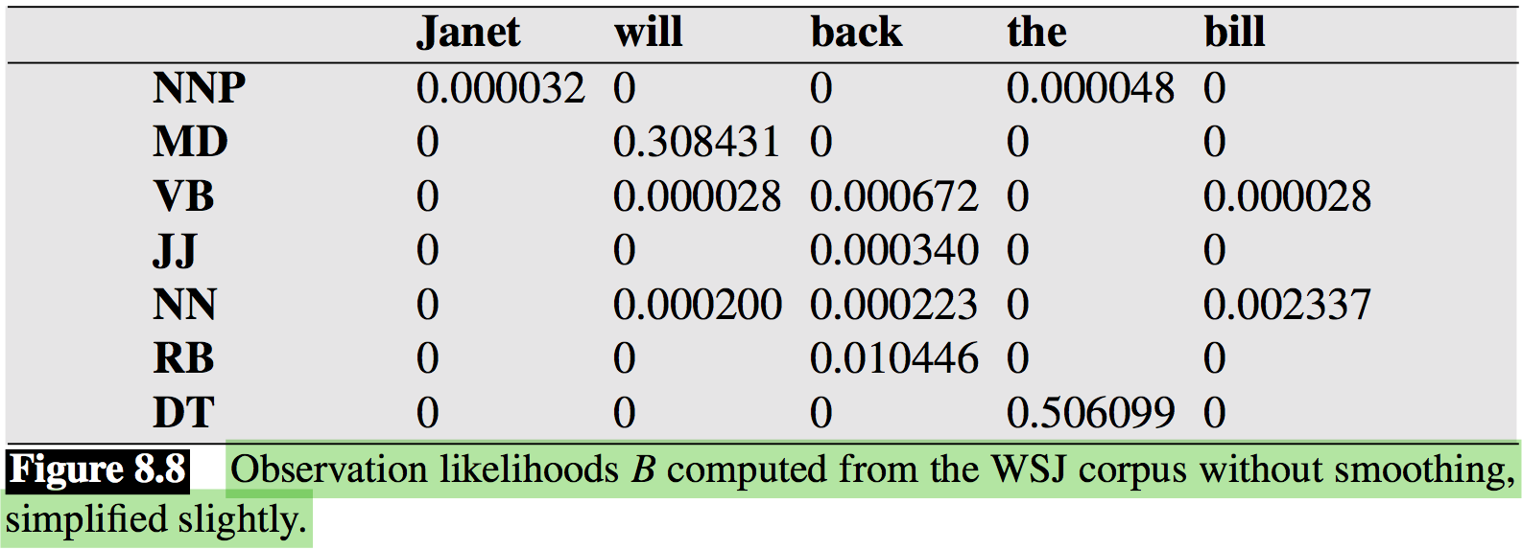
Working through an example
The Viterbi trellis for computing the best hidden state sequence for the observation sequence Janet will back the bill is given next Fig 8.9.

Slide 35
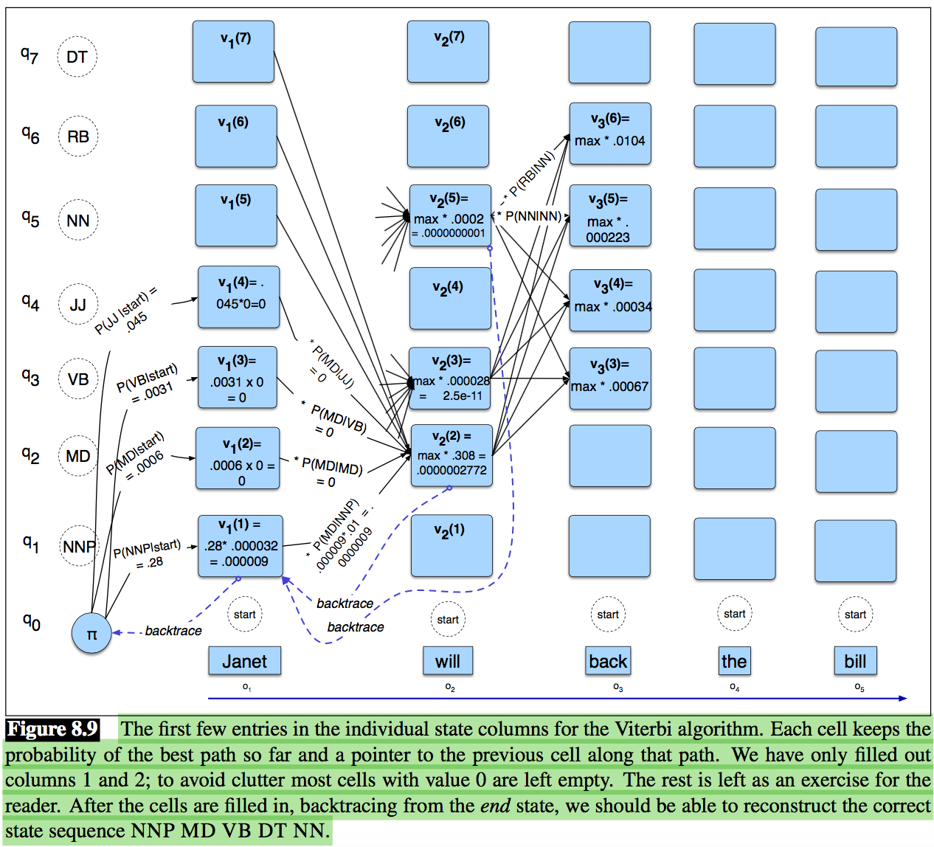
Working through an example

Slide 36
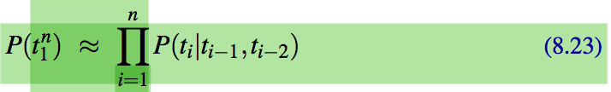
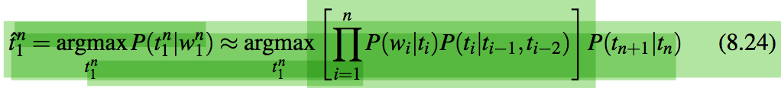
Extending the HMM Algorithm to Trigrams
Extending the HMM algorithm from bigram to trigram taggers gives a small (perhaps a half point) increase in performance.
Significant change to the Viterbi algorithm: take a max over paths from the previous two columns, thus considering N² hidden states.
HMM taggers have a number of other advanced features.
  Let the tagger know the location of the end of the sentence by adding an end-of-sequence marker for t_{n+1}.

Slide 37
Extending the HMM Algorithm to Trigrams
Three of the tags t₁, t₀, and t_{n+1}, can all be set to be a single special ‘sentence boundary’ tag that is added to the tagset, and hence will not match regular words.
One problem with trigram taggers is data sparsity can be solved using interpolation idea used in language modeling i.e. moving back to bigram or unigram probabilities.

Slide 38
Beam Search
When the number of states grows very large, the vanilla Viterbi algorithm be slow.
N can be even larger for other applications of Viterbi, for example to decoding in neural networks.
One common solution to the complexity problem is the use of beam search decoding
Instead of keeping the entire column of states at each time point t. Computes the Viterbi score for each of the N cells
Sorting the scores, and keeping only the best-scoring states. The rest are pruned out and not continued forward to time t+1.
One way to implement beam search is to keep a fixed number of states instead of all N current states.

Slide 39
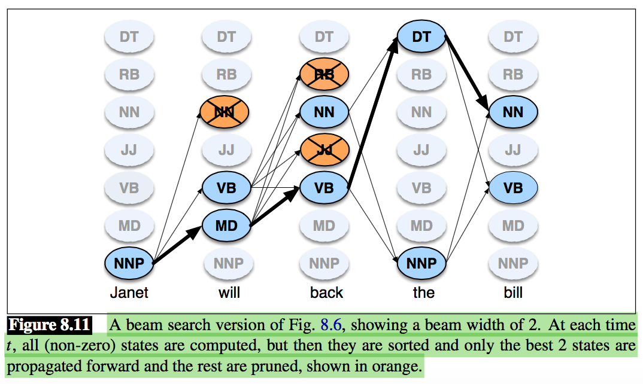
Beam Search

Slide 40
Unknown Words
To achieve high accuracy with part-of-speech taggers, a good model for dealing with unknown words is important e.g. new proper name NNP and acronyms ACRO.
Useful feature for distinguishing POS:
  Word shape:
    capital letters words can be NNP.
  Morphology:
    end in -s are likely to be plural nouns (NNS),
    words ending with -ed tend to be past participles (VBN),
    words ending with -able adjectives (JJ), and so on.
    can be enhanced to suffixes like (Brants, 2000) tagging accuracy of which is 96.7% on the Penn Treebank, slightly below the best MEMM and neural taggers.

Slide 41
Maximum Entropy Markov Models
Read it yourself from Section 8.5 of NLP book
Read it yourself from Section 8.6 of NLP book
Read it yourself from Section 8.7 of NLP book
Bidirectionality
Part-of-Speech Tagging for Other Languages

Slide 42
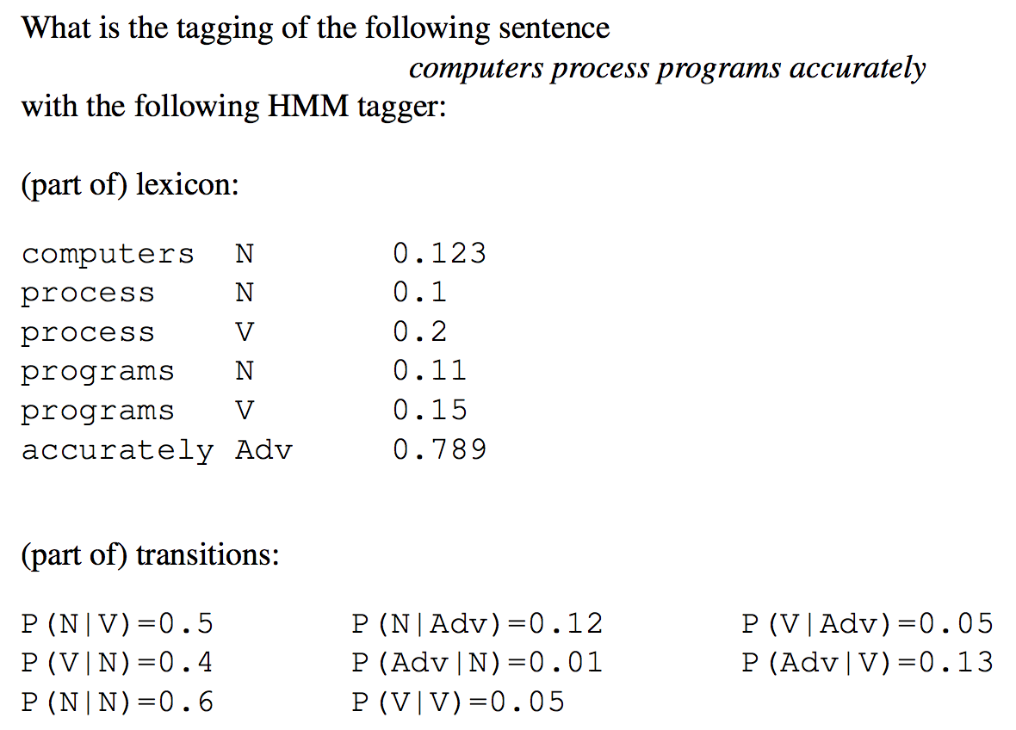
Exercises
Exercise I:

Slide 43
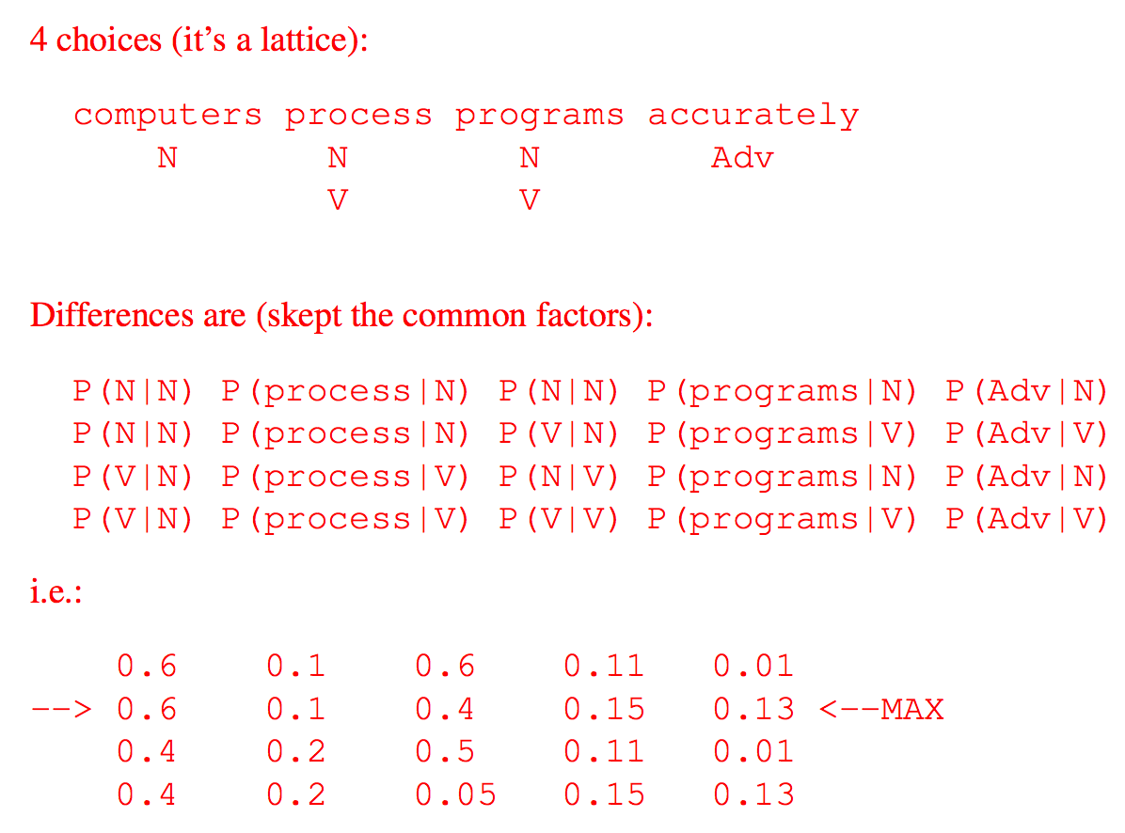
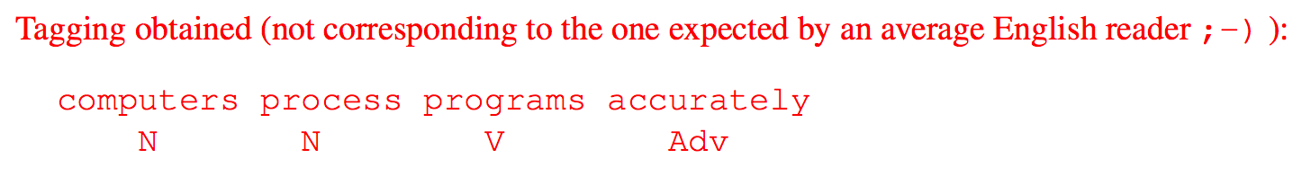
Exercises
Solution I:

Slide 44
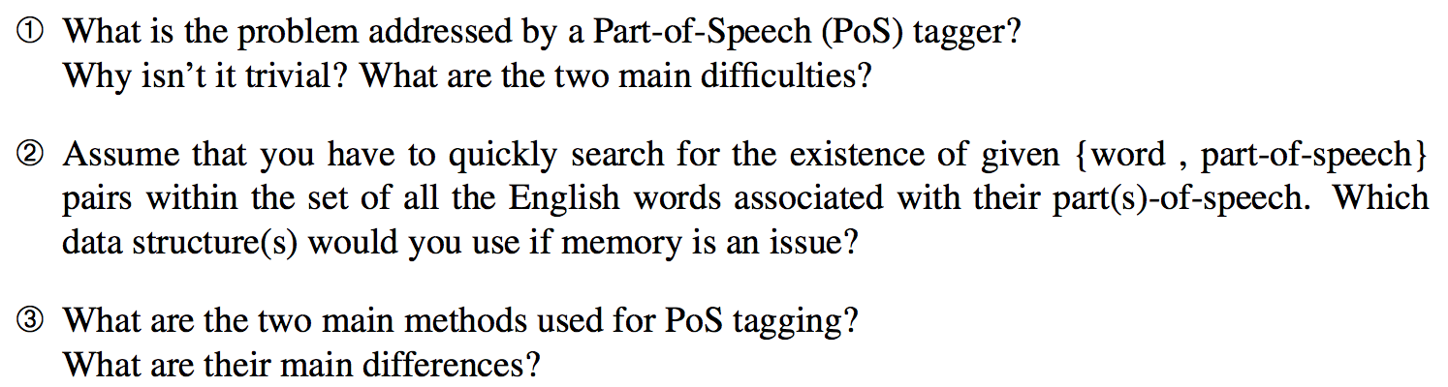
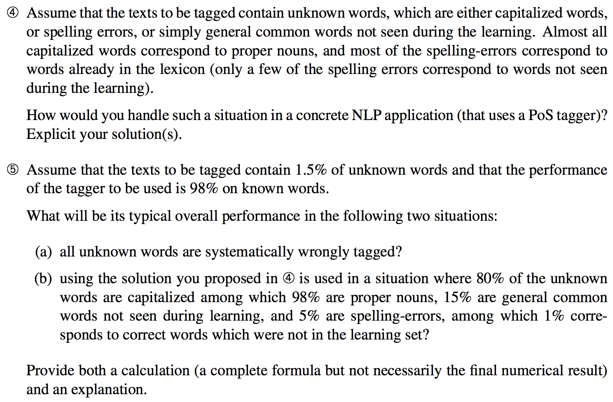
Exercises
Exercise II:

Slide 45
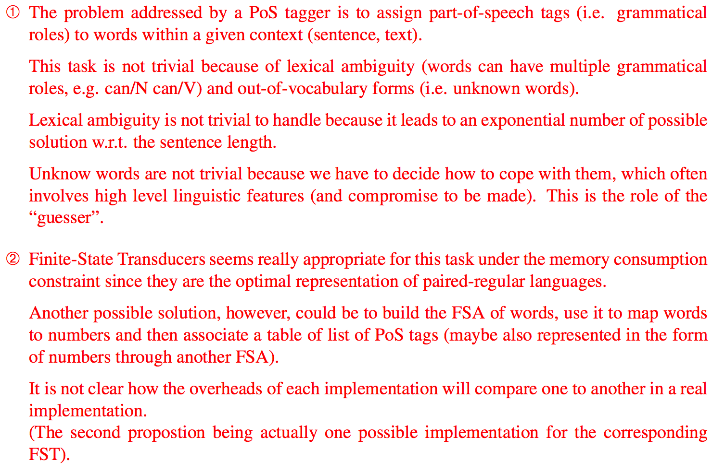
Exercises
Solution II:

Slide 46
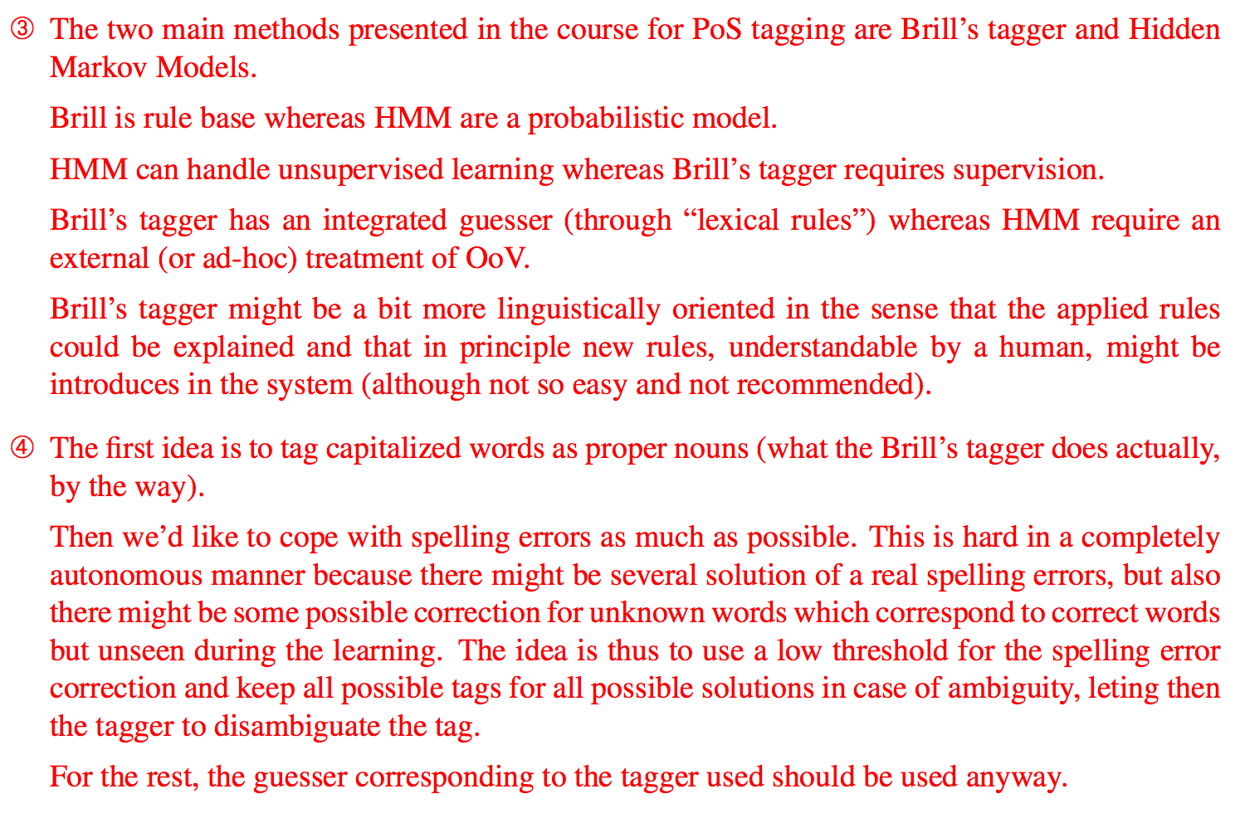
Exercises
Solution II:

Slide 47
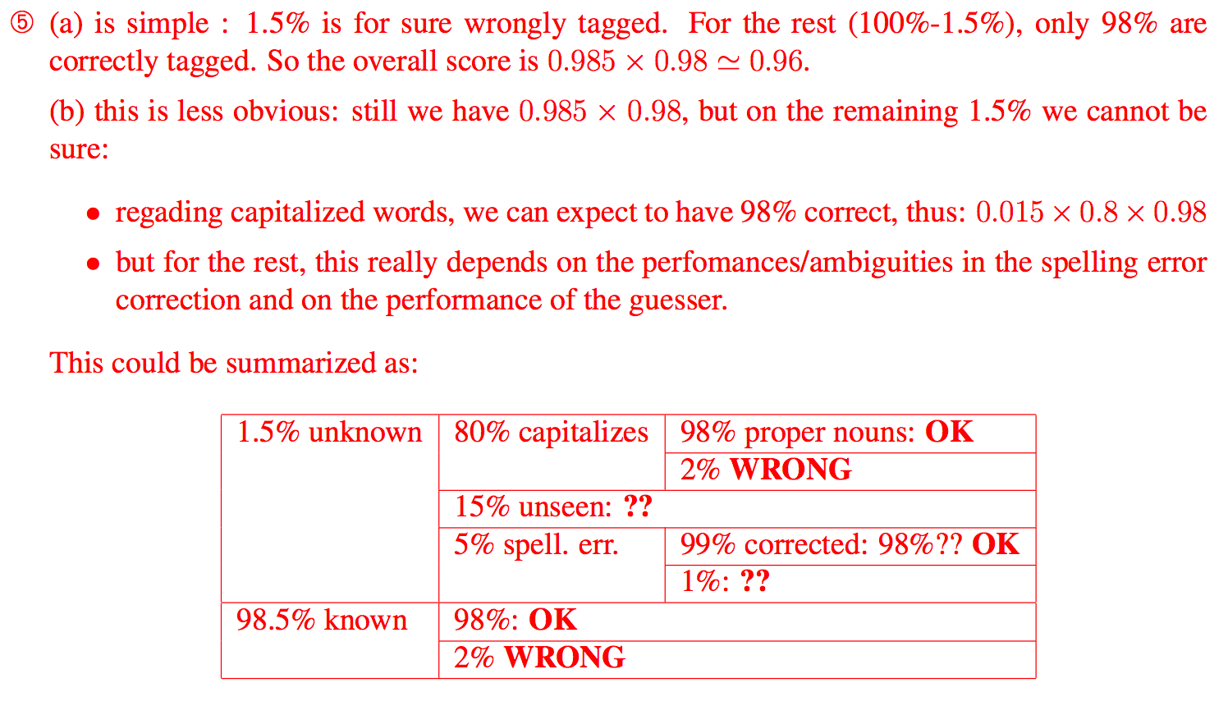
Exercises
Solution II:

Slide 48
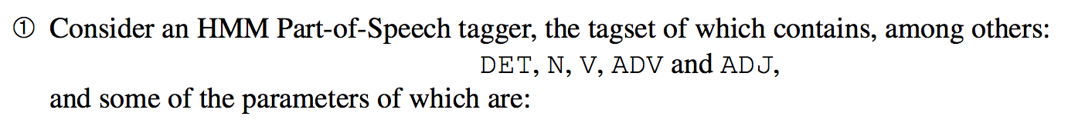
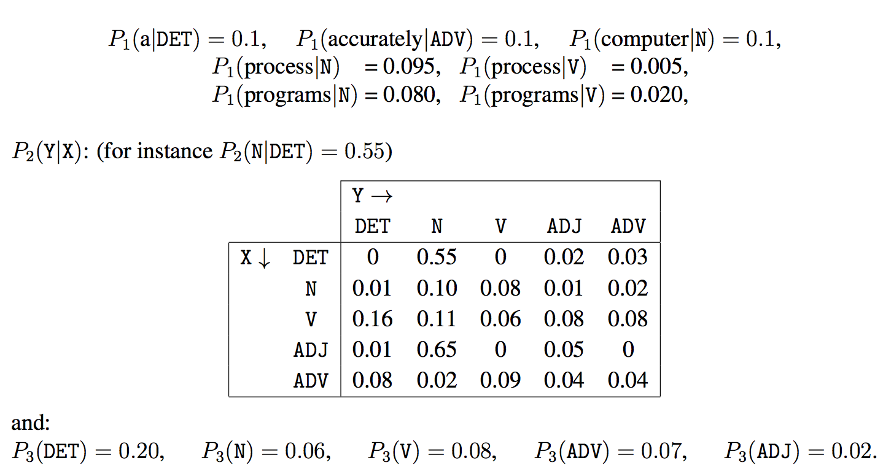
Exercises
Exercise III With Solution:

Slide 49

Exercises
Exercise III With Solution:

Slide 50
Home Work # 3
Configure the following POS tagger available at https://github.com/melanietosik/viterbi-pos-tagger . Try to produce achieve result on some different test set and submit the report. Also be ready for the presentation.
Configure the following Stanford MEMM POS tagger available at https://nlp.stanford.edu/software/tagger.shtml . Change the test data and submit the result accordingly. Also ready for the presentations soon.

Slide 51
References
E. M. Bennett, R. Alpert, and A. Goldstein. Communications Through Limited- Response Questioning. Public Opinion Quarterly, 18(3):303–308, 1954.
W. A. Scott. Reliability Of Content Analysis: The Case Of Nominal Scale Coding. Public opinion quarterly, 1955.
J. Cohen et al. A Coecient Of Agreement For Nominal Scales. Educational and psychological measurement, 20(1):37–46, 1960.
K. Krippendorff. Content Analysis: An Introduction To Its Methodology. Sage, 2012.
Abbas, Q. (2014b). Building Computational Resources: The URDU. KON-TB Treebank and the Urdu Parser (Doctoral dissertation)
Abbas, Q. (2014a). Semi-semantic part of speech annotation and evaluation. LAW VIII, 75.
Abbas, Q. 2016. Semi-Semantic Annotation: A guideline for the URDU. KON-TB treebank POS annotation. Acta Linguistica Asiatica, 6(2), 97-134.
Abbas, Q. 2012. Building a Hierarchical Annotated Corpus of Urdu: The URDU.KON-TB Treebank. Lecture Notes in Computer Science (LNCS). Vol. 7181(1), P 66-79, ISSN 0302-9743, Springer-Verlag Berlin/Heidelberg.
Abbas, Q. 2015, Morphologically rich Urdu grammar parsing using Earley algorithm, Natural Language Engineering (NLE), Vol.21(2), PP.1-36, ISSN: 1351-3249, DOI: 10.1017/S1351324915000133, Cambridge University Press, UK
Brants, T. (2000). TnT: A statistical part-of-speech tagger. In ANLP 2000, Seattle, WA, pp. 224–231.

