Slide 1
Enterprise Application Development With Java EE
Dr. Qaiser Abbas
Department of Computer Science & IT,
University of Sargodha
qaiser.abbas@uos.edu.pk

Slide 2
Java Mail
The JavaMail is an API that is used to compose, write and read electronic messages (emails).
The JavaMail API provides protocol-independent and plateform-independent framework for sending and receiving mails.
The javax.mail and javax.mail.activation packages contains the core classes of JavaMail API.
The JavaMail facility can be applied to many events. It can be used at the time of registering the user (sending notification such as thanks for your interest to my site), forgot password (sending password to the users email id), sending notifications for important updates etc. So there can be various usage of java mail api.

Slide 3
Do You Know?
How to send and receive email using JavaMail API ?
How to send email through gmail server ?
How to send and receive email with attachment ?
How to send email with html content including images?
How to forward and delete the email ?
In this lecture, we will do all these things.

Slide 4
Protocols used in JavaMail API
There are some protocols that are used in JavaMail API.
SMTP
POP
IMAP
MIME
NNTP and others

Slide 5
SMTP
SMTP is an acronym for Simple Mail Transfer Protocol. It provides a mechanism to deliver the email. We can use Apache James server, Postcast server, cmail server etc. as an SMTP server. But if we purchase the host space, an SMTP server is by default provided by the host provider. For example, my smtp server is mail.clsp.org or smpt.gmail.com (for Gmail). If we use the SMTP server provided by the host provider, authentication is required for sending and receiving emails.

Slide 6
POP
POP is an acronym for Post Office Protocol, also known as POP3. It provides a mechanism to receive the email. It provides support for single mail box for each user. We can use Apache James server, cmail server etc. as an POP server. But if we purchase the host space, an POP server is by default provided by the host provider. For example, the pop server provided by the host provider for my site is mail.clsp.org or pop.gmail.com (Gmail). This protocol is defined in RFC 1939.

Slide 7
IMAP
IMAP is an acronym for Internet Message Access Protocol. IMAP is an advanced protocol for receiving messages. It provides support for multiple mail box for each user ,in addition to, mailbox can be shared by multiple users. It is defined in RFC 2060.

Slide 8
MIME
Multiple Internet Mail Extension (MIME) tells the browser what is being sent e.g. attachment, format of the messages, etc. It is not known as mail transfer protocol but it is used by your mail program.

Slide 9
NNTP and Others
There are many protocols that are provided by third-party providers. Some of them are Network News Transfer Protocol (NNTP), Secure Multipurpose Internet Mail Extensions (S/MIME) etc.

Slide 10
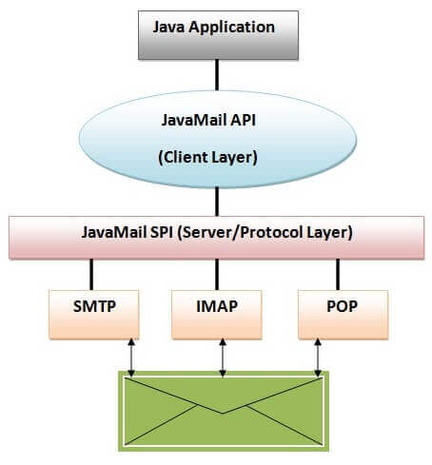
JavaMail Architecture
The java application uses JavaMail API to compose, send and receive emails. The JavaMail API uses SPI (Service Provider Interfaces) that provides the intermediatory services to the java application to deal with the different protocols. Let's understand it with the figure:

Slide 11
JavaMail API Core Classes
There are two packages that are used in Java Mail API: javax.mail and javax.mail.internet package. These packages contains many classes for Java Mail API. They are:
javax.mail.Session class
javax.mail.Message class
javax.mail.internet.MimeMessage class
javax.mail.Address class
javax.mail.internet.InternetAddress class
javax.mail.Authenticator class
javax.mail.PasswordAuthentication class
javax.mail.Transport class
javax.mail.Store class
javax.mail.Folder class etc.
We will know about these classes one by one when it is getting used.

