Slide 1
Enterprise Application Development With Java EE
Dr. Qaiser Abbas
Department of Computer Science & IT,
University of Sargodha
qaiser.abbas@uos.edu.pk

Slide 2
Course Outcomes
Learning Java EE Architecture
Java web application development
Learning Web Core Technologies: Servlets and JSP
Java Data Base Connectivity (JDBC) Architecture
Business Component Development
Learn how to use IDE for Java EE application development
Use Eclipse for Java EE Developers
Exposure to lots and lots of working examples / applications
Learn how to build and deploy Java Enterprise Applications through hands-on work

Slide 3
What is Java?
Java is a programming language and a platform. Java is a high level, robust, object-oriented and secure programming language.
Java was developed by Sun Microsystems (which is now the subsidiary of Oracle) in the year 1995. James Gosling is known as the father of Java. Before Java, its name was Oak. Since Oak was already a registered company, so James Gosling and his team changed the name from Oak to Java.
Platform: Any hardware or software environment in which a program runs, is known as a platform. Since Java has a runtime environment (JRE) and API, it is called a platform.

Slide 4
Java Example
class Simple{
public static void main(String args[]){
System.out.println("Hello Java");
}
}

Slide 5
Types of Java Applications
1) Standalone Application
Standalone applications are also known as desktop applications or window-based applications. Examples of standalone application are Media player, antivirus, etc. AWT and Swing are used in Java for creating standalone applications.
2) Web Application
An application that runs on the server side and creates a dynamic page is called a web application. Currently, Servlet, JSP, Struts, Spring, Hibernate, JSF, etc. technologies are used for creating web applications in Java.
3) Enterprise Application
An application that is distributed in nature, such as banking applications, etc. is called an enterprise application. It has advantages like high-level security, load balancing, and clustering. In Java, EJB is used for creating enterprise applications.
4) Mobile Application
An application which is created for mobile devices is called a mobile application. Currently, Android and Java ME are used for creating mobile applications.

Slide 6
Java Platforms / Editions
1) Java SE (Java Standard Edition)
It includes Java programming APIs such as java.lang, java.io, java.net, java.util, java.sql, java.math etc. It includes core topics like OOPs, String, Regex, Exception, Inner classes, Multithreading, I/O Stream, Networking, AWT, Swing, Reflection, Collection, etc.
2) Java EE (Java Enterprise Edition)
It is an enterprise platform that is mainly used to develop web and enterprise applications. It is built on top of the Java SE platform. It includes topics like Servlet, JSP, Web Services, EJB, JPA, etc.
3) Java ME (Java Micro Edition)
It is a micro platform that is dedicated to mobile applications.
4) JavaFX
It is used to develop rich internet applications. It uses a lightweight user interface API.

Slide 7
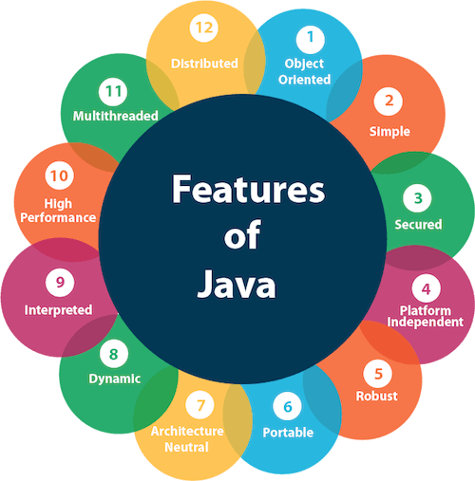
Features of Java
The features of Java are also known as Java buzzwords. A list of the most important features of the Java language is given below.

Slide 8
C++ vs Java
Comparison Index | C++ | Java
Platform-independent | C++ is platform-dependent. | Java is platform-independent.
Mainly used for | C++ is mainly used for system programming. | Java is mainly used for application programming. It is widely used in Windows-based, web-based, enterprise, and mobile applications.
Design Goal | C++ was designed for systems and applications programming. It was an extension of the C programming language. | Java was designed and created as an interpreter for printing systems but later extended as a support network computing. It was designed to be easy to use and accessible to a broader audience.
Goto | C++ supports the goto statement. | Java doesn't support the goto statement.
Multiple inheritance | C++ supports multiple inheritance. | Java doesn't support multiple inheritance through class. It can be achieved by using interfaces in java.
Operator Overloading | C++ supports operator overloading. | Java doesn't support operator overloading.
Pointers | C++ supports pointers. You can write a pointer program in C++. | Java supports pointer internally. However, you can't write the pointer program in java. It means java has restricted pointer support in java.

Slide 9
C++ vs Java
Compiler and Interpreter | C++ uses compiler only. C++ is compiled and run using the compiler which converts source code into machine code so, C++ is platform dependent. | Java uses both compiler and interpreter. Java source code is converted into bytecode at compilation time. The interpreter executes this bytecode at runtime and produces output. Java is interpreted that is why it is platform-independent.
Call by Value and Call by reference | C++ supports both call by value and call by reference. | Java supports call by value only. There is no call by reference in java.
Structure and Union | C++ supports structures and unions. | Java doesn't support structures and unions.
Thread Support | C++ doesn't have built-in support for threads. It relies on third-party libraries for thread support. | Java has built-in thread support.
Documentation comment | C++ doesn't support documentation comments. | Java supports documentation comment (/** ... */) to create documentation for java source code.
Virtual Keyword | C++ supports virtual keyword so that we can decide whether or not to override a function. | Java has no virtual keyword. We can override all non-static methods by default. In other words, non-static methods are virtual by default.

Slide 10
C++ vs Java
unsigned right shift >>> | C++ doesn't support >>> operator. | Java supports unsigned right shift >>> operator that fills zero at the top for the negative numbers. For positive numbers, it works same like >> operator.
Inheritance Tree | C++ always creates a new inheritance tree. | Java always uses a single inheritance tree because all classes are the child of the Object class in Java. The Object class is the root of the inheritance tree in java.
Hardware | C++ is nearer to hardware. | Java is not so interactive with hardware.
Object-oriented | C++ is an object-oriented language. However, in the C language, a single root hierarchy is not possible. | Java is also an object-oriented language. However, everything (except fundamental types) is an object in Java. It is a single root hierarchy as everything gets derived from java.lang.Object.

Slide 11
Eclipse IDE for Java development
The Eclipse IDE (integrated development environment) provides strong support for Java developer and Eclipse has been around for years now as an extremely popular IDE for multiple programming languages.
Eclipse can be extended with additional software components called plug-ins.
Eclipse IDE downloads provides Eclipse distributions for different use cases.
It includes support for the Maven and Gradle build system, support for the Git version control system, etc.
The latest Eclipse IDE installer requires Java version 8 or later installed on your system.

Slide 12
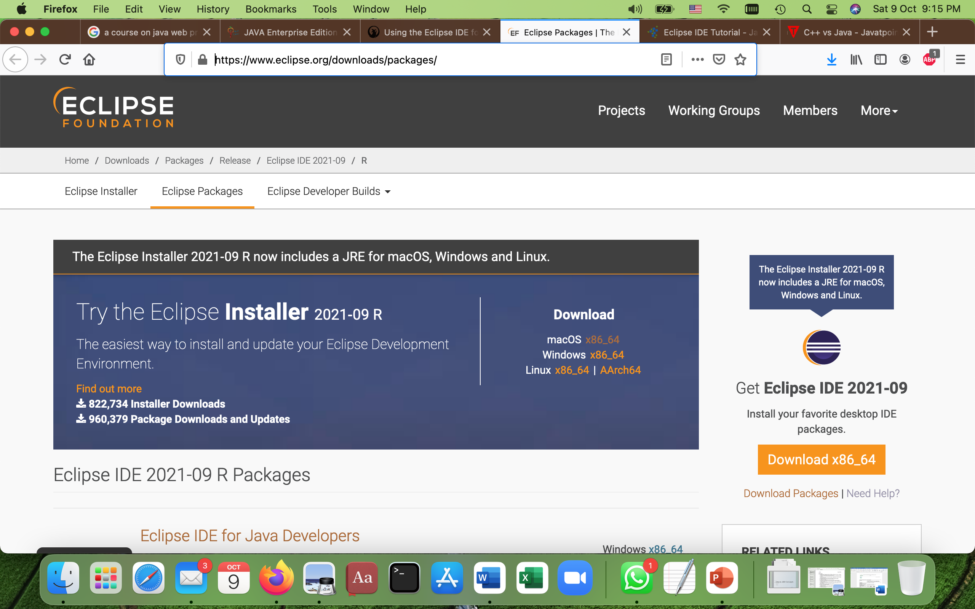
Install the Eclipse Java IDE
Download the installer via https://eclipse.org/downloads/eclipse-packages/

Slide 13
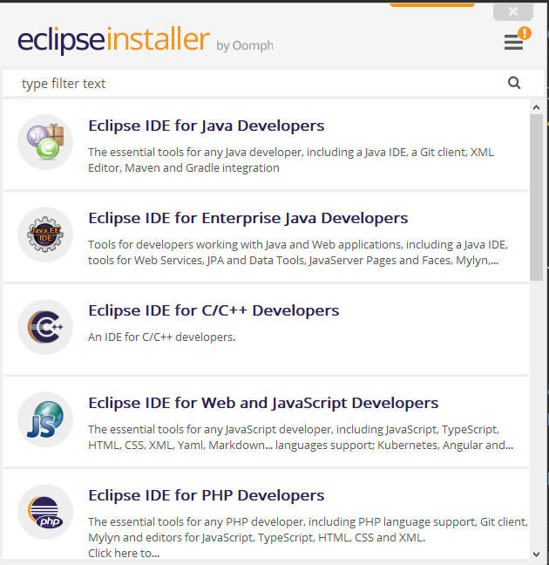
Install the Eclipse Java IDE
On Linux you have to unzip it before you can start it. On Mac the installer is delivered as packaged application and can be installed and started regular Mac installation procedures. On Windows and Mac you can run it directly via the delivered executable / package application.
Pick Eclipse IDE for Enterprise Java Developers from the list and perform the installation.

Slide 14
Challenge if happens
This challenge is an error showing Unable to start Java Virtual Machine. If at all you encounter such an error, there are two possible reasons for the same:
Missing Java Home Environment variable: JDK/JRE is installed but you missed to declare JAVA_HOME environment variable.
Missing JDK/JRE: Enter java –version on terminal/command prompt. If the version shows up, then Eclipse probably did not find it.
Solution: Add the path to the VM in eclipse.ini file. In case of MacOS, you could open up the Eclipse.app package and navigate to Contents->Eclipse->eclipse.ini. In case of Linux or Windows OS, the file could be found in the installation directly of Eclipse easily. The VM path can be added in the first two lines as shown below:
-vm
/usr/bin/
-startup
…………………………….

Slide 15
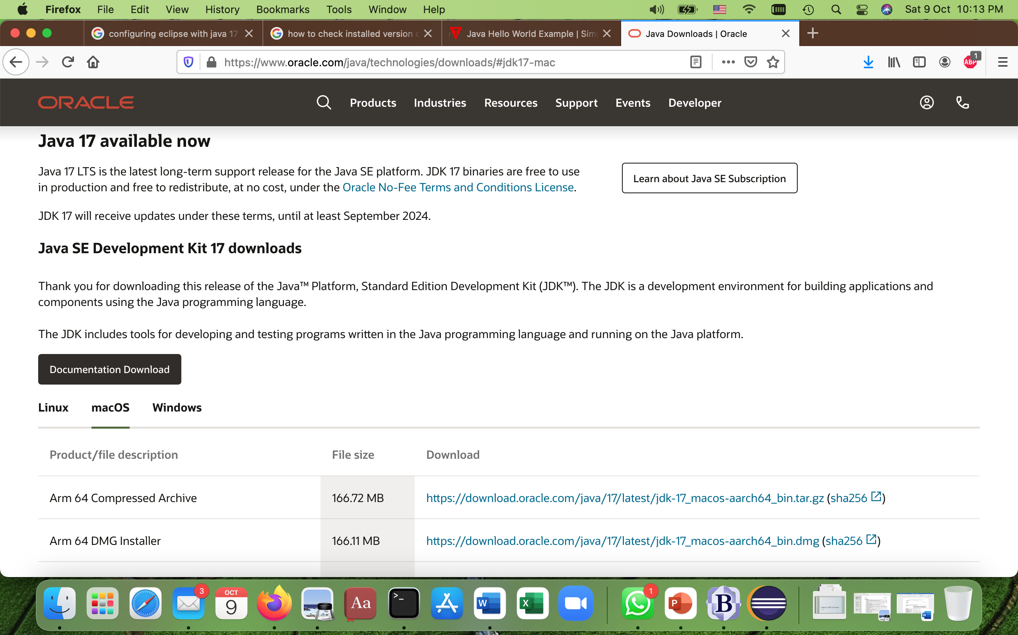
Hello World Example (Without Eclipse)
For executing any Java program, the following software or application must be properly installed.
Install the JDK if you don't have installed it, download the JDK and install it.
Set path of the jdk/bin directory.
Create the Java program
Compile and run the Java program

Slide 16
Hello World Example (Without Eclipse)
Setting Permanent Java Path:
Go to MyPC properties
Click on Advanced system settings
Click on Environment Variables
Click on New button of User variables
Write the path in the variable name
Setting Permanent Java Path:
Write the path in the variable name
Copy the path of the JDK bin folder
Paste path of bin folder in Variable value
Click on OK button
Click on ok button again

Slide 17
Hello World Example (Without Eclipse)
Create the Java program in any editor and name it as “helloWorld.java”
To compile on terminal: javac helloworld.java
To execute on terminal: java helloworld
public class helloWorld { public static void main(String[] args) { System.out.println("Hello World"); } }

Slide 18
Hello World Example (With Eclipse)
Open Eclipse
Click on New Java Project with or without module
Right Click on ’src’ in created Java Project and select ‘New’ and then ‘Class’
Give class name “helloWorld”, click option of ‘public static void main(String[] args)’ and press ok.
Press ‘Run’ button and see the output.
public class helloWorld {
public static void main(String[] args) {
// TODO Auto-generated method stub
System.out.println("Hello World");
}
}

Slide 19
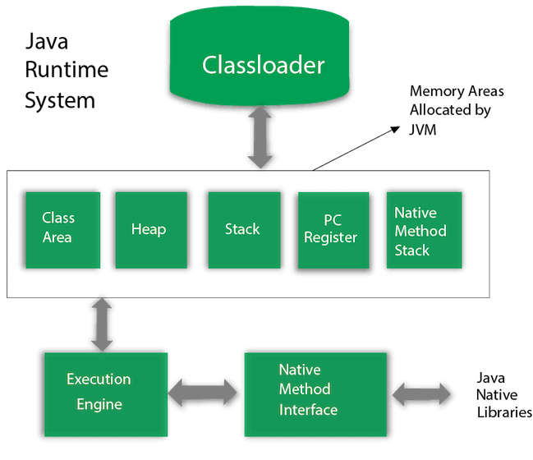
Difference between JDK, JRE, and JVM
What is JVM?
A specification where working of Java Virtual Machine is specified. But implementation provider is independent to choose the algorithm. Its implementation has been provided by Oracle and other companies.
An implementation Its implementation is known as JRE (Java Runtime Environment).
Runtime Instance Whenever you write java command on the command prompt to run the java class, an instance of JVM is created.
The JVM performs following operation:
Loads code
Verifies code
Executes code
Provides runtime environment
JVMs are available for many hardware and software platforms. JVM, JRE, and JDK are platform dependent because the configuration of each OS is different from each other. However, Java is platform independent.

Slide 20
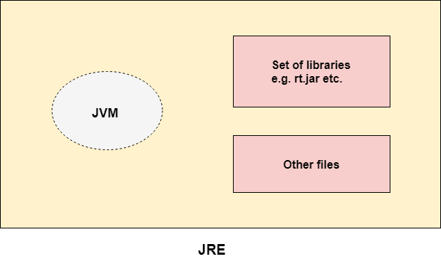
Difference between JDK, JRE, and JVM
What is JRE?
JRE/RTE is Java Runtime Environment. The JREis a set of software tools which are used for developing Java applications. It is used to provide the runtime environment. It is the implementation of JVM. It physically exists. It contains a set of libraries + other files that JVM uses at runtime.
The implementation of JVM is also actively released by other companies besides Sun Micro Systems.

Slide 21
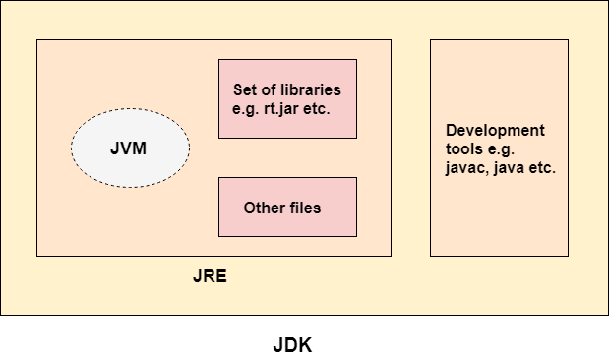
Difference between JDK, JRE, and JVM
What is JDK?
JDK is Java Development Kit, which is a software development environment used to develop Java applications and applets. It physically exists. It contains JRE + development tools.
JDK is an implementation of any one of the below given Java Platforms released by Oracle Corporation:
Standard Edition Java Platform
Enterprise Edition Java Platform
Micro Edition Java Platform
The JDK contains a private Java Virtual Machine (JVM) and a few other resources such as an interpreter/loader (java), a compiler (javac), an archiver (jar), a documentation generator (Javadoc), etc. to complete the development of a Java Application.

